Slide 1
Senior leaders programme

Slide 2
Overall aim of the programme
For delegates to know and be able to articulate what PBS is, understand the conditions needed for PBS to be implemented and what actions they need to take to monitor, sustain it, and continuously improve PBS practice.

Slide 3
Programme structure
1
2
3
4
Four modules.
Development work in between.
Continuous assessment and feedback.
You may choose to focus on one service as a pilot.

Slide 4
Modules
Module one: Introductory module.
Module two: Establishing conditions for implementation of PBS.
Module three: Monitoring and sustaining PBS.
Module four: Continuous improvement.

Slide 5
Preventative Support 3 tiers

Slide 7
What does good PBS look like now?
Download this document at: https://bit.ly/3Gjf06r

Slide 8
Critical factors for success
Factors critical to PBS being successfully implemented include:
The presence of skilled empathic mediators (those also deliver the direct support) (Allen et al 2013, Denne et al, 2013, 2015).
Practice leaders (Denne et al, 2015, Deveau and McGill, 2014).
Access to appropriate levels of behavioural expertise.
Organisational structures that support implementation (Allen, 2011).

Slide 10
Outcomes
What outcomes do you want from adopting PBS across your organisation?
How will we know it is working and making improvements to everyone’s quality of life?

Slide 11
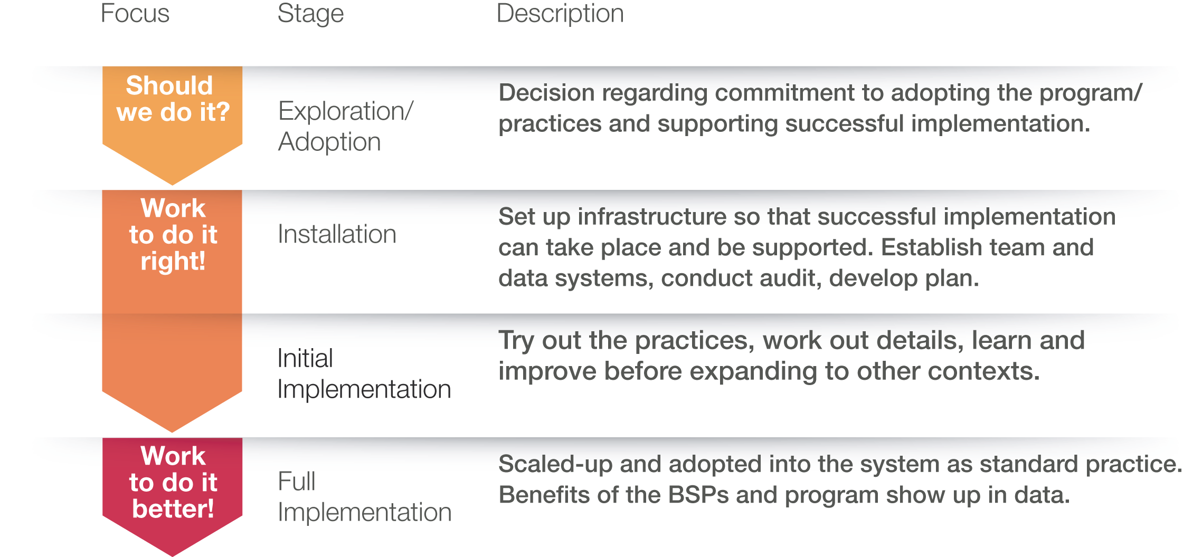
The four stages of implementation

Slide 12
Thank you
www.bild.org.uk

