Slide 1
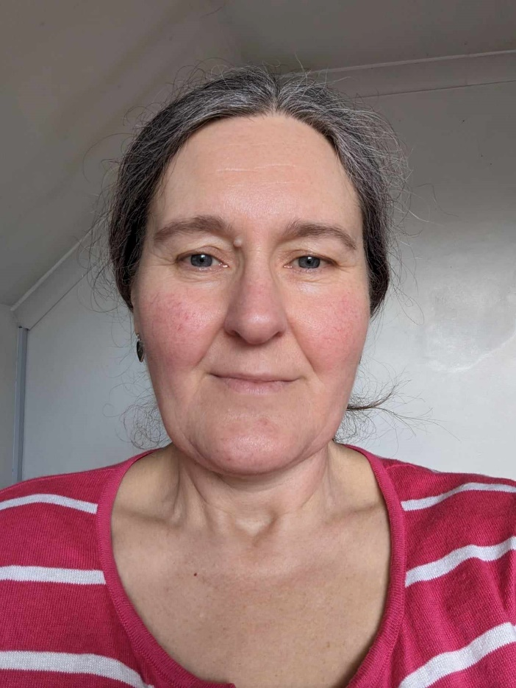
A peer review process for PBS training
Marie Lovell
October 2024
Marie.lovell@skillsforcare.org.uk

Slide 2
Notes:
Skills for Care’s remit is Adult Social care in England. However, people can participate in the peer review process who deliver training in other parts of the UK or to health or schools if they feel it will be helpful to them.

Slide 3
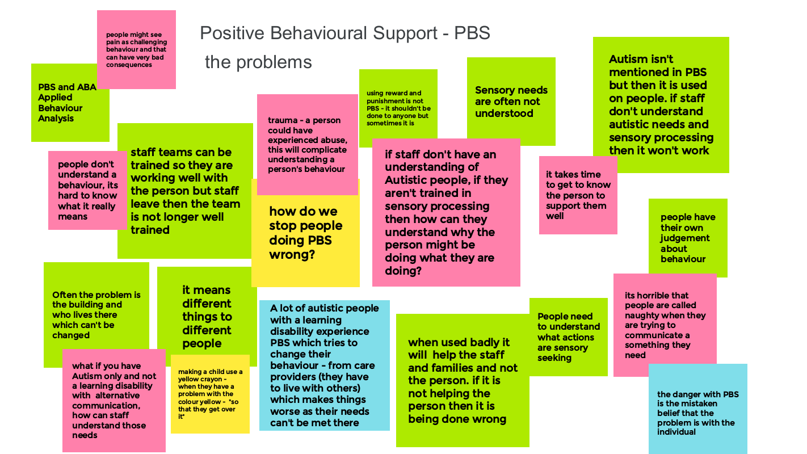
We asked our workforce expert advisory group – what are the problems with PBS?
Notes:
These were comments from our experts by experience advisory group

Slide 4
©Chris Burns

Slide 5
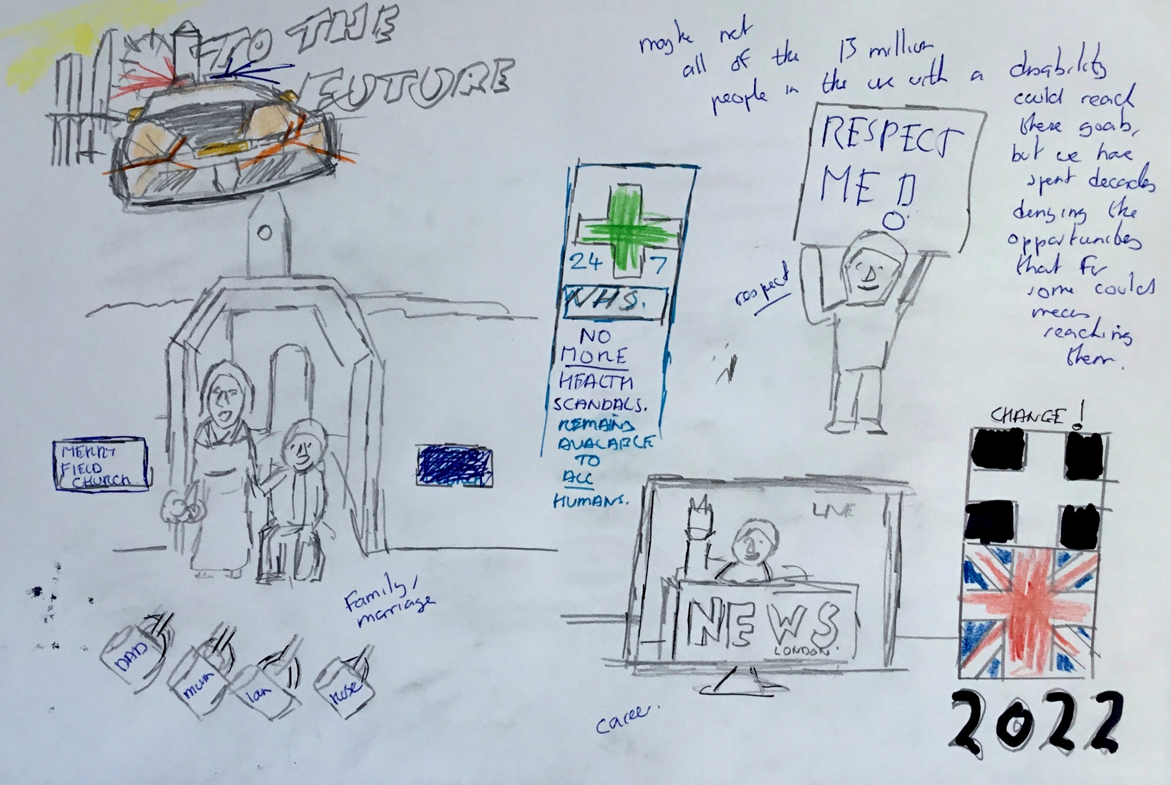
©Chris Burns

Slide 6
Agreed vision / aim
A peer review scheme for PBS training; assessing against the most contemporary research, guidance and best practice and in which the ‘voices’ of experts by experience are loud and clear.
An independent and transparent system for adult social care providers to make informed decisions when choosing a learning provider, based on a trusted peer review, quality assurance mechanism.
A self-sustaining system for learning providers, via voluntary participation, with valuable benefits for participants and adult social care providers. As affordable as possible for learning providers and ensure that those participating feel they’re getting good value.
Notes:
Started in 2019 and co-produced with the peers themseves

Slide 7
Learning Providers (inc. some service providers); lots of topics to lots of customers social care and in many case also health or education
Service providers with a L&D team; training their own staff only – in ONLY PBS or other topics
Service providers; training their own staff and offering training externally – in ONLY PBS
Learning providers with lots of customers but wholly or mainly PBS
Endorsement process
Learning providers involved in the PBS peer review
PLUS additional parts of PBS peer review
RRN Certification is completely separate but designed to be complementary for those providers delivering both
PBS (peer review)
Notes:
For some people, the cost benefit of going through the endorsement process doesn’t stack up. We have 58 people involved from 16 organisations.

Slide 8
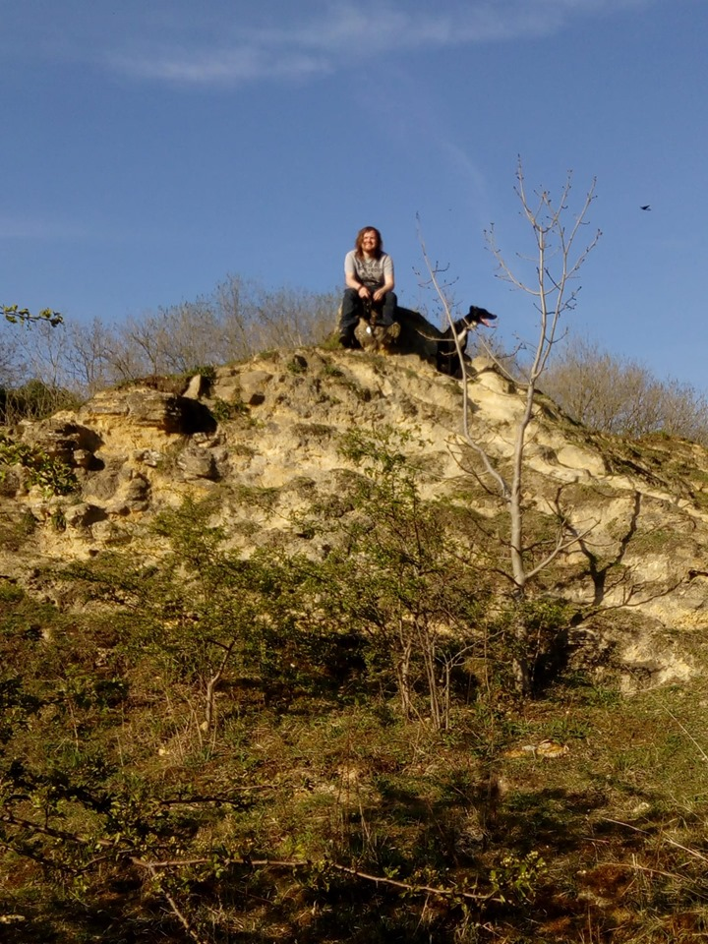
Planning alternative tomorrows with hope. . . NOT “Managing behaviour”
No-one’s NEEDS are more complex than another person’s; we all have the same basic human needs which we each meet in our own way. The support that people need becomes ‘complex’ when we have failed to meet their needs when it was simpler
Co-production,
Peers
Mutual respect and learning
Notes:
To what extent does the training work towards the PBS training standards?
Is it based on the definitions of PBS from:
PBS academy?
PBS alliance
Gore et al (2013)
Anne MacDonald, University of Kent.
And. . . .
Will this training equip staff to help the people they support have a better life?
1 http://pbsacademy.org.uk/wp-content/uploads/2016/11/Positive-Behavioural-Support-Competence-Framework-May-2015.pdf
2 http://pbsacademy.org.uk/standards-for-training/
3a http://pbsacademy.org.uk/key-messages-about-pbs/
3b amacdonald@trfs.org.uk 1. Use of Behavioural Technology2. Based on Specific Values3. Focus on Quality of Life 4. Commitment to Systems Change

Slide 9
3rd
1st
5th
2nd
4th
6th
12th
8th
7th
11th
10th
9th
Notes:
Two reviewers (preferably from different organisations) review another organisation, then someone else reviews theirs!

Slide 10
The review process follows the following stages
Setting up the review; greed vision
Two self assessments;
Carrying out the review / observation
Making a decision
Communicating the decision - DOCUMENT 5, review report template
DOCUMENT 2, reviewer self-assessment
DOCUMENT 3, training self-assessment
DOCUMENT 1, agreement between all parties
DOCUMENT 4, training provider information for context

Slide 11
Standards underpinning the reviews
PBS academy
Training standards
Competence framework

Slide 12
Domain 1: Education and experience standards (complete this domain to the appropriate level) |  |  |  | ASSESSMENT
Number | Criteria | Description of criteria | Perecentage required * | Not applicable | Standard not reached | Bronze | Silver | Gold | Notes, comments and/or steps taken to meet standard
Direct contact (those providing direct support in a paid or professional capacity)
EC.1.1 | Minimum Education/Training | Foundation PBS training of a minimum of 120 hours as specified in 'Improving the quality of Positive Behavioural Support (PBS): The standards for training' (pages 6 to 8). | 90%
EC.1.2 | On-going supervision after training | Continuous on the job supervision from a more experienced practitioner (Level 2 as defined in the PBS Competence Framework) plus on the job coaching in situ as required. In addition, a supervision session away from the support environment should be held at least once every 6 weeks. This can be group or individual. This means that direct care staff should receive supervision when directly supporting someone as well as during supervision meetings (1:1 or group) away from the support environment. Supervision during direct support should include direct coaching and feedback in relation to person specific support based on the person’s behaviour support plan as well as wider skills around supporting opportunities, participation and engagement and as outlined in the PBS Competence Framework. Supervision sessions away from the support environment should include time for reflection about skills learnt, any skills gaps and plans for any additional training or coaching to meet those gaps. | 90%
Behaviour Specialist/Supervisory/Managerial practitioner
EC.2.1 | Entry level requirements | Education/training at National Qualifications Level 56 or equivalent (Foundation degree, first year degree, NVQ level 5 e.g. Registered Managers Qualification). OR Ability to study at Foundation degree, first year degree, National Qualifications Level 5 or equivalent AND a minimum of 1 year’s experience providing direct contact support as detailed by the PBS Competence Framework. | 50%
Notes:
PBS academy

Slide 13
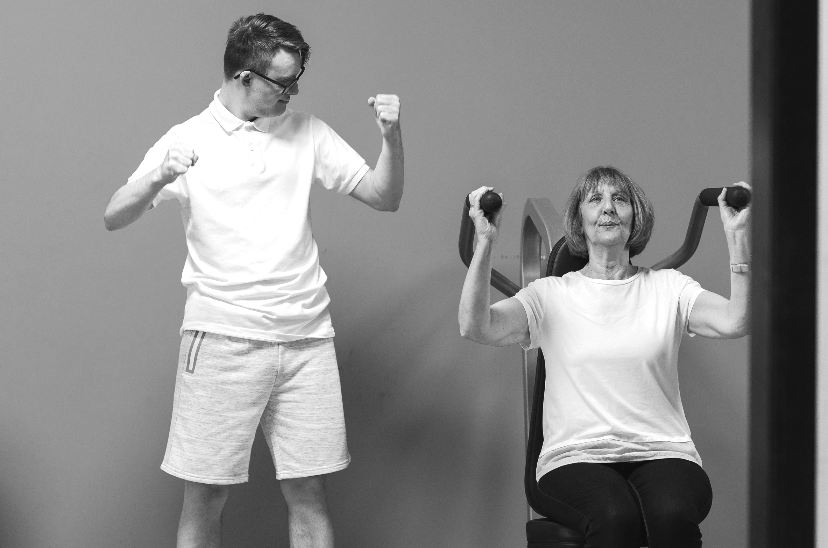
Communicating the decision / grading
Gold, silver or bronze!
Notes:
A pass or positive grading would stand for 12 months and would need to be renewed or the provider cease using it after that time.
Training rated as fail/inadequate/requires improvement / scoring less than a certain number out of five or ten, would not be publicly stated externally, but these learning providers would be given feedback to improve their training.
When an organisation fails, they will be allowed to resubmit once, but a fee will be charged to cover the additional cost

Slide 14
Challenges
Distance
Self Assessment Form
Number of reviewers / same day
Providing feedback
Reviewing over webinar
Limitations in seeing how well training is embedded in practice.

Slide 15
Benefits
PBS Peer Review Stamp
Networking
Offers different Pathways of delivering PBS
Looks at strengths and identifies opportunities for development (both for reviewer and reviewee)
Links with national guidance / best practice
Streamlining the quality of PBS training across providers.

Slide 16
Any questions?
Notes:
The questions can be found on the recording.

