Slide 1
Compassion First in PBS
The power of relationships

Slide 2
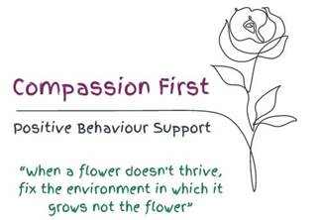
Our PBS Commitment
Notes:
Sarah to add more about our Compassion First PBS Commitment

Slide 3
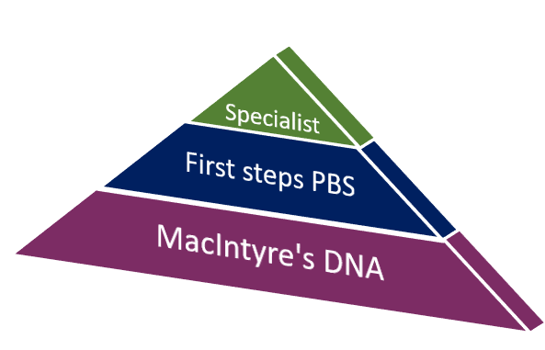
PBS as a Framework

Slide 4
POSITIVE AND PROACTIVE​
First Steps
PBS language is accessible – we use First Steps
Leadership and support from operational colleagues. Staff have a good understanding why behaviour happen and are actively involved in developing and sharing successful strategies
PBS Specialists – provide wider insight into those involved, transition planning processes and working together
Notes:
PBS is not behaviour management
The focus is on proactive strategies – first steps – long term goal is to help the person learn and grow
Moving on their timeline -

Slide 5
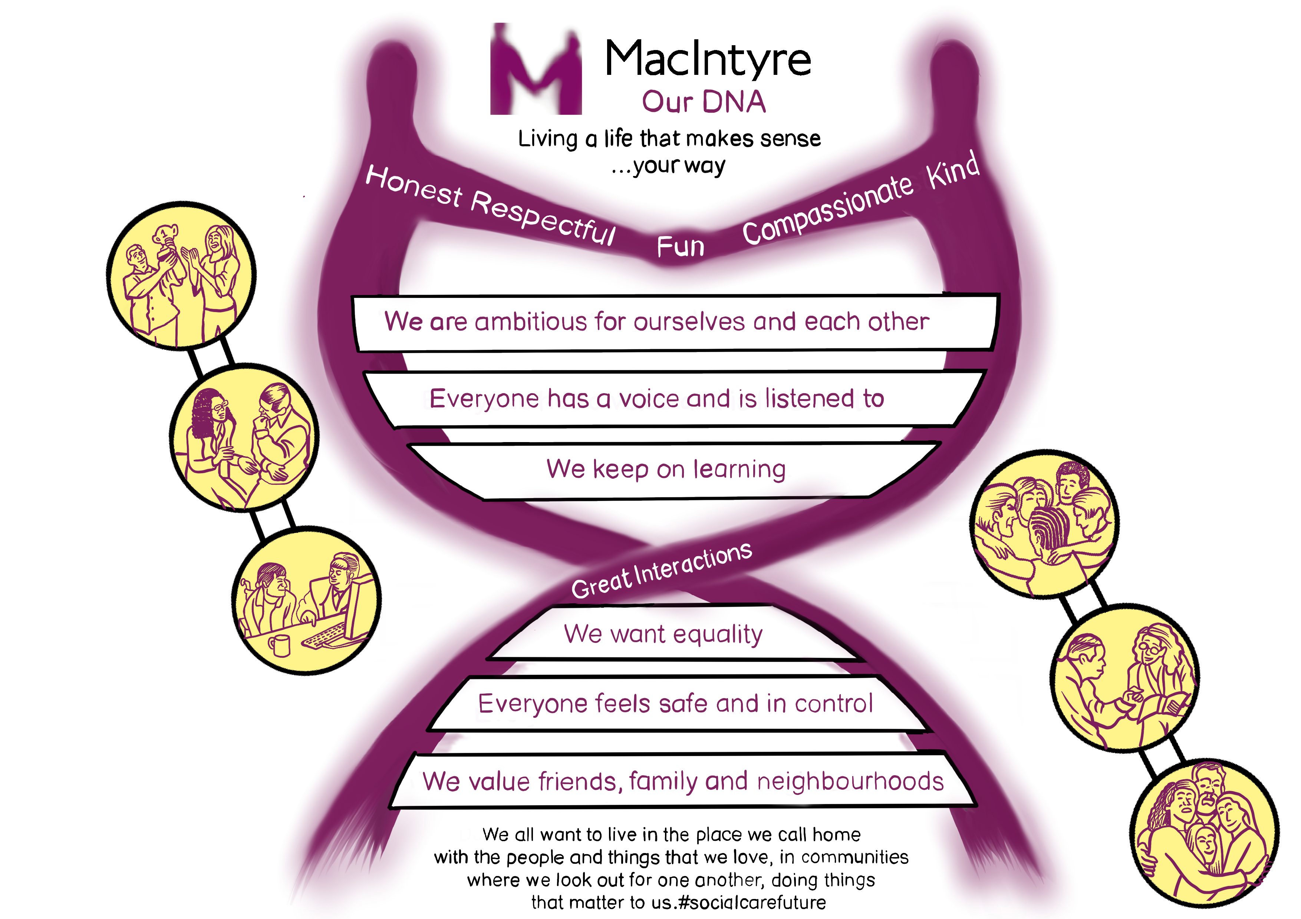
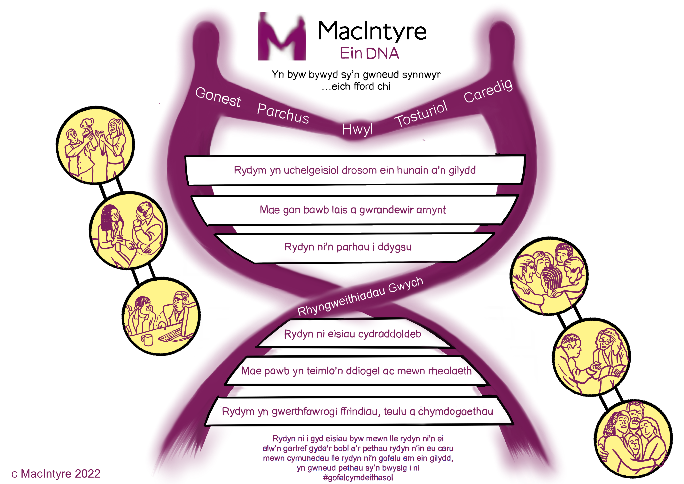
MacIntyre’s DNA
The way we communicate is a vital part of our DNA
Everyone has a voice and is listened to
Notes:
The way in which we communicate at work and with the people we support is a vital part of our DNA. It fits into all aspects, particularly that of giving “everyone” a voice and helping that they feel listened to as well as our Great Interactions, which is a form of communication in itself.

Slide 6
Relationships are at the heart of everything we do
Notes:
We focus on building trust and rapport with: click to the next slide

Slide 7
Significant Connections
Staff teams
And PBS
External professionals
Occupational Therapists
Families
Learning Disability nurses
Commissioners
Friends
Speech & Language Therapists
Operational teams
Notes:
Relationships at the heart of what we do.
Without trust and rapport and honest relationships with others, we cannot implement PBS strategies.
Working in partnership with others, especially other professionals means, we need to find common language to work together effectively and successfully.
Building strong rapport and relationship with families is important to us, but it is not always easy.
Click to reveal each text box for each area
Briefly talk through the points,
Using the last scenarios as a guide to prompt comment from learners saying now what if you….were in the supermarket and.. or what if you were travelling somewhere important in the car and….using some of the points your have revealed
Trainer statement: so we can clearly see the difference and this difference means a bigger chance of people with a learning disbsility having little or no choice then to use behaviours the cause the biggest impact to get their needs met.
BUT …
Question: Ask the group to how many of these we in our role can provide support in to help? - feedback
Trainer Statement:; Life is full of texture, no one is always completely happy or relaxed everyday of their life and that’s okay but most of us, have the ability to make choices about how we perhaps reduce the bad stuff or the skills to deal with the difficult
Think about the people who draw on our support who have a learning disability – do they?
Supporting this change is your first steps in PBS for everyone

Slide 8
Trust and Rapport
Team approach
Using First Steps
Ongoing Learning

Slide 9
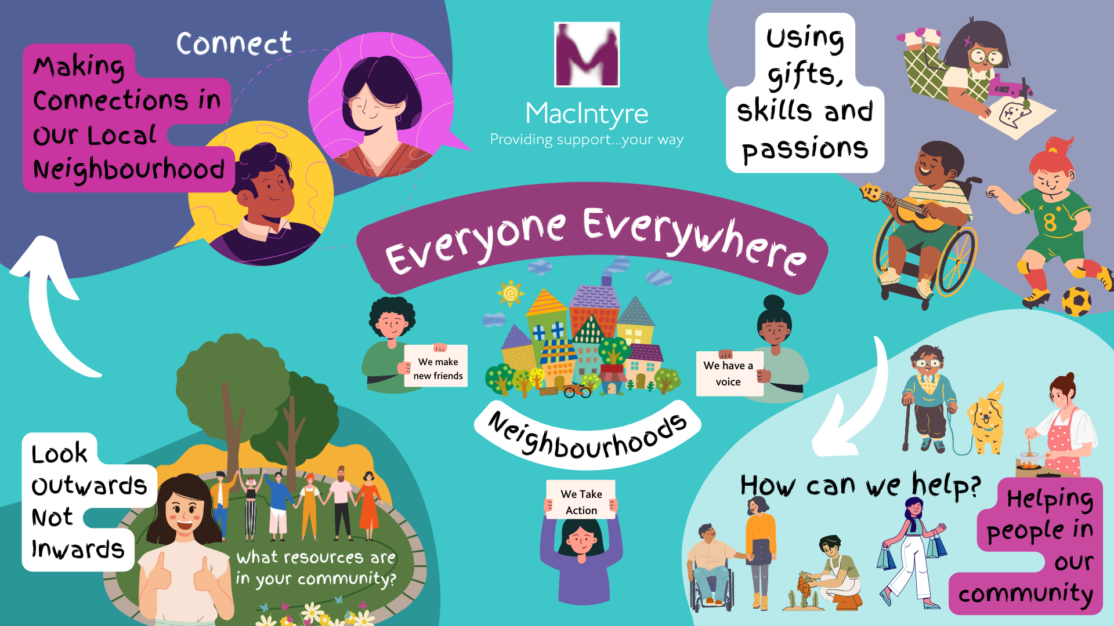
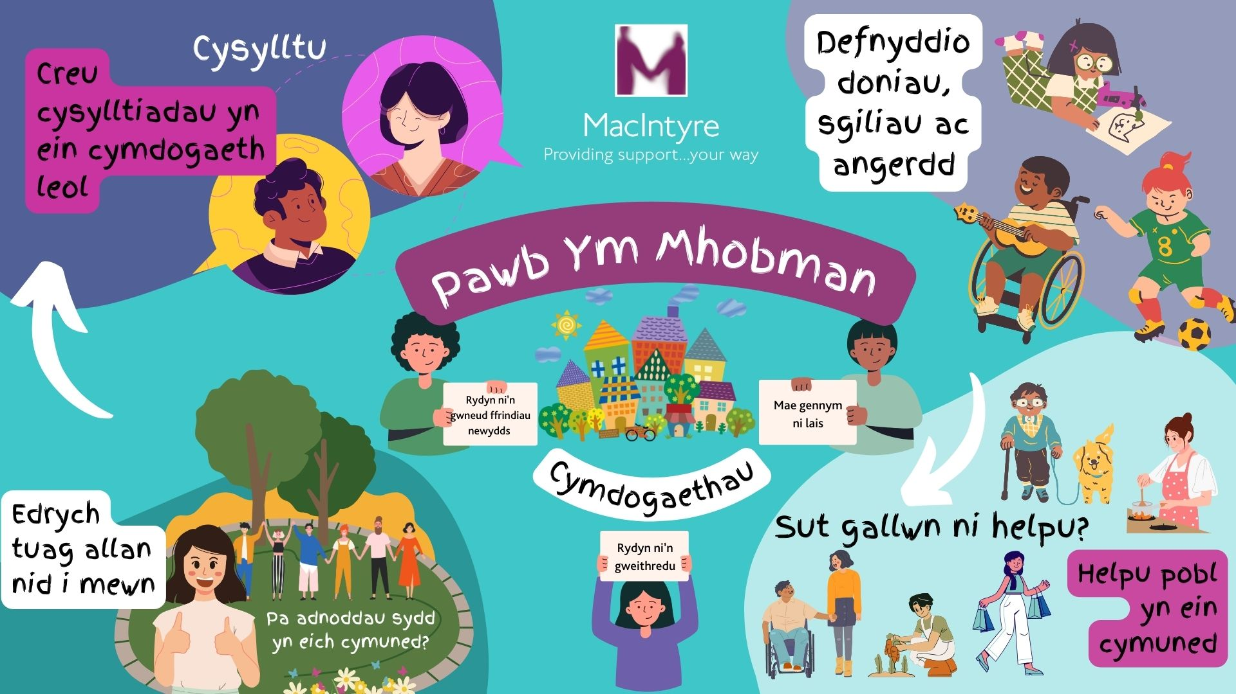

Slide 10
We don’t always get it right, but it doesn’t stop us from trying
Reflections
Notes:
The importance of finding the common language/ realistic and specific enough goals
How do we not loose sight of the road ahead
when we are dealing with families and other specialists and stakeholders.
Same outcomes/different approach
Intelligent kindness – Reflection on what is right for the person mean we sometimes have to say no –
No to being able to support the person
No to parents when we are asked to use approach that is not aligned with our DNA – example?

Slide 11
The road ahead It is the journey not the destination Meeting people where they are at
Notes:
We keep on learning – as people change we change our approach accordingly
We keep on reflecting
The journey - everybody's journey is different. Moving at the right speed – being patient. Having a goal/being realistic
GHaving a
{

Slide 12
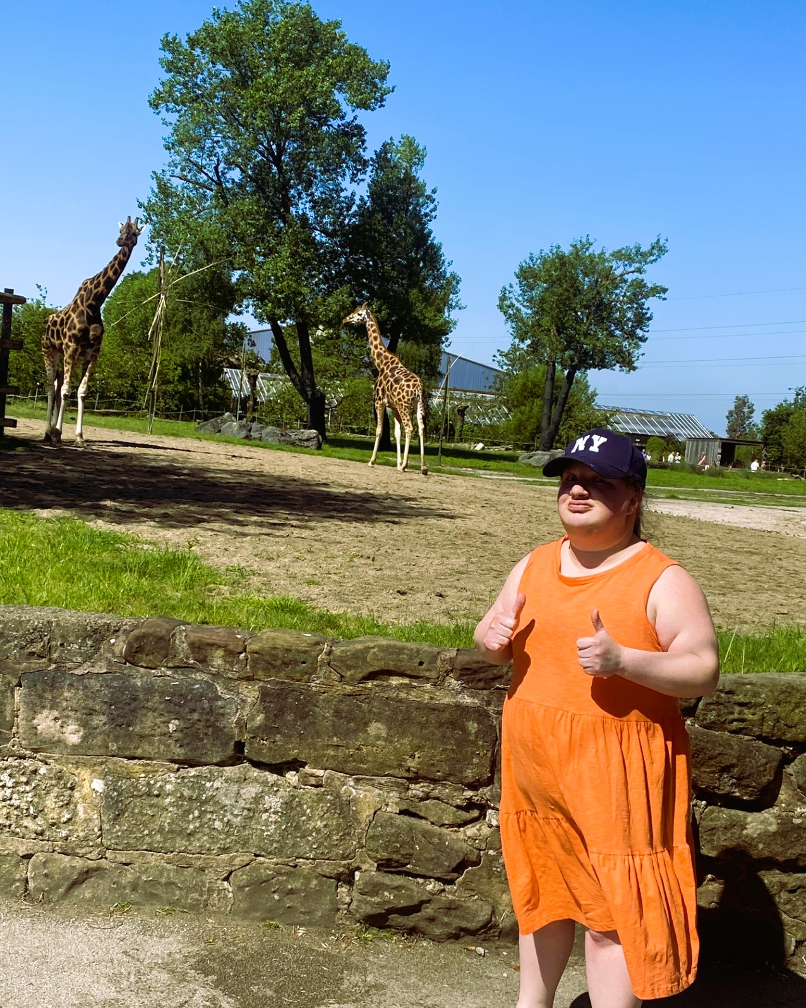
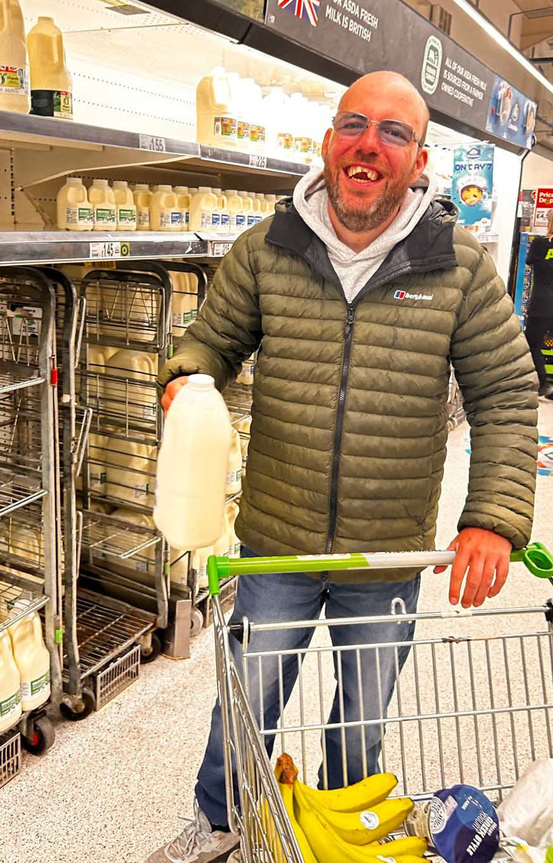
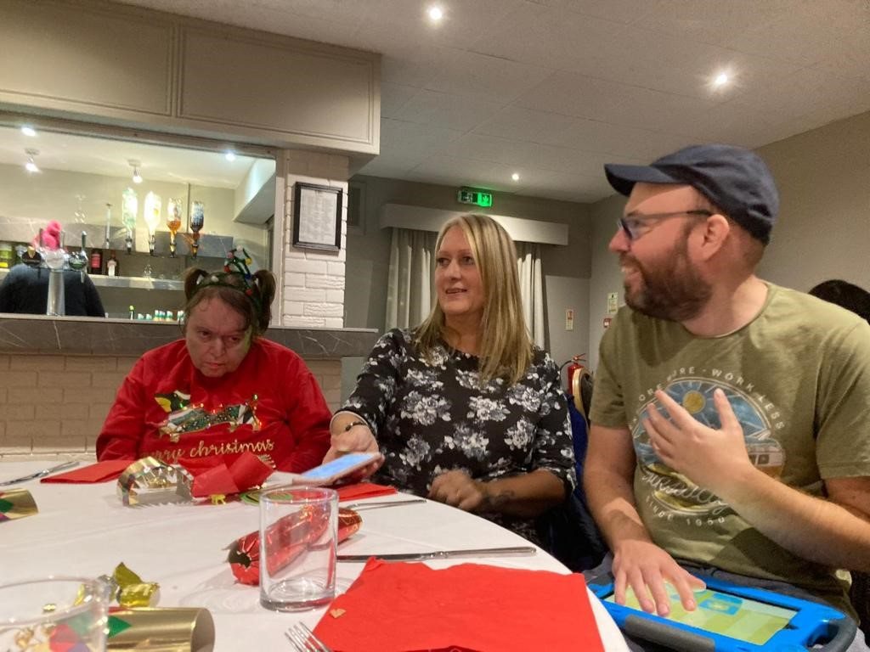
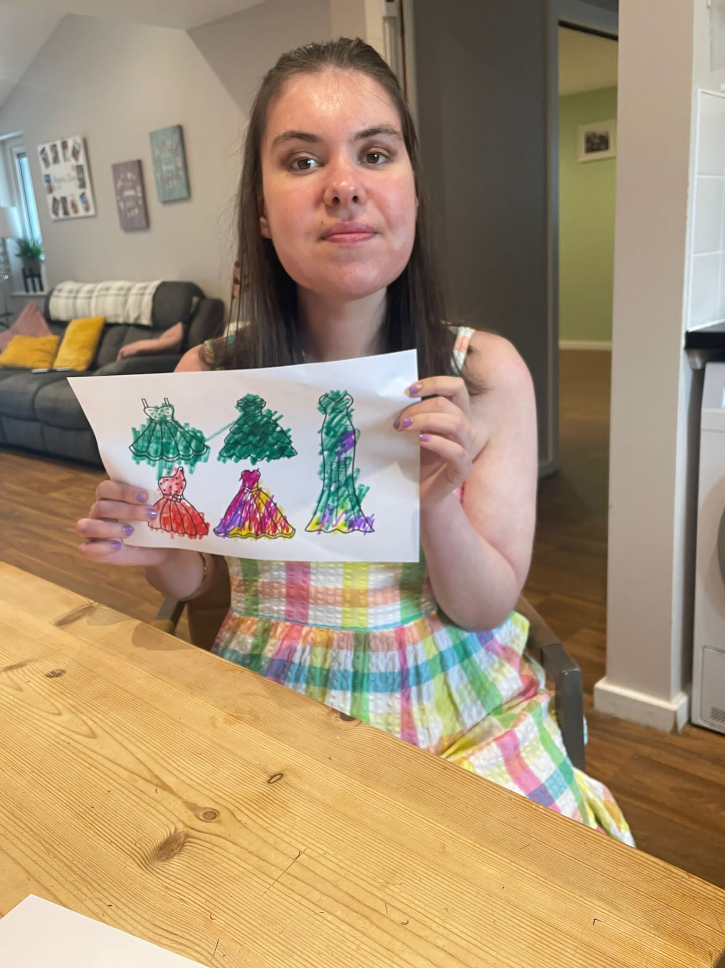
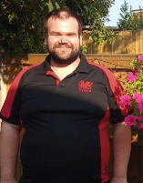
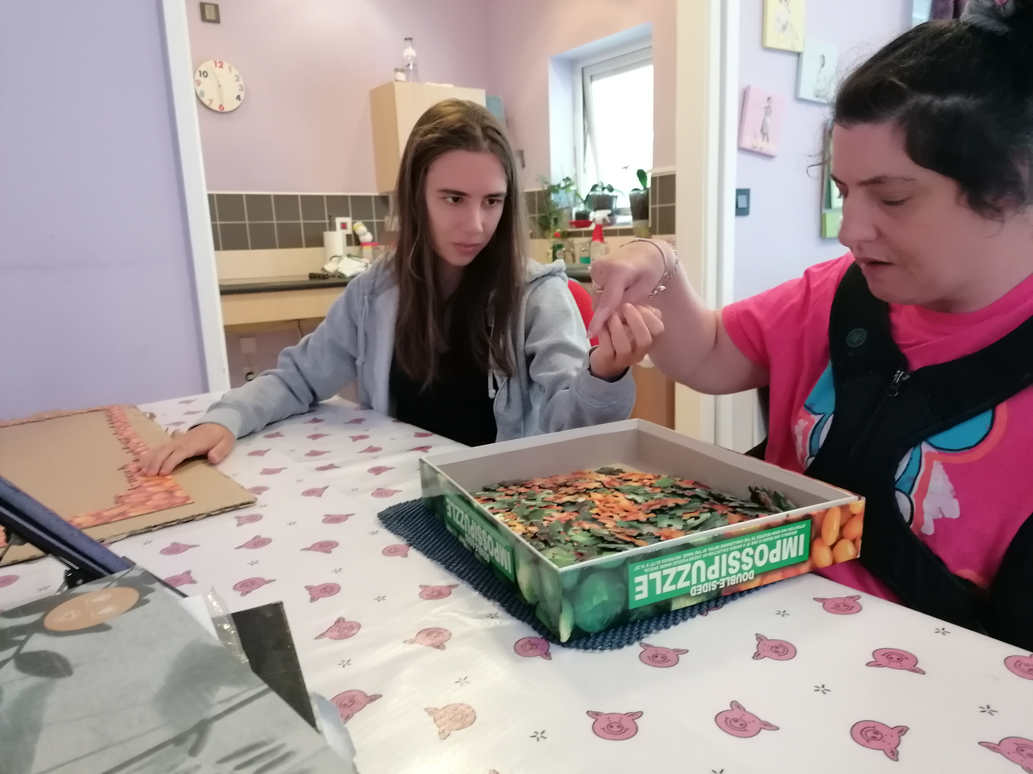
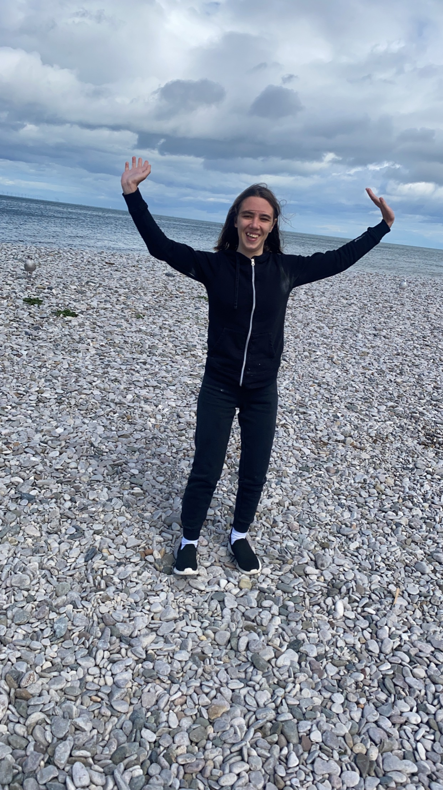
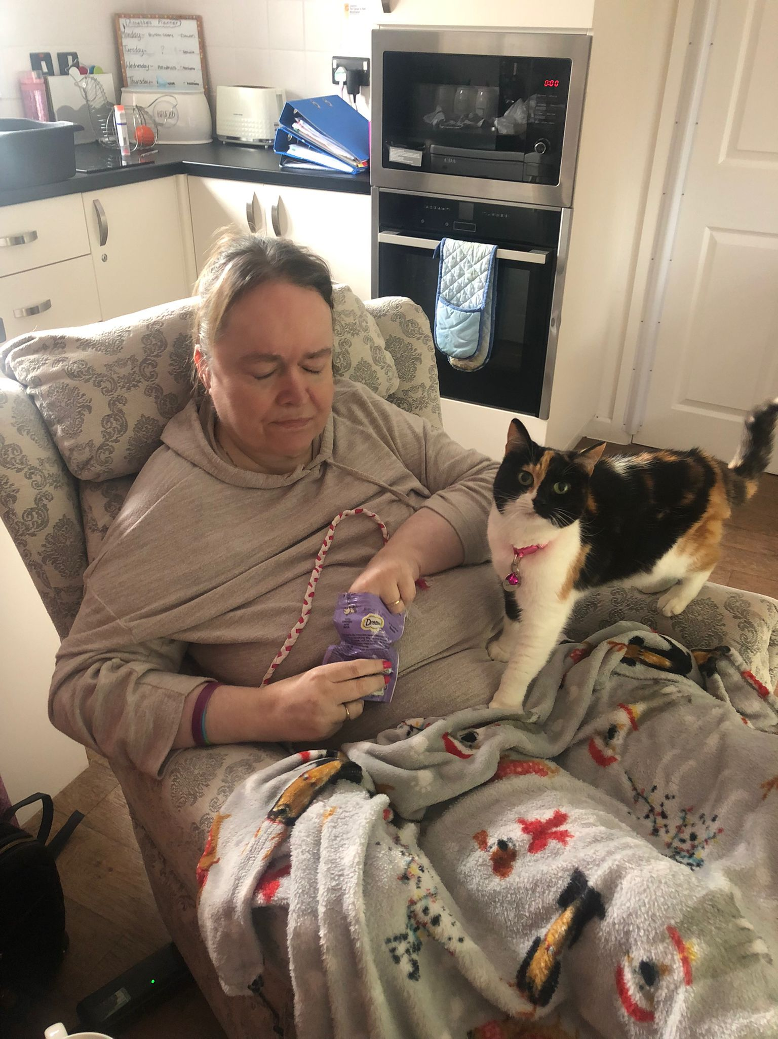
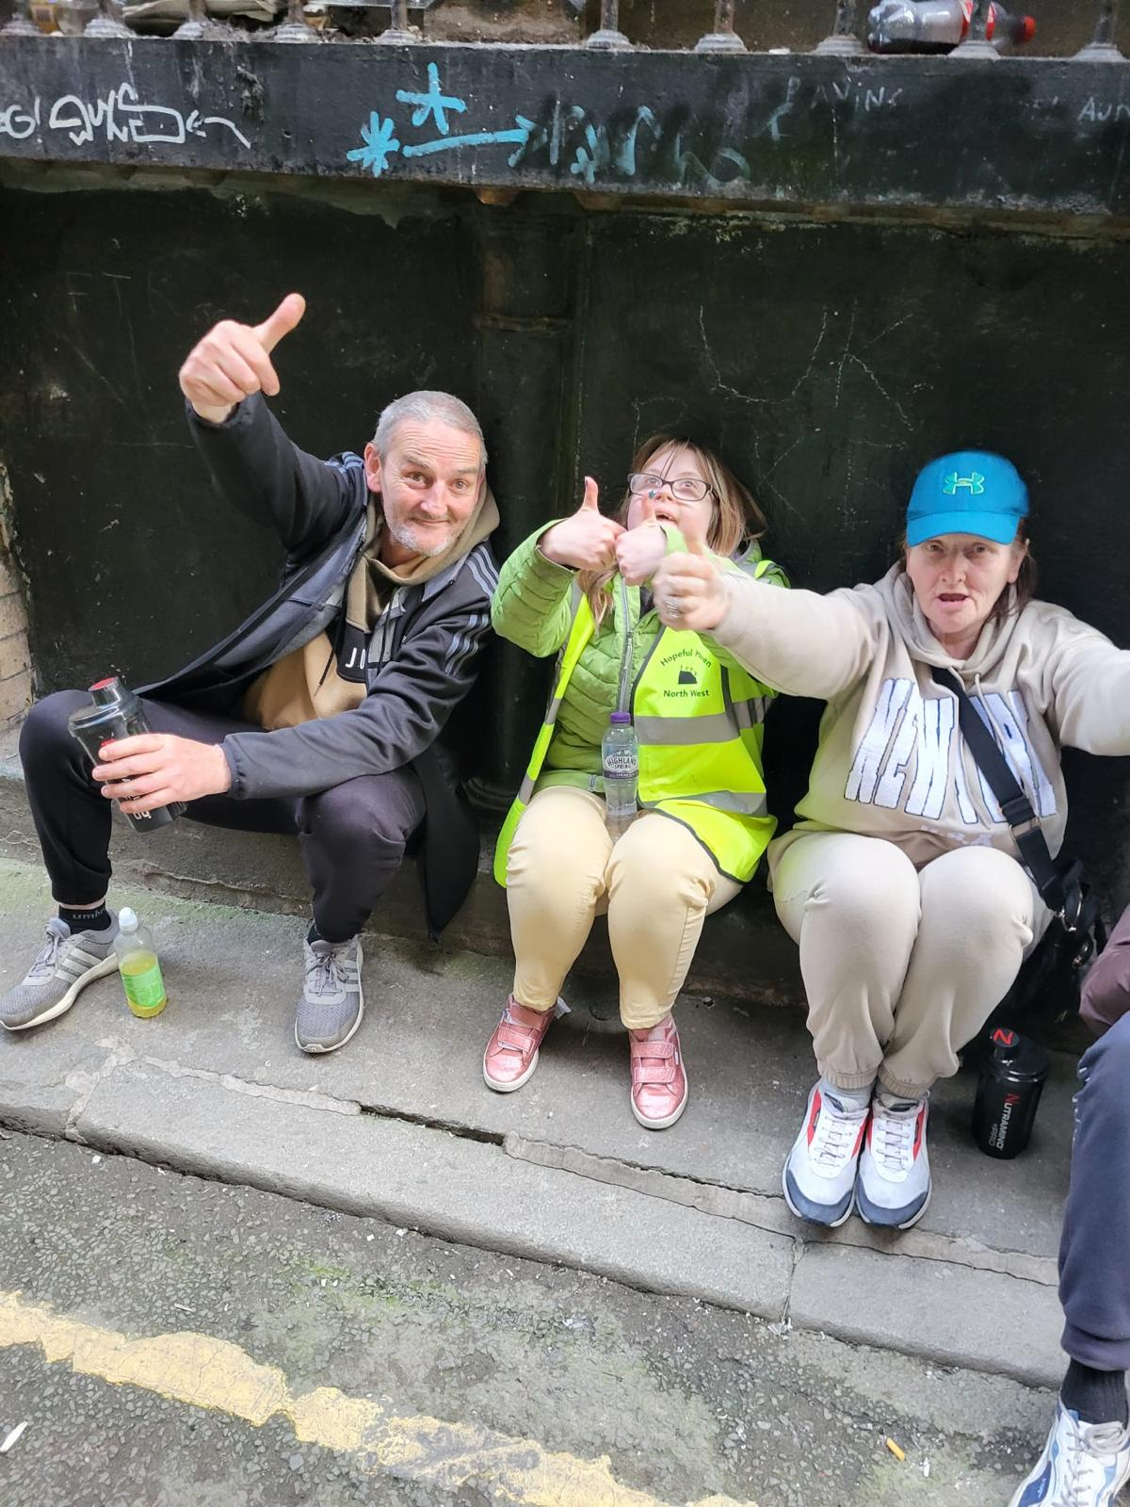
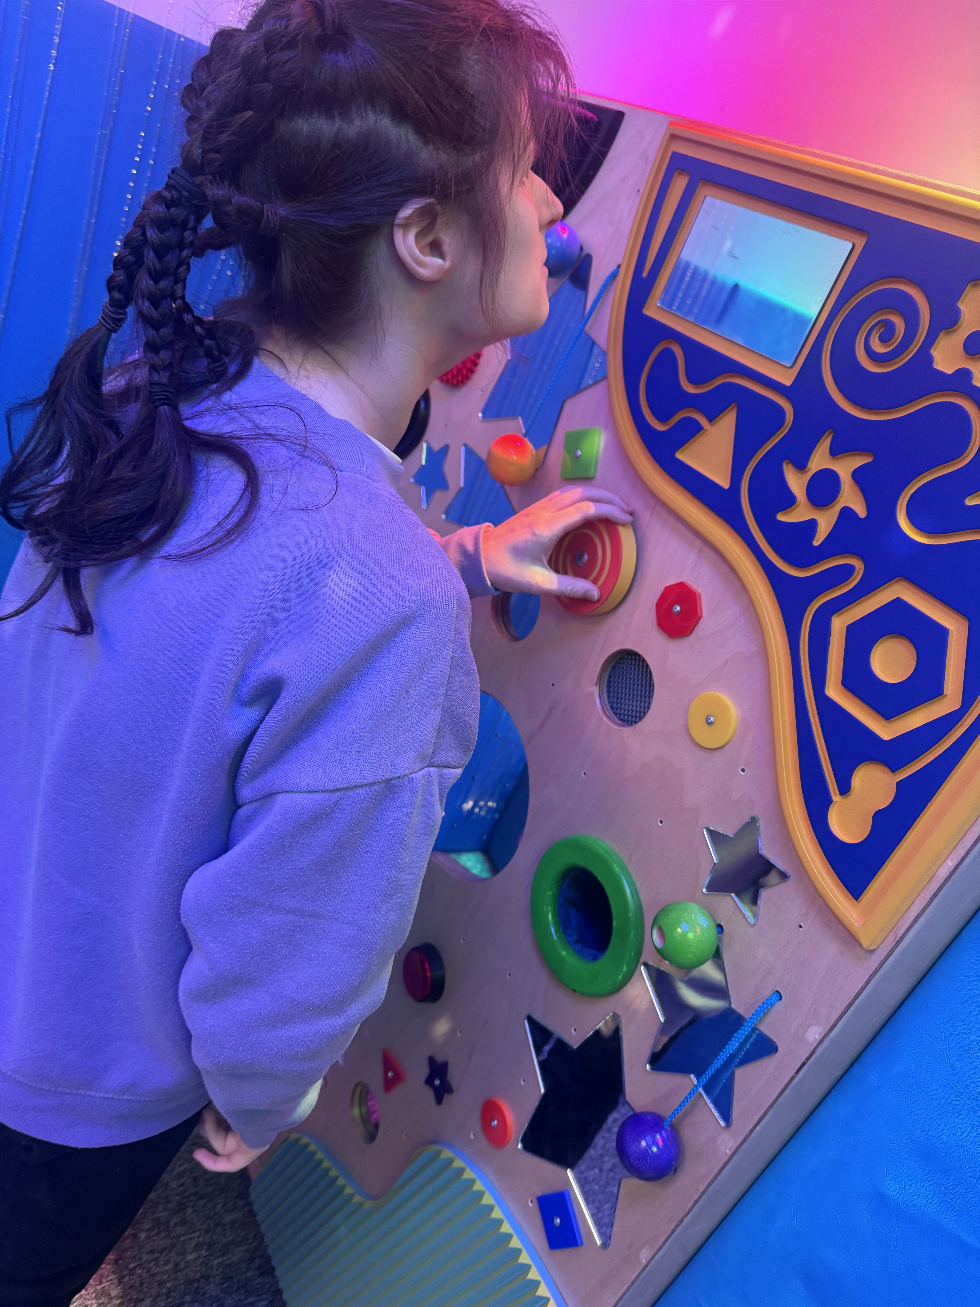
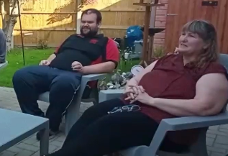
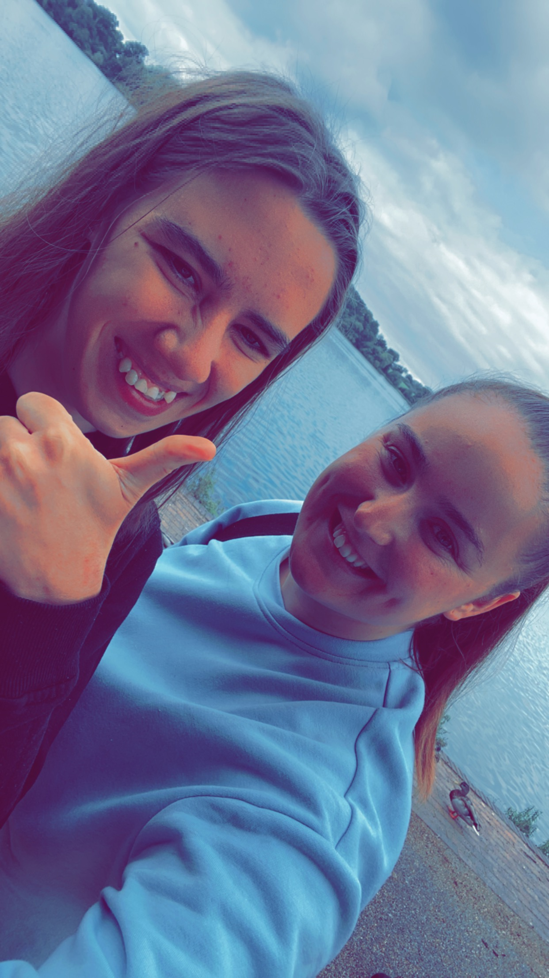
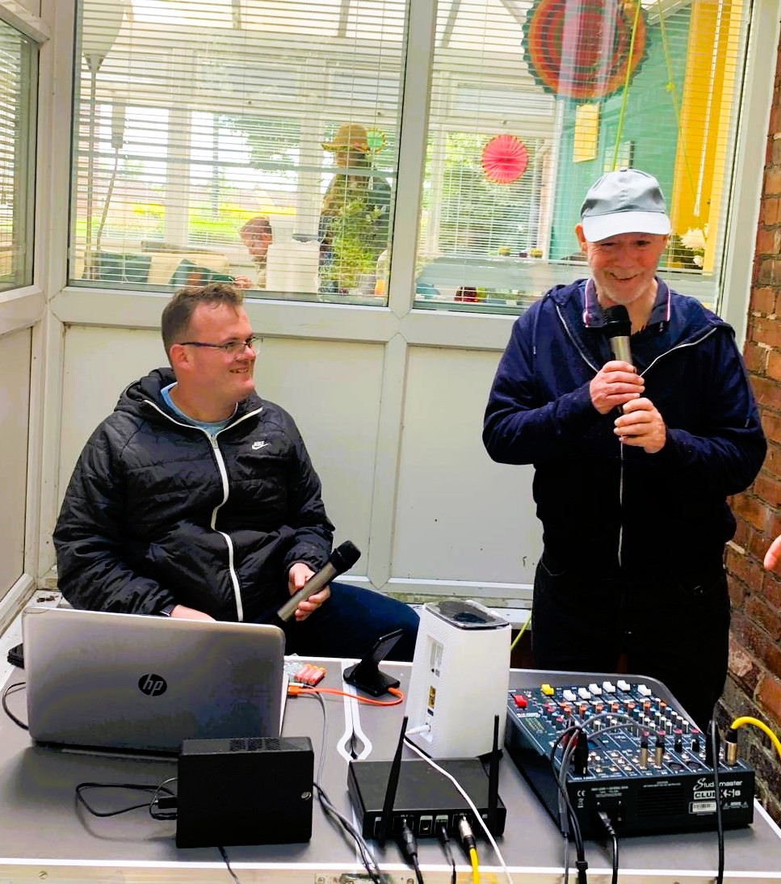
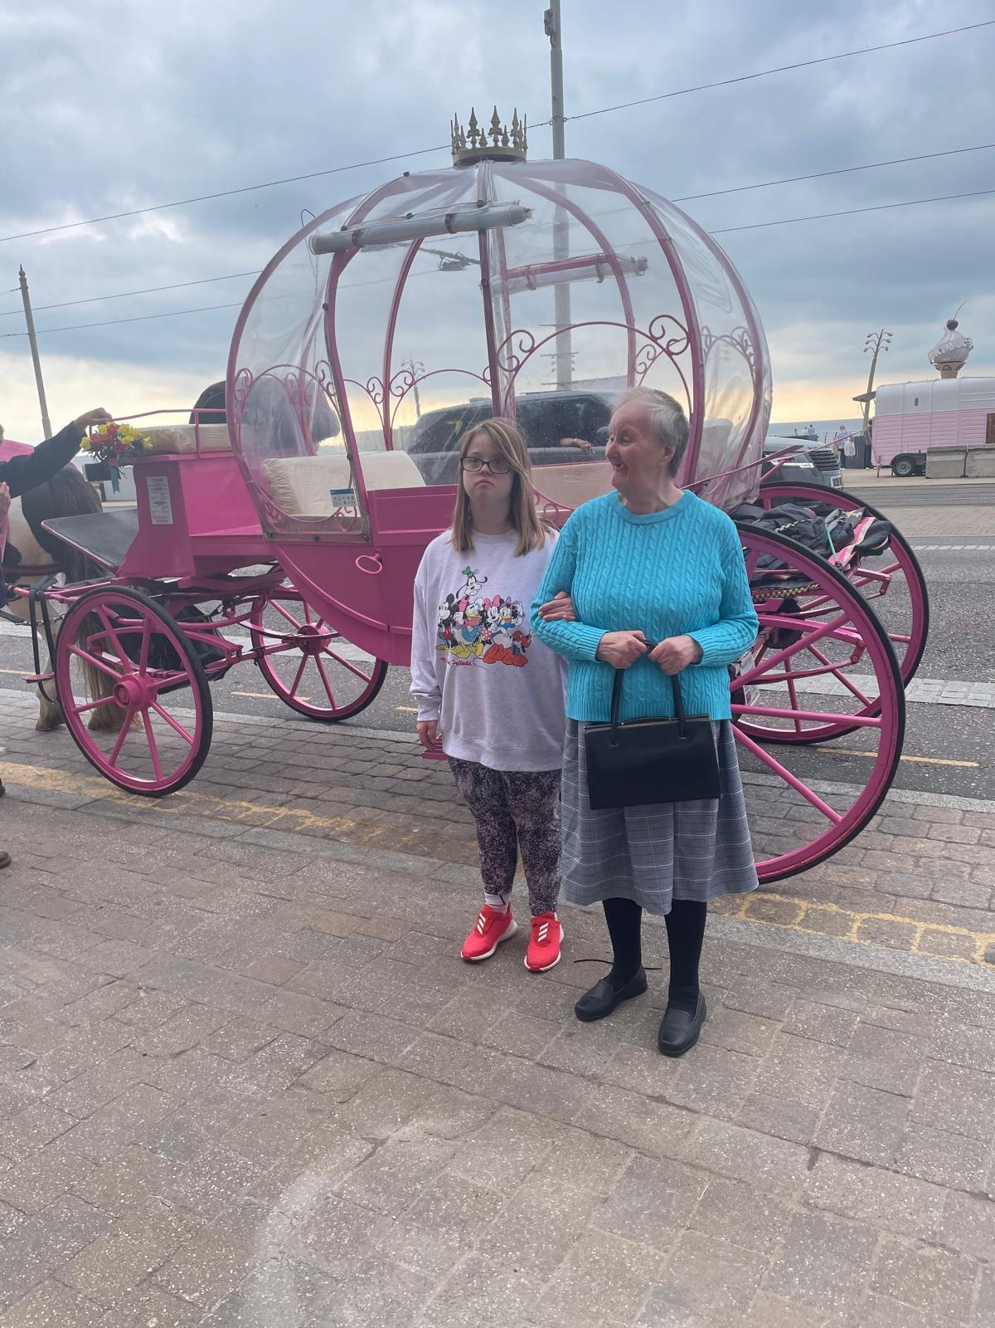
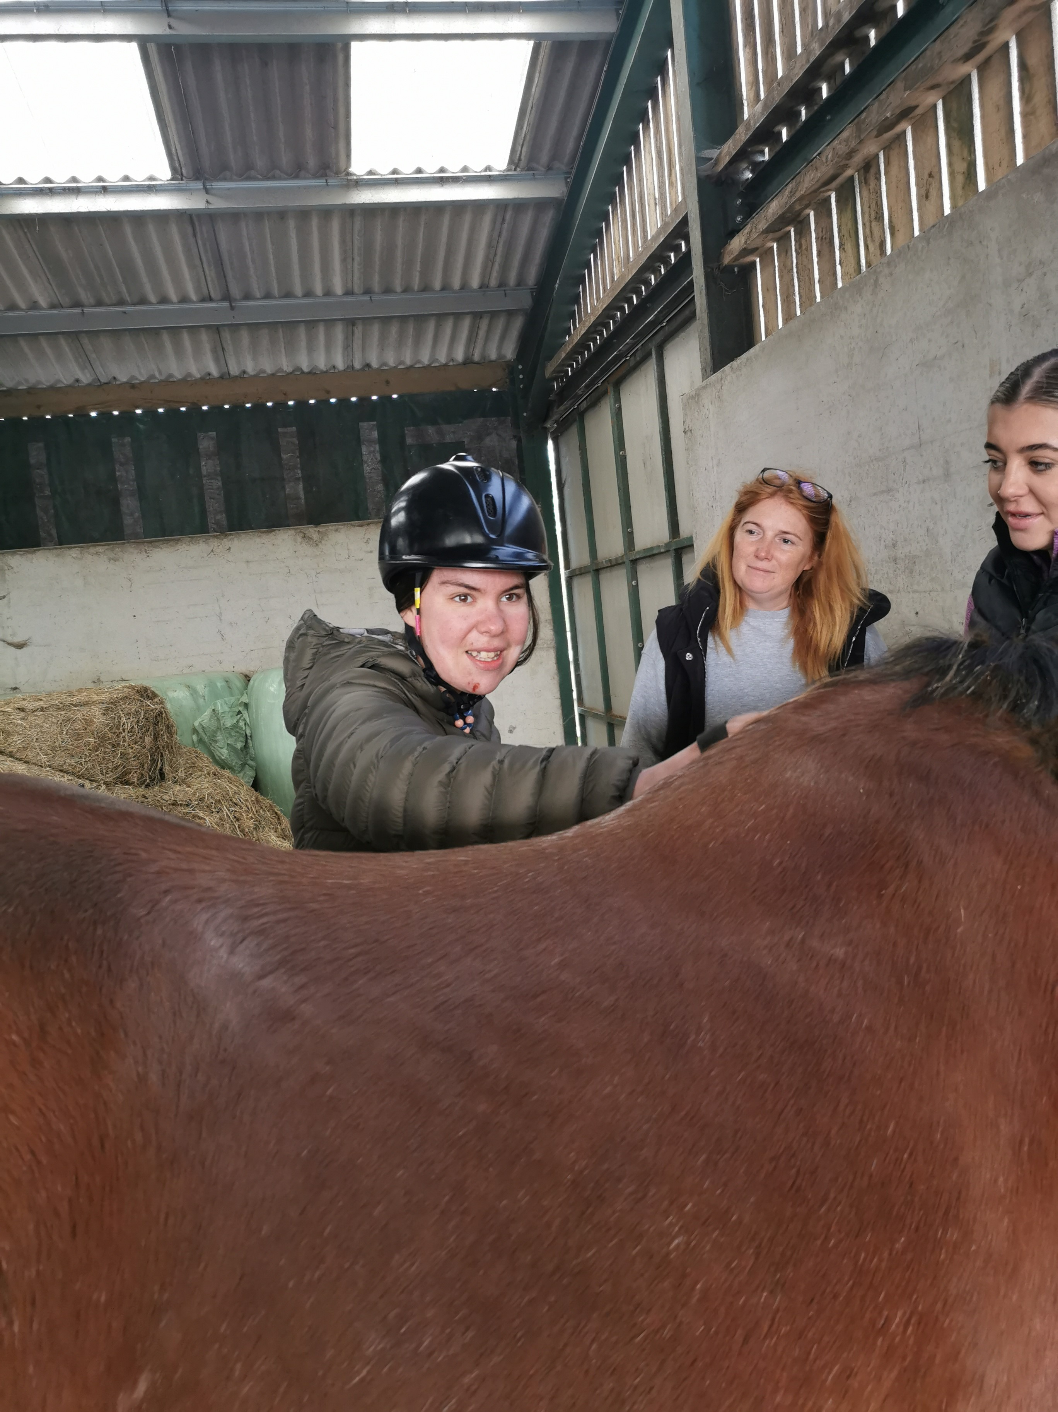
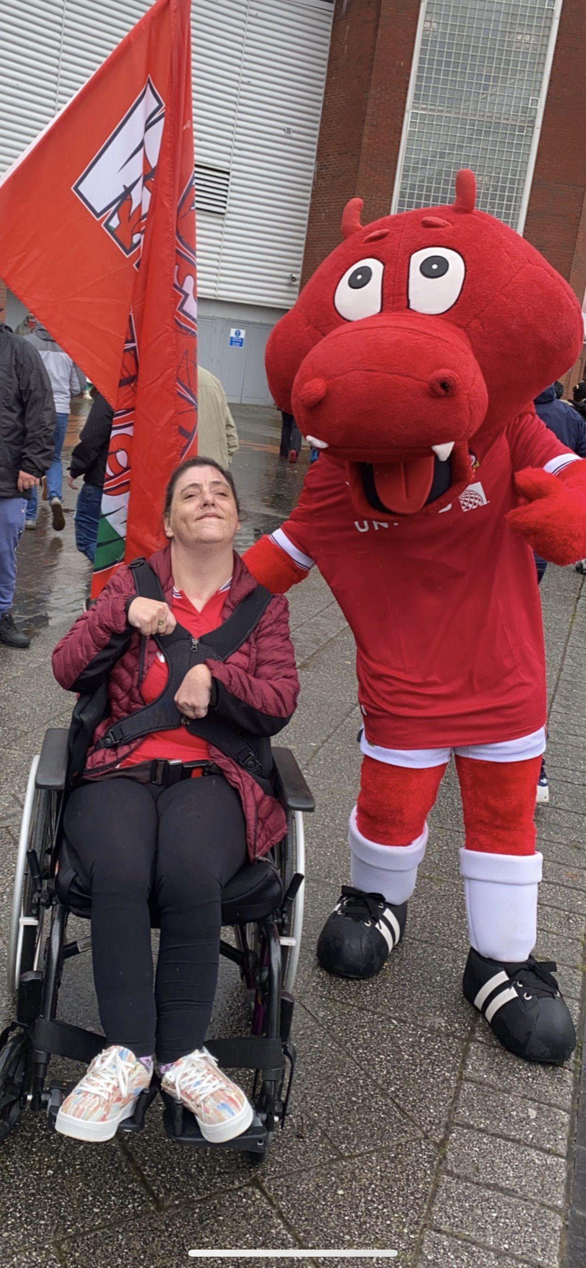
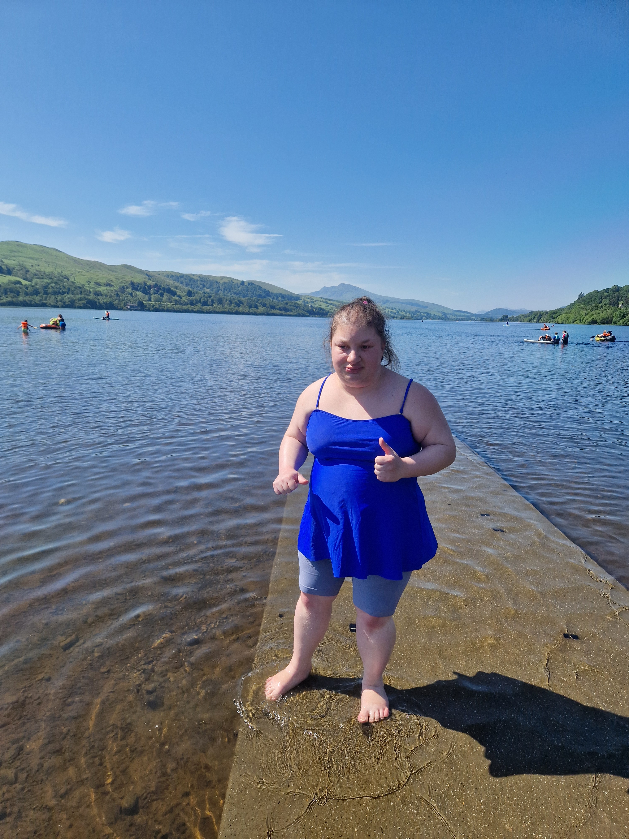
Notes:
WE don’t try to change the person
Life doesn’t always feel positive

Slide 13
Overcoming barriers
Honesty and Transparency
Empowering for all working with compassion and kindness
Flexibility finding common ground
Notes:
Staff and their life journeys – everyone comes with their life learning history – experiences of trauma/fear/attitudes
PBS and First Steps Supports people to recognise barriers and aims to empower people

Slide 14
"When flower doesn’t bloom you change the environment in which it grows, not the flower"
Compassion
Guide and inspire
Notes:
PBS is a framework – we apply First Steps to understand the person, their needs, we build empathy and understanding..

Slide 15
Any Questions
Thank You

