Slide 1
The Behaviour Support Plan Content Appraisal Tool (BSP-CAT) and How this Can Help Enhance Your Service and Practice
Dr Nick Gore
2024

Slide 2
Hello and thank you
Dr Nick Gore
PhD DClinPsy BCBA
Practitioner
Researcher
Behavioural Scientist
People with learning disabilities
& Autistic People
Those that care for and support them
Services and systems
Behaviours that challenge,
Positive Behavioural Support,
Children and young people and early intervention
Gore_{©2024}

Slide 3
BSPs and Why We Need them
Gore_{©2024}

Slide 4
Why do we need Behaviour Support Plans?
Cook et al. (2010) found links between behaviour support plans (BSPs) and good outcomes
Cook, C. R., Mayer, R. G., Browning-Wright, D., Kraemer, B., Wallace, M. D., Dart, E., Collins, T. and Restori, A. (2010). Exploring the link among behaviour intervention plans, treatment integrity, and student outcomes under natural educational conditions. The Journal of Special Education, 46, 3–16.
Recommended by NICE and other best practice guidance
National Institute for Health and Care Excellence (NICE) (2015). Challenging behaviour and learning disabilities: Prevention and interventions for people with learning disabilities whose behaviour challenges.
Not sufficient – but arguably very necessary
Gore_{©2024}

Slide 5
Key components of PBS (Gore et al., 2022)
Gore_{©2024}
Rights and values: A focus on rights and good lives | 1. Person-centred foundation
 | 2. Constructional approaches and self-determination
 | 3. Partnership working and support for key people
 | 4. Elimination of aversive, restrictive and abusive practices
Theory and evidence base: Ways to understand behaviour, needs, and experience | 5. A biopsychosocial model of behaviour that challenge
 | 6. Behavioural approaches to learning, experience and interaction
 | 7. Multi-professional and cross-disciplinary approaches
Process and strategy: A systematic approach to high quality support | 8. Evidence informed decisions
 | 9. High quality care and support environments
 | 10. Bespoke assessment
 | 11. Multi-component, personalised support plans
 | 12. Implementation, monitoring and evaluation

Slide 6
The qualities of a BSP (Gore et al., 2022)
A key part of PBS process that:
Combines the findings of functional assessment with person centred goals (synthesis of which requires technical skills and supervision)
Focuses on supporting good lives for people and reducing the risk and impact of behaviours that challenge (requires consistency and cohesion)
Will necessarily be multi-component and personalised (bespoke)
Will need to be developed in partnership and consultation with key people to ensure supports are bespoke to the needs and circumstances of the person and their support system
Gore_{©2024}

Slide 7
Functional Behavioural Assessment (FBA) is the bedrock for development of contemporary BSPs (Horner et al, 2000) / the foundation of a technically strong BSP (Benazzi et al, 2006)
Enable functional statements to be made about challenging behaviours and the contexts in which they do and do not occur (Repp and Horner, 1999).
This leads to the development of a functionally related and individualised BSP (Horner et al, 2000).
Without this, practitioners are at risk of developing plans that are at best ineffective and at worse harmful (Steege and Watson, 2009).
Gore_{©2024}

Slide 8
Needs to include ethical and non-aversive reactive strategies, tailored to an individual’s needs and circumstances (that minimise harm and support people in instances where behaviours that challenge occur and/or will likely soon occur)
PBS strategy and intervention are, however, predominantly proactive in nature:
An overriding aim of reducing the likelihood, severity, or impact of behaviours that challenge over time…
… by supporting good lives for people and mitigating specific risk factors…
…across systems of support
Gore_{©2024}

Slide 9
Proactive Strategies will routinely include:
1. Strategies that guide how others can best support environmental enrichment and mitigate contexts that evoke behaviours that challenge - Antecedent Interventions
2. Strategies to help teach skills that are helpful for the individual’s life across a broad range of contexts
i.e., skills that provide functionally equivalent alternatives to behaviours that challenge and/or coping and other self-support strategies to help manage and promote independence in everyday life…
Gore_{©2024}

Slide 10
So what can you do when know the function(s)?
Attention Maintained
Escape from Attention
Escape from Demand
Tangible Maintained
Automatically Reinforced
Once we know the function of a behaviour there are three main things we can do:
Change the person’s environment in ways that are helpful/supportive for that person
Support the person to access more of the things they need when challenging behaviour is not occurring (or before it happens)
Support/encourage the person to learn an alternative to challenging behaviour
Evidence based
Data driven
Consistent with Rights and Values of PBS
Gore_{©2024}

Slide 11
Ensure Mohamed has ready access to quiet spaces
Ensure Mohamed has ready access to his ear defenders
Mohamed begins to bite his hand when in a crowded room and things are getting noisy
Beth screams and hits out at staff when she has been waiting alone for an activity to start
At least one member of staff should talk with Beth during transitions
Staff should involve Beth in helping prepare activities
When Ranjan looks at the door or makes a moaning sound ask him if he needs a break
Help Ranjan learn other simple ways of communicating when he needs a break
Ranjan spits at carers and throws objects when he is being supported to clean his kitchen for long periods
Gore_{©2024}

Slide 12
What BSPs include and the way they are created and implemented needs to be consistent with the Rights and Values of PBS…
Gore_{©2024}

Slide 13
Rights and Values
Find out what people need, want and like - pick goals that are right for each person.
NOT doing and stopping things that cause pain, shame or fear.
Find the right ways to help people develop skills, express themselves and influence what happens
Key people are supported and work together to decide what is important and to make changes
Gore_{©2024}
Notes:
Nick

Slide 14
PBS works to design and ensure physical and social environments that support good lives for people with learning disabilities and reduce risk of behaviours that challenge, by mitigating key maintaining processes and vulnerability factors commonly associated with the functions these commonly serve.
Communication Choice & Control Safe Environments
Engagement Physical & Mental Health Relationships
Gore_{©2024}

Slide 15
Process and Strategy
Behaviour Support Plans linked to a prior Functional Assessment
High Quality Care and Support Environments
Characteristic of tier 1 but of continuing importance at all tiers
Gore_{©2024}

Slide 16
What strategies will ensure the BSP is implemented as intended?
What strategies will monitor and evaluate whether the BSP is achieving its aims?
Gore_{©2024}

Slide 17
Assessing Content and Quality of BSPs
Gore_{©2024}

Slide 18
Why do we need to measure BSP quality and how?
Worryingly the quality of plans produced is often poor (Van Acker, Boreson, Gable & Potterton, 2005; McVilly, Webber, Sharp & Paris, 2012b; Chaplin, Hastings and Noone,2014)
To date most research has been conducted using the Behaviour Support Plan Quality Evaluation Tool (BSP-QEII) Browning-Wright D., Saren D. & Mayer G. R. (2003) The behaviour support plan-quality evaluation guide. Available at: http://www.pent.ca.gov
Widely used and with many strengths but does have some limitations for PBS in a UK context…
Gore_{©2024}

Slide 19
BSP-QEII Limitations
Originally developed for school-based context
Assumes a Functionally Equivalent Replacement Behaviour must always be taught
Some cumulative scoring issues
Does not include other things that are really important for PBS particularly emphasis on systems change and stakeholder involvement
Does not quite fit with a UK context of practice – language, multiple and varying settings, many different types of BSPs in use and range of documents that capture PBS interventions
Gore_{©2024}

Slide 20
Development of a new tool for the UK context – the Behaviour Support Plan Content Appraisal Tool (BSP-CAT)
Gore_{©2024}

Slide 21
The BSP-CAT
Sharland Foundation project of interested practitioners and researchers with experience of the BSP-QEII. Developed over a series of workshops and writing rounds
Feedback from practitioners and content and face validity evaluated by clinicians in the field
Based on principles of technically strong BSP, qualities of a BSP as defined in the UK and some of the structure of BSP-QEII
Primary focus on BSPs developed for adults with Learning Disabilities in the context of behaviours that challenge
Aimed at appraisal of BSP where functional behavioural assessment has already been completed
Recognises BSP activities may be evidenced across a range of coordinated documents
Deigned to evaluate and help shape better behaviour support planning in multiple applied settings by local PBS communities
Gore_{©2024}

Slide 22
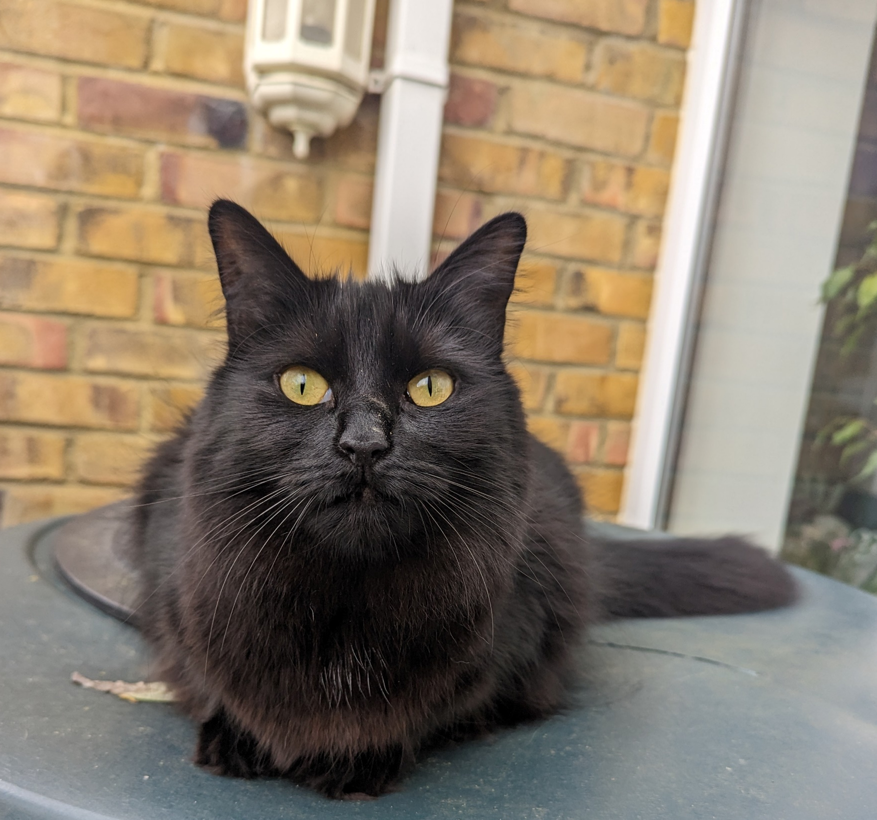
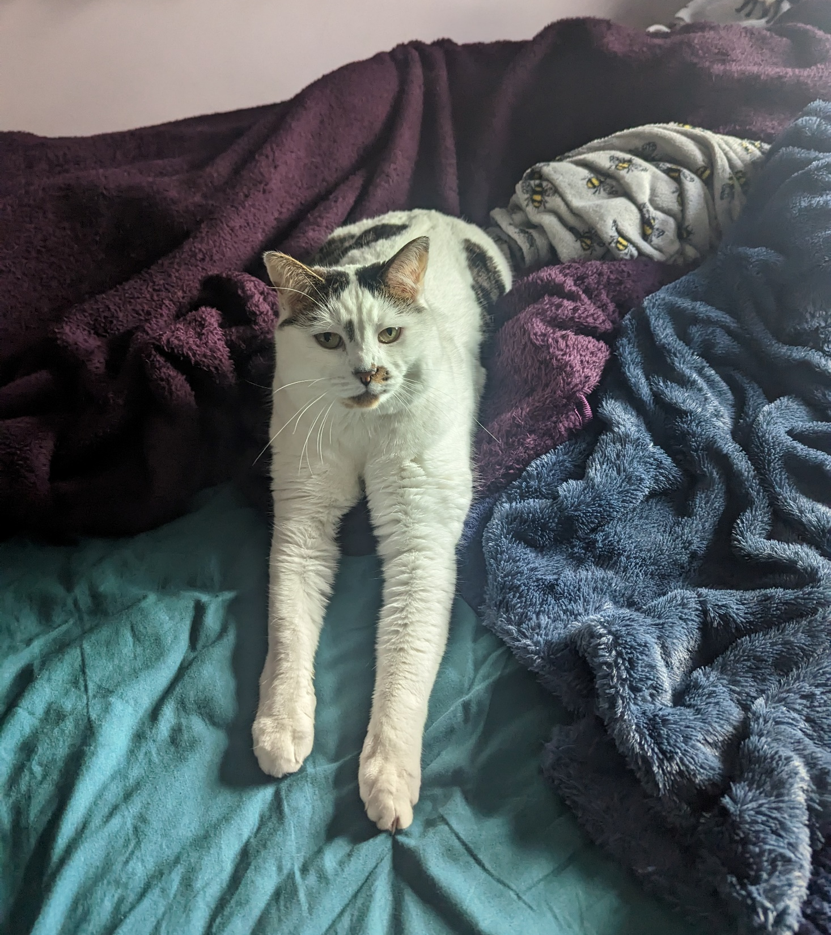
CAT!

Slide 23
Structure of the BSP-CAT

Slide 24
What is the BSP-CAT?
Comprised of 15 components/items for plan evaluation, divided into 6 strands
Each component/item is scored 0-3 based on the quantity and quality of supporting evidence (behaviour support planning documents and associated reports, e.g. communication passports, person centred plans)
Includes a rationale for each component/item and scoring examples throughout
Total score, modal and strand scores can be calculated with categorical quality bandings

Slide 25
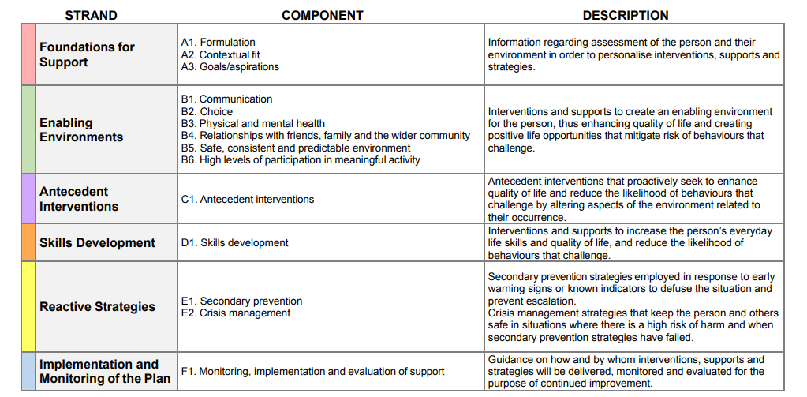
How theoretical and values based components come together in a BSP (assessment, person-centred practices, working with key people..
High quality supports that meet people’s specific needs to support QoL and reduce risk of CB
Interventions that address the particular functions of behaviours that challenge identified for the individual in proactive and constructional ways
Non aversive strategies to minimise risk and escalation and impact of behaviours that challenge when they happen
Strategies to support implementation, monitoring and review

Slide 26
Overview of the BSP-CAT
A) Foundations for Support
A1. Formulation
A2. Contextual fit
A3. Goals/aspirations
B) Enabling Environments
B1. Communication
B2. Choice
B3. Physical health & Metal health
B4. Relationships with friends, family and the wider community
B5. Safe, consistent, and predictable environment
B6. High levels of participation in meaningful activity
C) Antecedent Interventions
C1. Antecedent interventions
D) Skills Development
D1. Skills development
E) Reactive Strategies
E1. Secondary prevention E2. Crisis prevention
F) Implementation and Monitoring of the Plan
F1. Monitoring, implementation and evaluation of support

Slide 27
Particular considerations and assumptions
Learning Disability and Significant CB where a prior FA is required
Relationship between service quality, quality of life and CB (and Mental Heath)
Linking assessment to strategies
Constructive Interventions (including but not always or just FERBs)
Capable Environments
Secondary Prevention and Crisis Prevention
Strategies may be presented across a variety of inter-linked documents
Who used by: people with PBS training/experience – relate to competence framework. Ideally establish reliability with co-raters)
Used to do: research, audit/evaluation, shaping practice for individuals/services, training)

Slide 28
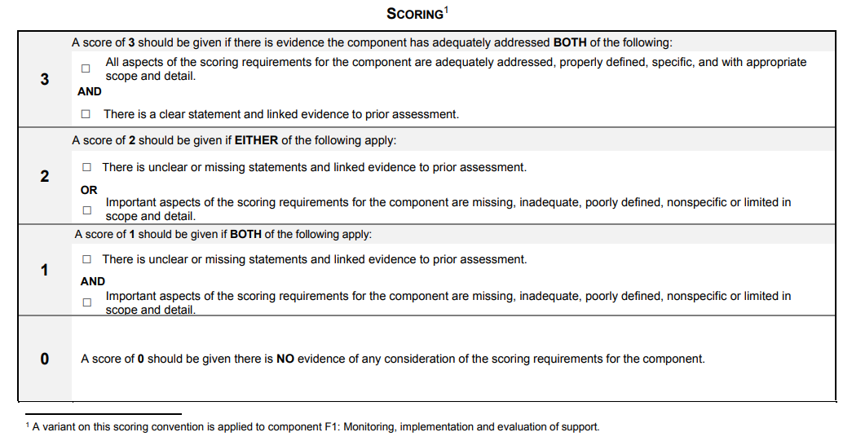

Slide 29
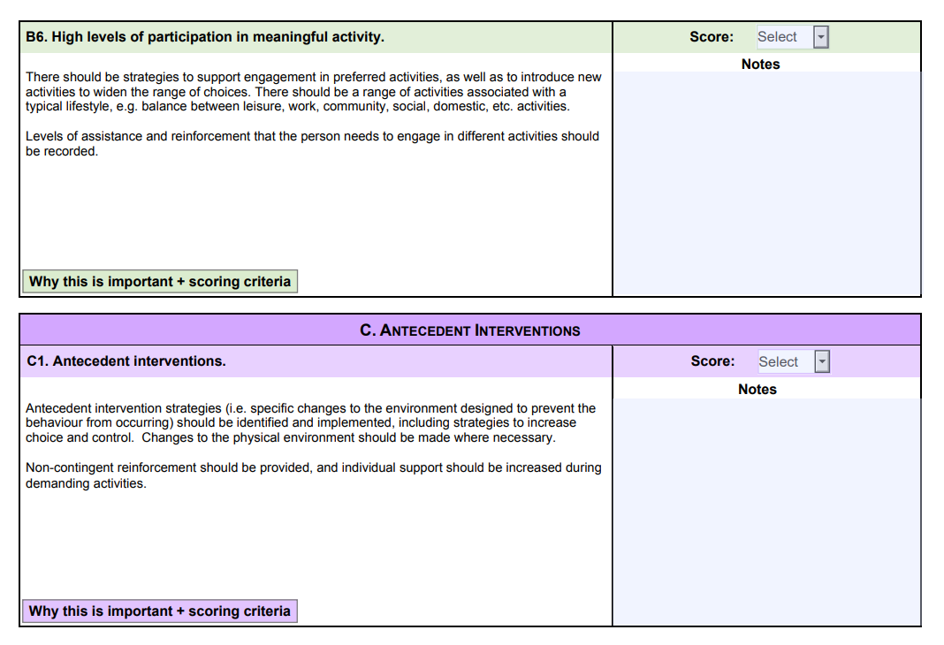

Slide 30
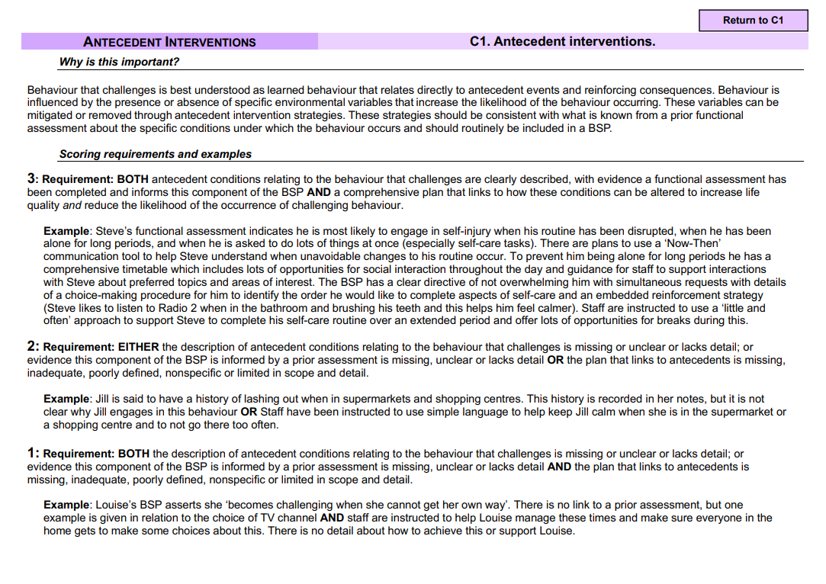

Slide 31
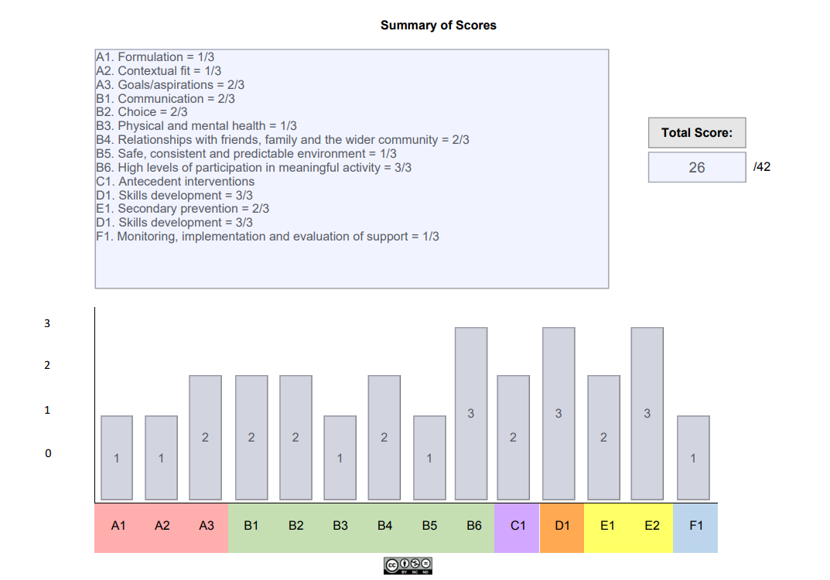

Slide 32
Psychometrics

Slide 33
Timeline of developing and testing the BSP-CAT
Current progress:
Development of BSP-CAT
Content and face validity evaluation
Reliability
testing
Next steps:
If needed, further revisions and testing
Using BSP-CAT

Slide 34
Reliability of an assessment tool
Reliability is the degree to which an assessment tool produces stable and consistent results
This means the same result would be derived whoever administered the test in whatever circumstances
If the measure is reliable then it more likely to be an accurate and true representation of the phenomena it is assessing (in this case the quality of behaviour support plans) – this is termed validity
We need to demonstrate that the BSP-CAT is both reliable and valid

Slide 35
Test-retest data – mean scores (total)

Slide 36
Inter-rater data – mean scores (group)

Slide 37
Discussion
Preliminary statistics only but suggests good inter-rater and test-retest reliability
We recognised the need to revisit Strand C – weaker in terms of test-retest, substantial in terms of inter-rater despite difference in group means
We recognised the need to further increase utility and reliability – additional materials, improve training/bespoke localised training
(Changes following this and stakeholder consultation workshops: All wording refined; scoring logic refined; strand C one antecedent component only; stand E 2 components; Physical health and mental health collapsed into one component)
Will soon be freely available along with training manual fro use by those with appropriate training and experience in PBS

Slide 38
Final Conclusions Reflections and Questions
PBS is an integrative framework of best practice for supporting people with learning disabilities at risk of behaviours that challenge
Behaviour Support Plans are a key aspect of PBS that connect Rights and Values and Theory and Evidence Based components to support Good Lives
The BSP-CAT connects closely to the UK conception and practice of PBS
It can be used to assess quality and content of BSPs with the intention of facilitating better plans and PBS practice overtime

Slide 39
Some questions
How might we best support services and practitioners to access and use the BSP-CAT? (How to make available, orientation, training?)
How could services and practitioners (YOU!) use the BSP-CAT to shape practice and BSP quality?
What other research questions/projects/service developments could make use of the BSP-CAT?
What other tools and resources might be helpful to develop that measure and support implementation of key PBS processes? (And how best could these be designed/created?)

Slide 40
Thank you and final questions
☺
DrNJGore@gmail.com

