Slide 1
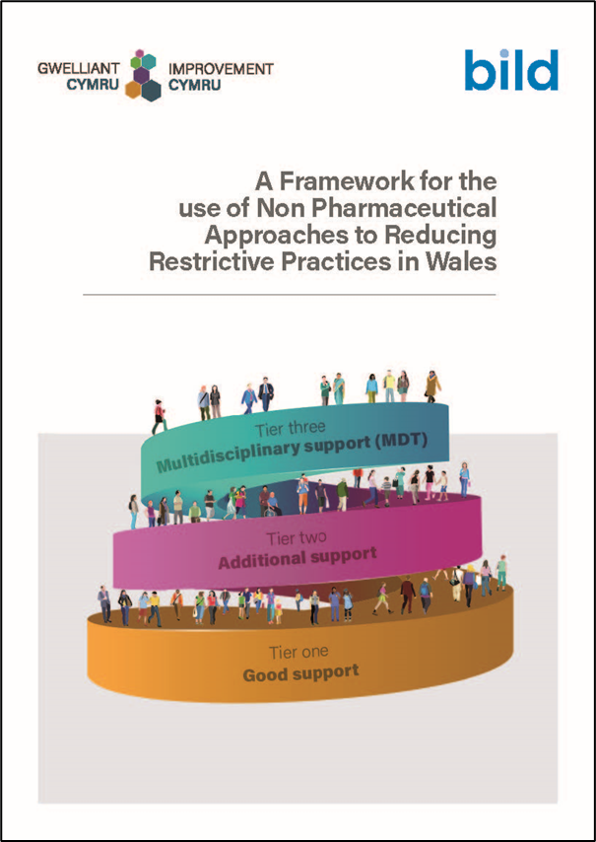
A Framework for the use of Non-Pharmaceutical Approaches to Reducing Restrictive Practices in Wales
David O’Brien
Senior Improvement Manager, NHS Executive Wales

Slide 3
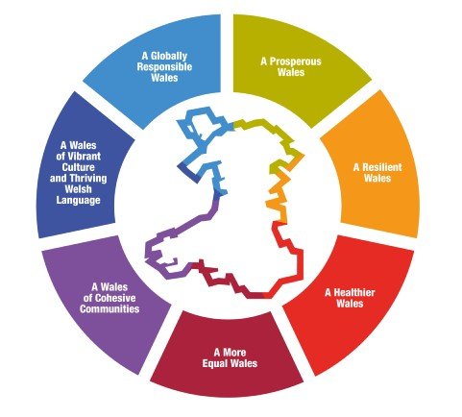
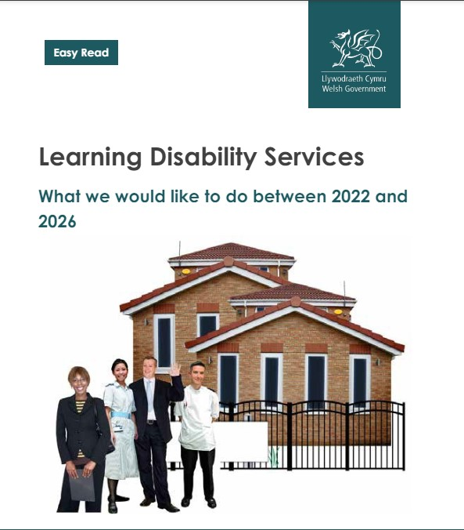
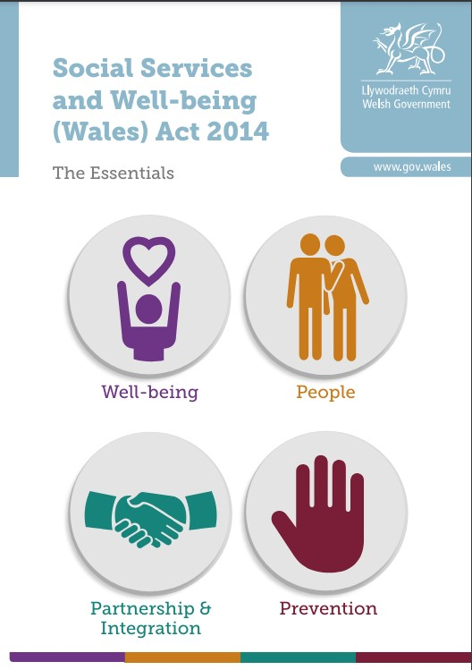
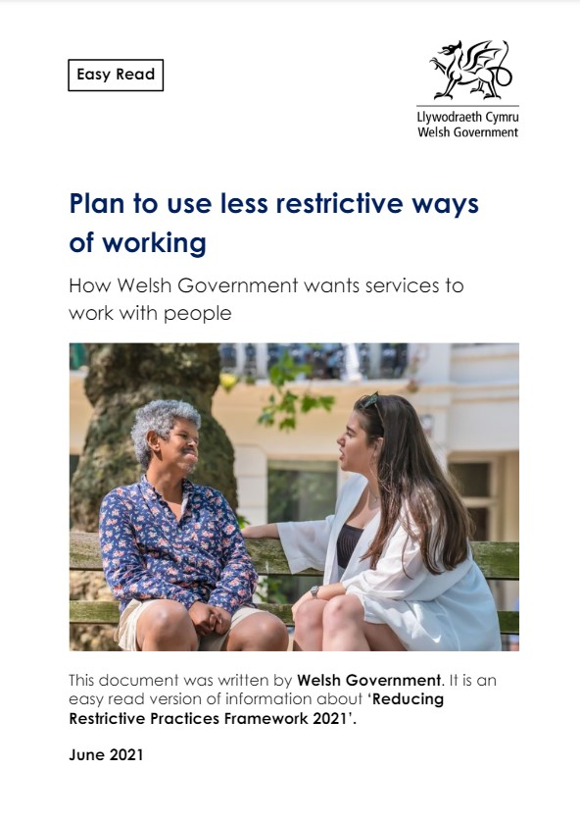
A Future Generations Act
Notes:
The Well-being of Future Generations Act
Putting into law that that future generations have at least the same quality of life as we do now. The act provides for better decision-making by ensuring that public bodies
take account of the long term
help to prevent problems occurring or getting worse
take an integrated approach
take a collaborative approach, and
consider and involve people of all ages and diversity.
This rights based framework supports the commitment the Welsh government has made to reduce the use of unnecessary restrictive practices. The Reducing Restrictive Practices Framework (Wales Government, 2021) tells us that the use of restrictive practices should be within the context of the European Convention on Human Rights) and should be the least restrictive approach.
Reducing the use of all restrictive practices is one of the priority actions in the Welsh Government Learning Disability Strategic Action Plan 2022-2026.

Slide 4
What is the problem are we trying to solve ?
Restrictive practice is an increasingly common feature of care & support
Many adults and children are given medicine for it’s sedative effect
Masks the reason for the behaviour
All chemical restraint carries harmful affects
Wide range of alternative interventions
Notes:
Many adults and children with learning disabilities in Wales and elsewhere are being given medication when they present with behaviours
of concern, but do not have a mental or physical illness. The medication is likely to have been prescribed by a medical professional or in some cases is bought over the counter in a pharmacy.
In 2015, Public Health England (PHE) and Clinical Practice Research Datalink (CPRD) have estimated that every day approximately
30,000 to 35,000
adults with a learning disability are taking psychotropic medicines, when they do not have the health conditions the medicines are for.
They state that psychotropic drugs should only be considered for managing behaviour if:
● psychological or other forms of therapy do not help within an agreed time; or
● treatment for a mental or physical health problem has not improved the behaviour; or
● the risk of harm to the person or others is very severe;
● psychotropic drugs are only used in combination with psychological or other therapies.

Slide 5
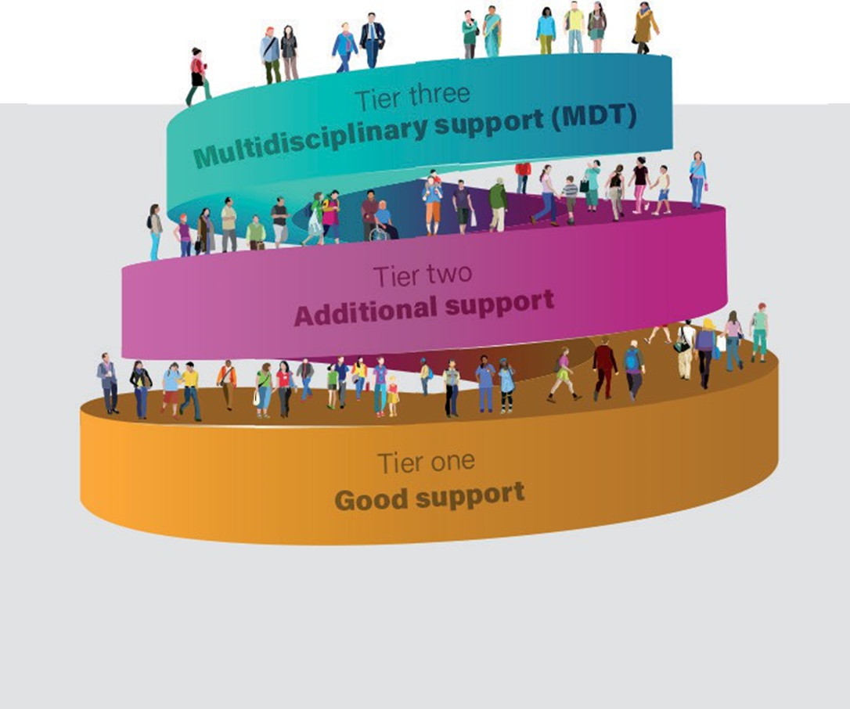
Our Change Idea
Highlight the approaches that are being used successfully in Wales
Explain the key principles of each approach
Link to current policy and guidance
Identify the existing information and resources
Include recommendations on how to implement
Accessible to a range of users

Slide 6
The purpose of this framework
Empowering people to make decisions about their care and treatment
Improving wellbeing
Promoting early intervention and education
Sharing alternative approaches and interventions

Slide 7
How we developed the framework
Online survey (n=120)
Interviews with people with lived experience
Literature review
Developed a draft logic model.
Consulted with the national Task and Finish Group

Slide 8
What we found
85% of respondents or a family member was being given prescribed medication to manage behaviour
Most of these were adults (91%).
92% felt other approaches worked and could be used some of the time.
15% thought medication could be replaced in all cases.
13% felt medication was needed alongside alternative approaches.

Slide 9
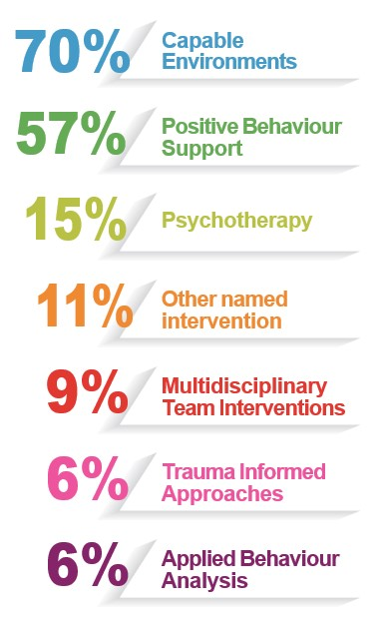
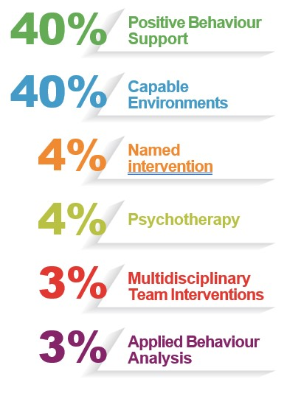
Survey findings: interventions and approaches being used
Notes:
The most frequently mentioned approach could be grouped under ‘capable environments.’ Capable environments are those in which people can thrive and are less likely to utilise behaviours of concern and might include things like having appropriate communication systems in place, having meaningful things to do, having consistent approaches to support, and having sensory needs attended to. Seventy per cent of survey respondents mentioned an approach that fits with the idea of providing capable environments. Another intervention frequently mentioned was Positive Behaviour Support or Behaviour Support Plans (57%). Psychotherapy was mentioned by 15% of people (this covers a range of therapies, including Dialectical Behaviour Therapy, Acceptance Commitment Therapy, Compassion Focused Therapy and other arts based psychotherapy). Other named interventions were mentioned by 11% of respondents (these included PACE approach − described below, Emotional Literacy Support Assistant’s, training in de-escalation, Thrive (trauma informed, whole school approach to mental health and wellbeing), TIS (communication) approach, mechanical horse riding, rebound therapy, music therapy. Also mentioned were multidisciplinary team intervention (9%), trauma informed approaches (6%) and Applied Behaviour Analysis (6%).
People responding to the survey were also asked which approach or intervention they thought was most effective. Thirteen per cent of respondents felt that they could not choose one and that it
was the range of approaches and interventions in combination that were important, or that different things worked for different
people. Of those that were able to highlight just one or two key
40%
40%
4%
4%
3%
3%
Positive Behaviour Support
Capable Environments
Named intervention
Psychotherapy
Multidisciplinary Team Interventions
Applied Behaviour Analysis
interventions or approaches that were most effective for addressing
behaviours of concern (see figure 4), the majority emphasised
Positive Behaviour Support (40%) or facilitating capable environments
(via a range of approaches, 40%). Aside from this, 4% offered another
named intervention as most effective, 4% cited psychotherapy, 3%
multidisciplinary team interventions and 3% Applied Behaviour Analysis.
Based on these survey findings, a literature review was produced on the most frequently mentioned, and these have been incorporated within the tiered approach presented in section 3

Slide 10
Lived experience
Having choice and control
A circle of support
It is not always an alternative to medication. Sometimes we need both
Access to advocacy at the right time
Early intervention via schools
Access to activities, places and opportunities
Knowing where to go to access support
Notes:
People with learning disabilities interviewed reported the following things were important to ensure they had a good life:

Slide 11
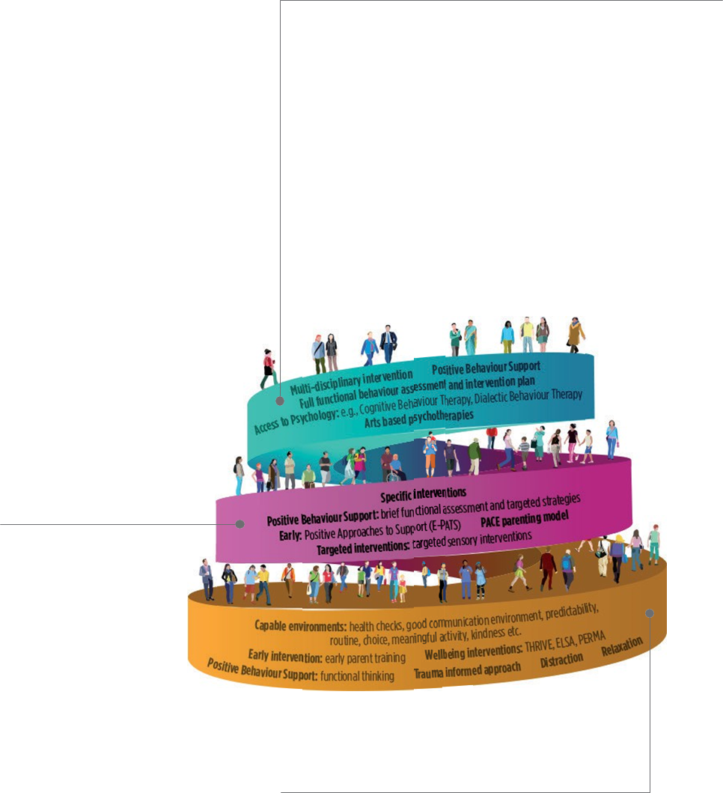
A tiered approach to behavioural support
Tier three: Multidisciplinary support
Tier two: Additional support
Tier one: Good support
Notes:
The first tier is basically good support where people’s needs are met adequately. For people with learning disabilities and families, even access to what should be available to meet basic needs may be difficult, e.g., reasonable adjustments when accessing services. A communication passport that everyone can use is a good example of a tier one support.
In the second tier, which is about 15% of people with learning disabilities at any time, some additional support may be needed for a period of time
For 5% of people with learning disabilities, a multidisciplinary team (MDT) approach and multiple interventions will be needed – this is probably the only tier where medication or even detention might be used too, as a short term intervention to help people stabilise. As both of these options carry potential harms, the MDT should work with the family and the person to enable access to person centred community support, which may be a combination of approaches or interventions. It is not expected that the person will remain in tier three. The right support should mean they can move back down the pyramid as long as other tiers of support are in place.
|Reducing Unwarranted Variation – reduces harm

Slide 12
Implementation
Notes:
Promoting the use of non pharmaceutical interventions in Wales for people with learning disabilities, in the ways outlined in this framework, will involve a range of different stakeholders working together to support the person and their family. Coproduction will need to be a key process to facilitate this. Coproduction as a vehicle for individual care and support planning with the person and their circle of support, as well as coproduction of appropriate wider services.
It is not the aim of this framework to recommend a specific approach or intervention, that is a matter of clinical judgement. However, to facilitate putting this framework into practice, information from policy, the literature review and consultations have informed a number of recommendations which would support putting into practice the approaches and interventions outlined in the tiered approach. This includes activities that need to happen with or by the systems around the person
as well as by commissioners.

Slide 13
How will we evaluate the impact?
Role of services
Role of networks
Role of commissioners

Slide 14
Diolch/ Thank you
Questions

