Slide 1
Engaging Directly with People with Complex Communication Needs to Shape and Inform their Behaviour Support Plans
Dr Nick Gore & Professor Jill Bradshaw
2024

Slide 2
Hello and thank you
Dr Nick Gore
PhD DClinPsy BCBA
Practitioner
Researcher
Behavioural Scientist
People with learning disabilities
& Autistic People
Those that care for and support them
Services and systems
Behaviours that challenge,
Positive Behavioural Support,
Children and young people and early intervention
Gore_{©2024}

Slide 3
This presentation summarises independent research funded by the National Institute for Health and Care Research School for Social Care Research. The views expressed are those of the author(s) and not necessarily those of the NIHR SSCR, the NIHR or the Department of Health and Social Care

Slide 4
What is Positive Behavioural Support (in the UK)? A (very!) quick overview
Gore_{©2024}

Slide 5
Key components of PBS (Gore et al., 2022)
Rights and values: A focus on rights and good lives | 1. Person-centred foundation
 | 2. Constructional approaches and self-determination
 | 3. Partnership working and support for key people
 | 4. Elimination of aversive, restrictive and abusive practices
Theory and evidence base: Ways to understand behaviour, needs, and experience | 5. A biopsychosocial model of behaviour that challenge
 | 6. Behavioural approaches to learning, experience and interaction
 | 7. Multi-professional and cross-disciplinary approaches
Process and strategy: A systematic approach to high quality support | 8. Evidence informed decisions
 | 9. High quality care and support environments
 | 10. Bespoke assessment
 | 11. Multi-component, personalised support plans
 | 12. Implementation, monitoring and evaluation
Gore_{©2024}

Slide 6
Rights and Values
Find out what people need, want and like - pick goals that are right for each person.
Find the right ways to help people develop skills, express themselves and influence what happens
NOT doing (and stopping) things that cause pain, shame or fear.
Key people are supported and work together to decide what is important and to make changes
Gore_{©2024}
Notes:
Nick

Slide 7
Theory and Evidence Base
Includes lots of other evidenced-based approaches that are in line with ‘Rights and Values’ of Positive Behavioural Support and brings things together in a functional biopsychosocial model…
Uses behavioural science, including ABA, to understand and support people
Gore_{©2024}

Slide 8
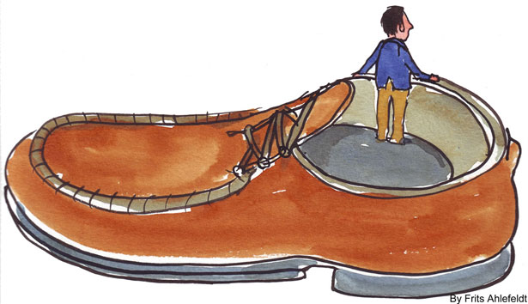
Process and Strategy
How when and why someone displays behaviours that challenge
‘An act of empathy’
Bespoke
Comprehensive
Data driven
In partnership
Flexibility to fit the situation
Directly informs plans for support
Functional Assessments
Gore_{©2024}

Slide 9
Behaviour Support Plan
Multicomponent plans bring together information from functional assessments with person-centred goals.
Multicomponent plans have lots of support strategies that:
Support good lives for people with learning disabilities and key people in their lives
Reduce the occurrence and impact of behaviours that challenge.
Gore_{©2024}

Slide 10
Whose Behaviour Is it anyway?!
PBS demands:
Participation with key people at every stage of a clinical pathway
Interventions and outcomes that are personalised and high in social validity
BUT support is often determined by someone other than the person who will be receiving that support – so reflecting their needs and priorities and demands, rather than those of the individual in question
If individual’s themselves are helped to determine dimensions of their own support this is more likely to connect to meaningful life areas, fit with their circumstances and preferences and support personalised enhancements in life quality.
Gore_{©2022}

Slide 11
So How?
Those requiring behavioural support often present with additional communication needs and live in systems that limit choice making and control
In these contexts a range of behavioural methods are critical for helping understand what is important to people and why they do what they do (e.g., preference/reinforcer assessments; direct observation)
We need to expand the range of effective technologies (in the context of constructional approaches and self-determination)

Slide 12
Notes:
How a person is supported, what their life is like and behaviours that challenge are all linked. Behaviours that challenge are less likely to happen when a person is having a good life and getting good support. Behaviours that challenge are more likely to happen when a person is having a bad life and getting poor support.
The goals of Positive Behavioural Support are to make sure people have a good life and to reduce behaviours that challenge and any impact that these have.

Slide 13
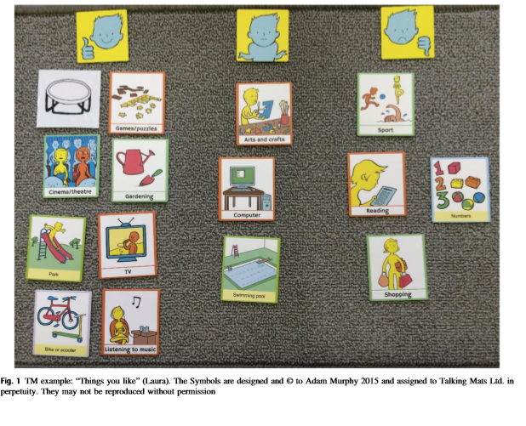
Talking Mats
Visually based communication tools that enable people to organise and express their views.
Typically used with people with communication difficulties (Mitchell & Sloper, 2011; Watson, Cameron and Murphy, 2003)
Involve placement of visual symbols to indicate an individual’s thoughts or feelings on a given topic area
Gore_{©2022}

Slide 14
Talking Mats®

Slide 15
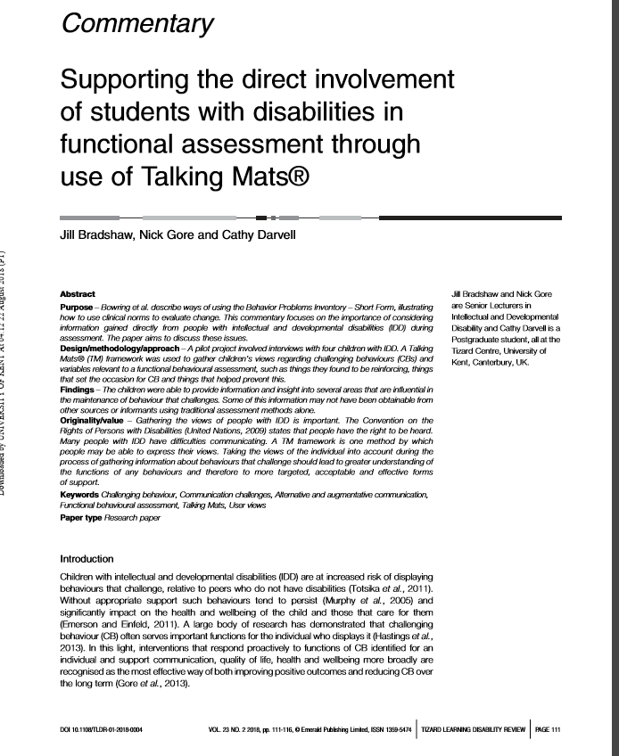
Direct Involvement of Students with IDD in Functional Assessment Work
3 young people with learning disabilities
Things I like (reinforcers)
Things I do (challenging behaviour)
Things that help on a bad day (de-escalation strategies)
Things that make for a bad day (setting events, MOs, discriminative stimuli)

Slide 16
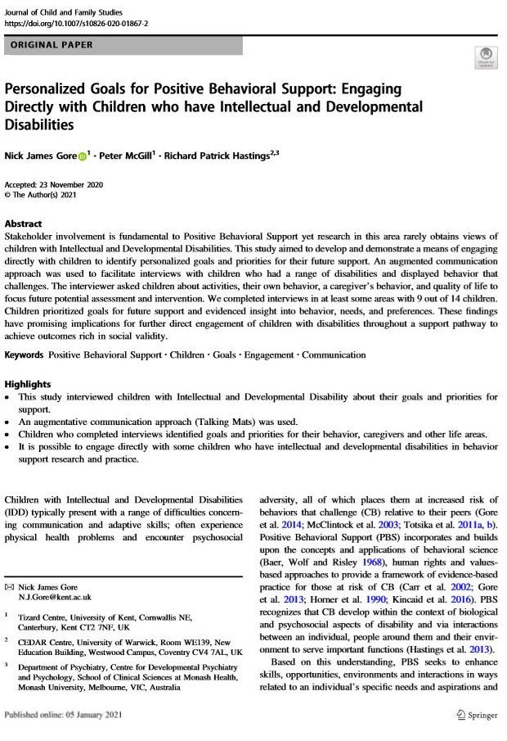
Direct Involvement of Students with learning and developmental disabilities in selecting Goals Selection for PBS
Things I like to do (reinforcers and preferred activities)
Things I’d like to do more (adaptive behaviours)
Things I’d like to do less (challenging behaviours)
Things others do (caregiver behaviours)
Things that are important (Quality of Life)
Gore_{©2022}

Slide 17
Notes:
How a person is supported, what their life is like and behaviours that challenge are all linked. Behaviours that challenge are less likely to happen when a person is having a good life and getting good support. Behaviours that challenge are more likely to happen when a person is having a bad life and getting poor support.
The goals of Positive Behavioural Support are to make sure people have a good life and to reduce behaviours that challenge and any impact that these have.

Slide 18
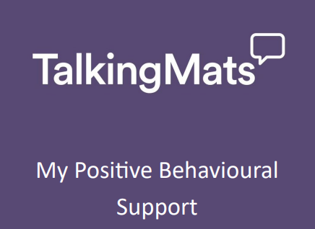
My Positive Behavioural Support
Support people in the creation of their own BSP
Used by people with prior TM training and experiences of PBS
Manual, training materials plus stimuli for 6 TMs
N.J.Gore@gmail.com to find out more on how to access

Slide 19
The Talking Mats
Activities – This mat aims to identify activities that people enjoy doing. Supporting someone to do the things they like doing increases their quality of life and reduces the risk of Behaviours that Challenge.
My Skills – This mat aims to identify skills people have. This includes daily living, social and coping skills. Supporting someone to build on their strengths and develop their skills increases their quality of life and reduces the risk of Behaviours that Challenge.
My Behaviours (Behaviours that Challenge) – This mat focuses on behaviours that challenge. It provides opportunities for someone to identify the behaviours that challenge that they display. It is important to identify particular behaviours that challenge as a focus for assessments and support planning in Positive Behavioural Support. The other mats in this resource contribute to helping understand when and why behaviours that challenge occur.
Notes:
Finding ways for people to do more of the things they enjoy is an important part of a Behaviour Support Plan.
Finding ways to build on people’s strengths and to support areas of need is an important part of developing a Behaviour Support Plan.

Slide 20
The Talking Mats
Things in my life part 1 – This mat explores how people are feeling about environments, situations, interactions and other things in their life. It is important to identify things that people might ﬁnd diﬃcult and things people are generally ﬁnding ok. Making helpful changes and supporting some-one to manage things they ﬁnd more diﬃcult increases their quality of life and reduces the risk of Behaviours that Challenge. These are sometimes referred to as antecedent strategies and are important part of developing a Behaviour Support Plan.
Things in my life part 2 – This mat explores things that a person might ﬁnd helpful or less helpful when they are experiencing diﬃculties. At times of diﬃculty, someone is more likely to display behaviours that challenge. It is important to identify things that might help people to cope at these times. Supporting someone in ways that help them to cope increases their quality of life and reduces the risk of Behaviours that Challenge. These strategies may relate to times of diﬃculty prior to, during or following episodes of Behaviours that Challenge.

Slide 21
The Study
Using the Talking Mats My Positive Behavioural Support Resource with an adults with intellectual disabilities to update a Positive Behavioural Support Plan.
We recruited 24 practitioners working with adults with intellectual disabilities who are supported in adult social care settings. (4 male and 20 female)
Foundation Training in Talking Mats (4 already trained)
Short video (less than 30 minutes) outlining the research process and providing information about how the information gained from the Talking Mats My Positive Behavioural Support Resource might be used in a Behaviour Support Plan
Invited paid and family carers who support and care for the individual to take part in stage 2.
Read the updated PBS Plan and complete a survey
We recruited 14 paid and family carers.
Notes:
Of the 24, one withdrew, one only took part in stage 1, 3 did not complete the foundation training,
Practitioner Survey
Participants who created the BSP using the toolkit were invited to take part (anonymously) in an online survey created through Qualtrics. This survey asked practitioners to rate the extent to which the toolkit helped them to understand something new about the person they supported and whether the toolkit was useful. They were also asked to rate the guidance provided, whether experiences of using the toolkit were positive, whether or not useful information was provided, to identify any difficulties and to identify anything that would have made the tool better. We also asked questions about the particular parts of the tools that had been used (e.g., which Mats). A total of 40 questions were asked, typically using a 5-point Likert scale.
Stakeholder Survey
Participants who were stakeholders were asked to (anonymously) complete a different online survey, again created through Qualtrics. In this survey, stakeholders were asked to rate the extent to which the plan was helpful in understanding the person with ID with respect to key elements of a high quality BSP (e.g. around foundations for support, enabling environments, antecedent interventions, skills development, reactive strategies). Stakeholders were also asked to rate the perceived involvement of the person with ID in developing the plan and the ways in which the plan reflected the experiences of the person. A total of 28 questions were asked, typically using a 5-point Likert scale.

Slide 22
Results
19 participants completed required training, used the toolkit to develop a new Behaviour Support Plan and completed the survey
Practitioners reported that the training and guidance provided was useful
Mat completion was mostly within 20 minutes (63%)
The majority of practitioners completed all mats
Mat 1 (activities) (95%)
Mat 2 (functional skills) (84%)
Mat 3 (topographies of behaviours that challenge) was competed (58%)
Mat 4 ( environments, situations and events that may be difficult for people) (89%)
Mat 5 (what helps when things are difficult) (63%)
Notes:
Practitioners
A total of 19 practitioners were recruited to this stage of the study. This sample comprised 16 females (and 3 males), 16 people who had used PBS for more than 5 years (and who had used PBS for 1-5 years)
Stakeholders
A total of 14 stakeholders were recruited to the second stage of the study and completed the second questionnaire, having read a newly created BSP. This comprised 10 females (and 4 males), 7 of whom had been using PBS for more than 5 years, 6 who had used PBS for 1-5 years, and 3 who had used PBS for less than one year and three of these were family carers.
Training Adherence
All participants in stage 1 (n=19) completed required training (TM training where required and viewing of the toolkit video). Furthermore, all participants used the toolkit to develop a new Behaviour Support Plan and all participants went on to completed the survey.
Survey Findings
Practitioner Survey
Guidance
Practitioners reported that the training and guidance provided was useful with 74% rating this to be really or mostly helpful (highest possible ratings) and 16% as quite helpful.
Completion of mats
The majority of practitioners completed the first mat in the toolkit focussed on preferred activities (95%) with many also completing the mat focussed on functional skills (84%) and the mat relating to environments, situations and events that may be difficult for people (89%). The mat concerning things that the person might find more helpful or less helpful when they are experiencing difficulties was completed to a lesser extent (63% of participants) and the mat focused on topographies of challenging behaviour was competed the least (58% of participants). Most practitioners (64%) reported to have completed a mat within a 20 minute period

Slide 23
Results
Experience of using the toolkit
100% ‘listeners’ really/mostly enjoyed using it
Practitioners reported that the ‘thinker’ mostly/really enjoyed using (84%) experience
All practitioners thought that the toolkit helped then understand the person they were supporting without judgement
Helpfulness of each mat
Identify activities person enjoys (84%)
Understand skills that might be helpful for person (79%)
Understand the types of behaviours the person displays (56%)
Understand how the person is feeling about environments, situations and events that may be difficult (90%)
Understand what helps when experiencing difficulties (74%)
Notes:
Practitioners
Practitioners
A total of 19 practitioners were recruited to this stage of the study. This sample comprised 16 females (and 3 males), 16 people who had used PBS for more than 5 years (and who had used PBS for 1-5 years)
Stakeholders
A total of 14 stakeholders were recruited to the second stage of the study and completed the second questionnaire, having read a newly created BSP. This comprised 10 females (and 4 males), 7 of whom had been using PBS for more than 5 years, 6 who had used PBS for 1-5 years, and 3 who had used PBS for less than one year and three of these were family carers.
Training Adherence
All participants in stage 1 (n=19) completed required training (TM training where required and viewing of the toolkit video). Furthermore, all participants used the toolkit to develop a new Behaviour Support Plan and all participants went on to completed the survey.
Survey Findings
Practitioner Survey
Guidance
Practitioners reported that the training and guidance provided was useful with 74% rating this to be really or mostly helpful (highest possible ratings) and 16% as quite helpful.
Completion of mats
The majority of practitioners completed the first mat in the toolkit focussed on preferred activities (95%) with many also completing the mat focussed on functional skills (84%) and the mat relating to environments, situations and events that may be difficult for people (89%). The mat concerning things that the person might find more helpful or less helpful when they are experiencing difficulties was completed to a lesser extent (63% of participants) and the mat focused on topographies of challenging behaviour was competed the least (58% of participants). Most practitioners (64%) reported to have completed a mat within a 20 minute period
Experience of using the toolkit
Practitioners seemed to really enjoy using the toolkit, with 100% reporting to really or mostly enjoy using it (the highest possible ratings). Practitioners also felt that the person they were engaging with through the toolkit (the ‘thinker’) also enjoyed this experience, with 84% rating tis perceived enjoyment as mostly or really (the highest possible ratings). All practitioners thought that the toolkit helped then understand the person they were supporting without judgement, with 84% giving this the two highest possible ratings.
Helpfulness of each mat
Table 1 reports percentages of practitioners who reported the highest ratings (mostly or really) when asked how helpful each mat in the toolkit was for identifying relevant information and providing insights.
The vast majority of practitioners reported that the mats 1, 2, 4 and 5 were very helpful in eliciting information and insights. Practitioners reported mat 3 (focused on topographies of challenging behaviour) to be less helpful (but it is important to note that far fewer participants had actually utilised this mat and these ratings may therefore have reflected assumptions rather than direct experience).

Slide 24
Results
Behaviour Support Plan Quality
The majority of participants (69%) gave the highest possible ratings (really/mostly) when asked how helpful information derived from using the tool kit was for developing a new BSP.
All practitioners rated the new BSP they created (based on use of the toolkit) as being of better quality than their prior BSPs, with 62% rating this as better in many ways or lots better (the highest possible ratings).
Stakeholder responses indicated that the newly developed BSP was highly personalised, captured important information about the focal person, was highly individualised and presented the person in a non-judgemental and positive light.
Notes:
The majority of participants (69%) gave the highest possible ratings (really/mostly) when asked how helpful information derived from using the tool kit was for developing a new BSP. All practitioners rated the new BSP they created (based on use of the toolkit) as being of better quality than their prior BSPs, with 62% rating this as better in many ways or lots better (the highest possible ratings).
Stakeholder responses indicated that the newly developed BSP was highly personalised, captured important information about the focal person, was highly individualised and presented the person in a non-judgemental and positive light.

Slide 25
Results
“The staff who were on duty thought it was amazing and want everyone we support to have a session”
“Very impressed with the information gleaned in the PBS plan”
“Just to let you know, I really enjoyed doing the Mats with this individual, and I think the PBS Plan is much more person-centred than a former version because of it!”
“The quality and quantity of information elicited was much more than the person’s support worker had expected and the thinker really found talking mats useful and is keen to do more.”

Slide 26
Conclusions
Adults with intellectual disabilities should and can be engaged directly in behaviour support planning.
Initial evaluation indicates that The Talking Mats My Positive Behaviour Support Resource shows promise.
Involvement is dependent on prior training and experience of staff with regards Talking Mats and Positive Behavioural Support.
This concerns both the procedural dimensions of these approaches together with the values and attitudes inherent to these approaches.
Ensuring cultures that are person-centred and evidence-based remains a key priority for Adult Social Care.

Slide 27
Questions
☺

