Slide 1
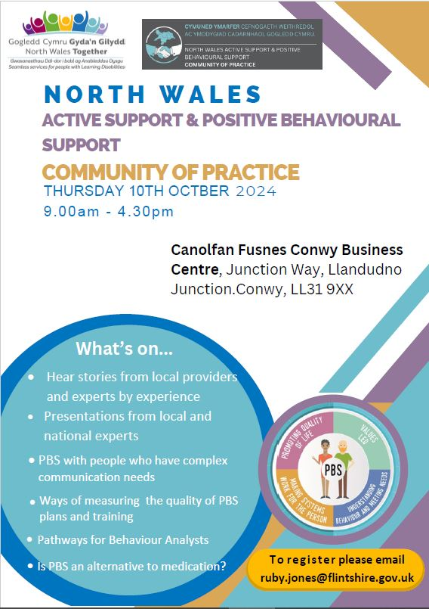
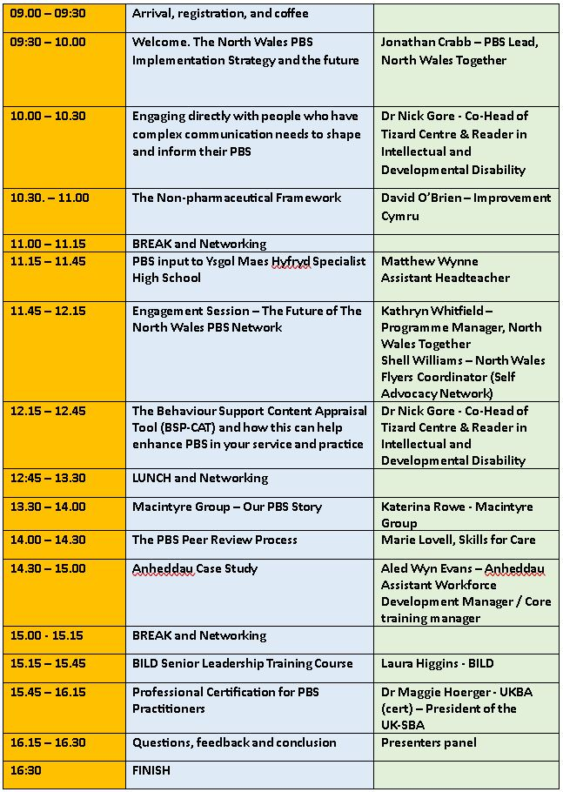

Slide 2
North Wales Positive Behavioural Support (PBS) Implementation Strategy
Strategaeth Gweithredu Cefnogaeth Ymddygiad Cadarnhaol (CYC) Gogledd Cymru
Shell Williams
North Wales Flyers Coordinator / Cydlynydd ar gyfer Ehedwyr Gogledd Cymru
Jonathan Crabb
North Wales PBS Specialist Lead / Arweinydd Arbenigol CYC Gogledd Cymru
North Wales Together / Gogledd Cymru Gyda’n Gilydd
North Wales CoP / Cymuned Ymarfer Gogledd Cymru
October 10th 2024 / 10 Hydref 2024

Slide 3
Gwybodaeth ymarferol Housekeeping
Introductions
Toilets
Lunch and breaks
Timekeeping
Fire exits
Mobile phones
Respecting and valuing each other
Cyflwyniadau
Toiledau
Cinio ac egwyl
Cadw amser
Allanfeydd tân
Ffonau symudol
Parchu a gwerthfawrogi ein gilydd
Notes:
Photo taking consent. I would also like to introduce Belinda Bradley who has joined us as in North Wales Together as a Planning and Development Officer, and I am particularly pleased that part of her role is supporting our PBS Implementation Strategy. I know Belinda is keen to get to know everyone so please feel free to introduce yourself to her during breaks and lunch.

Slide 4
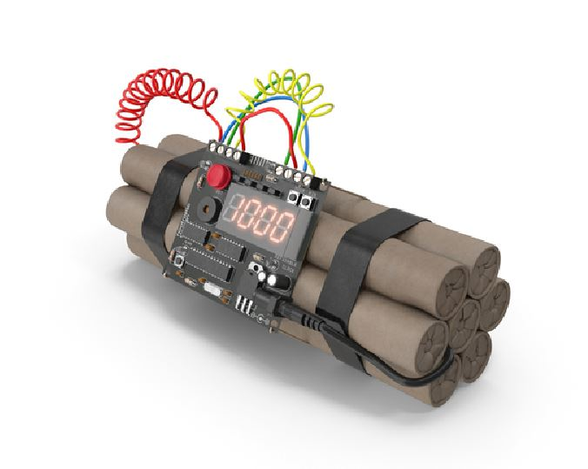
What we’ve been doing about PBS in North Wales over the last two years (and particularly since January)
In 25 minutes Aaargh!
Notes:
I’m going to tell you a story. Sadly, not about pirates but about

Slide 5
Background
North Wales Together
Regional integration Funded to 2027
Innovation and delivery of projects that
will benefit from being delivered regionally
Accommodation model of care
Accommodation planning
Workforce (including PBS)
Intermediate care
Appointed Consultant to lead the strategy
Notes:
The NW LD Partnership were able to gain funding from the Regional Integration fund for the following workstreams. Our PBS focus came within the accommodation and workforce workstream that led to me being employed as a Consultant to lead the PBS Implementation Strategy. The work we do is based on the NW LD Strategy

Slide 6
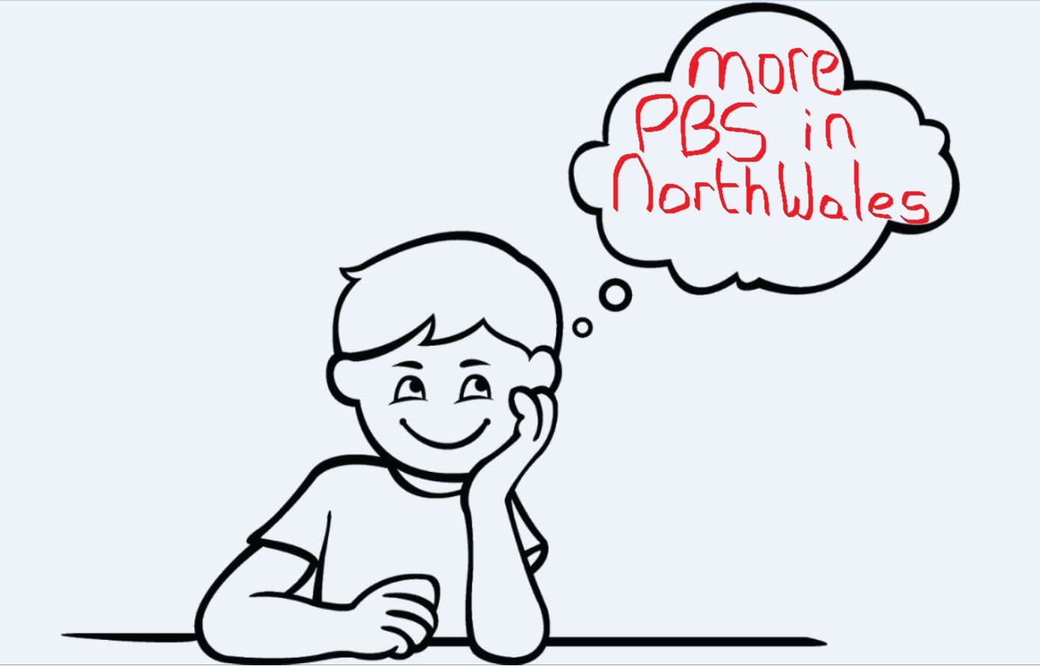
Notes:
With the exponential growth of PBS, both nationally and internationally, many providers are aware that in order to be keeping up with best practice, they should be using PBS.
This can often lead to something we call the glossy brochure syndrome – when the organisational brochure proudly proclaims the use of PBS but if you skim beneath the surface the quality just isn’t there.

Slide 7
Good PBS?
Person not involved
Not based on functional behavioural assessment
Scattergun approach to training
No whole system approach
Staff not trained in PBS
Staff not trained in the use of X’s PBSP
PBSP lives in a drawer and is wheeled out for special occasions (e.g. audit or annual review)
Focus on problem behaviour rather than quality of life
Lack of consistency and practice leadership
PBS?

Slide 9
Establish a North Wales steering group of PBS experts and drivers:
Carrie Shield – Specialist Behavioural Support Service (BCUHB)
Dr Alan Dowey - Consultant Clinical Psychologist / Head of Adult Clinical Psychology (Learning Disabilities) (BCUHB)
Andrew Guy – PBS Lead, Gwynedd County Council
David O’Brien - Senior Improvement Manager, Improvement Cymru
Sarah Horton – Children and Families Support Services Manager, Anglesey County Council
Dr Jason Devereux – Advanced Nurse Practitioner in PBS (BCUHB)
Emma Edwards – Community Support Coordinator, Conwy Council
Heather Henry – Project Team Manager, Wrexham Council
Jo Price – Education & Development Lead – BILD
Shell Williams – North Wales Flyers Coordinator (Self Advocacy Network)
Belinda Bradley - Planning and Development Officer, North Wales Together
Kathryn Whitfield – Programme Manager, NWT
Jonathan Crabb – PBS Specialist Lead, North Wales Together
Notes:
I assembled a group of PBS experts and drivers who probably thought their input would look like this.
But their driving probably looked more like this, it probably looked more like this

Slide 10
Goal
To increase the prevalence and quality of good PBS within North Wales
Notes:
I use the term ‘ good PBS’ to distinguish from the sometimes use of the term to refer to poor quality practice that is not deserving of its name. I would love to tell you about the exponential growth of PBS and how it has led to the ‘Glossy brochure syndrome’ but I don’t have time so feel free to ask later or email me. We decided to make reference to good PBS to be able to tell people that there was a difference

Slide 11
Promote awareness of ‘good’ PBS and its worth and benefits
Provide support, guidance and funding to help access accredited PBS training and develop Practice Leadership
Increase the prevalence and quality of good PBS within North Wales
Establish a North Wales PBS Community of Practice
Develop a network of PBS practitioners that can share information and support each other
Notes:
We identified the following aims:

Slide 12
We joined the UK PBS Alliance ☺ https://www.bild.org.uk/uk-pbs-alliance/
Very helpful to hear about the experiences from other networks / alliances and to be able to ask about how challenges were resolved e.g. communicating with members

Slide 13
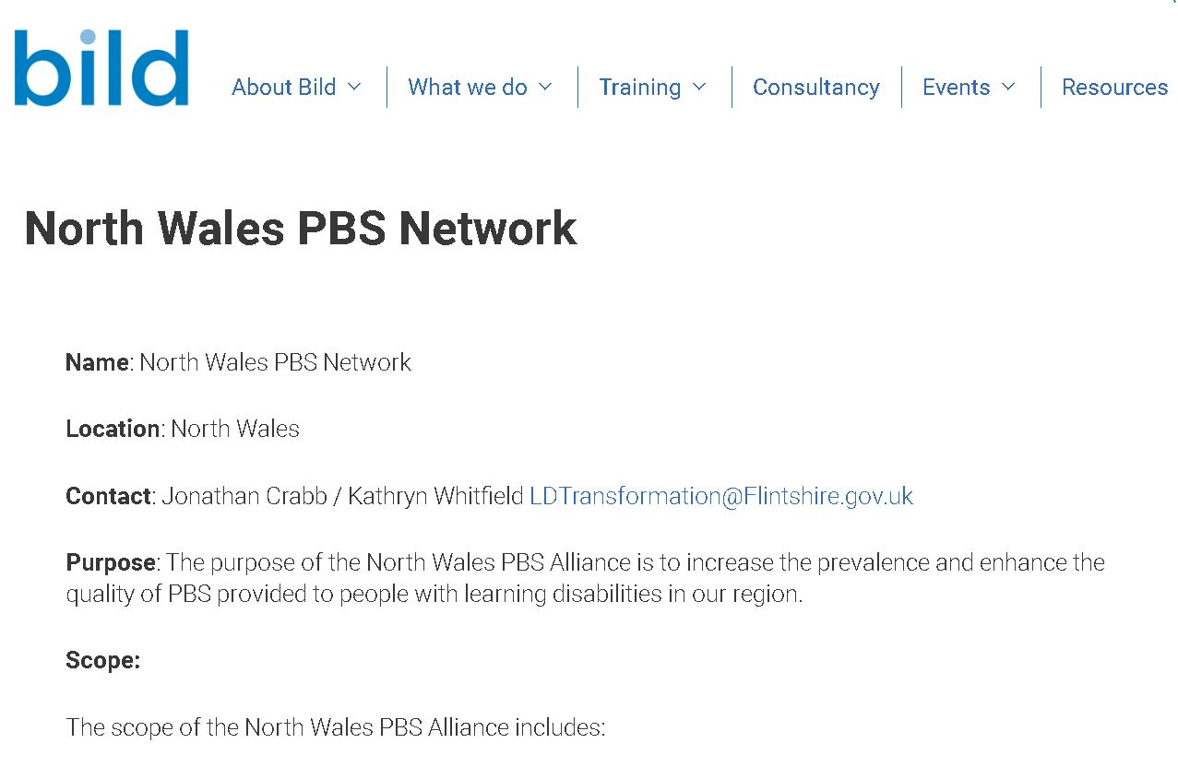

Slide 14
Provide support, guidance and funding to help access accredited PBS training and develop Practice Leadership
Increase the prevalence and quality of good PBS within North Wales

Slide 15
Training
Funding for PBS training
Offer support to organisations to articulate a PBS training and development strategy that embraces Practice Leadership and a Whole Systems approach.
A train the Trainers model could be an invest to save model focused on longevity
To arrive at a destination of internal capability and fluency to deliver internal high quality PBS training without further external funding
Supported by BILD and SBUHB

Slide 16
North Wales Together: Supporting BILD PBS Senior Leadership Programme
NWT are investing in funding a BILD Senior Leadership programme
This course will enable participants to think strategically about what support they need to put in place in order to be able to implement PBS fully within their organisation.
Notes:
North Wales Together is a Regional project funded through Welsh Government monies until 2027.
We have recognised that to create maximum potential for PBS growth and quality in our region, we need to raise the awareness of Senior Leaders, Budget Holders and Commissioners and to support the development of PBS champions and leaders within organisations
Our prioritisation for funding is therefore focusing more now on the provision of training for these cohorts.
This will be achieved through promoting this model, combined with funding of the BILD Senior Leadership Training programme and Coaches / higher level PBS Btech courses.
The programme work on 6 workstreams, helping to develop approaches that would benefit from being delivered regionally.
Examples of the other workstream projects are;
the health check champions,
Step up Step down developments in BCUHB,
the family transitions project delivered by Conwy Connect.
The supported employment model currently being piloted in central and just about to be called up to the whole region.

Slide 17
Promote awareness of ‘good’ PBS and its worth and benefits
Increase the prevalence and quality of good PBS within North Wales

Slide 18
Leaflets
North Wales Positive Behaviour Support Implementation Strategy. January 2024
North Wales Positive Behaviour Support – Planning together to make things better (Easy Read). March 2024
Content:
What is PBS?
What is good PBS and what does that look like?
What are we doing about that?
How to get help with PBS development in North Wales

Slide 20
Increase the prevalence and quality of good PBS within North Wales
Establish a North Wales PBS Community of Practice

Slide 21
Inaugural North Wales PBS CoP January 2024
Inspired by All Wales CB CoP and Active Support CoP
Sold out of initial venue (capacity 50) after 48 hours
Booked bigger venue (150) and filled it to capacity
Key ingredients:
Face to face
Stories from experts by experience
Stories from local service providers
Presentations from local and National experts
Engagement session
Networking opportunities
And Tony Osgood!

Slide 22
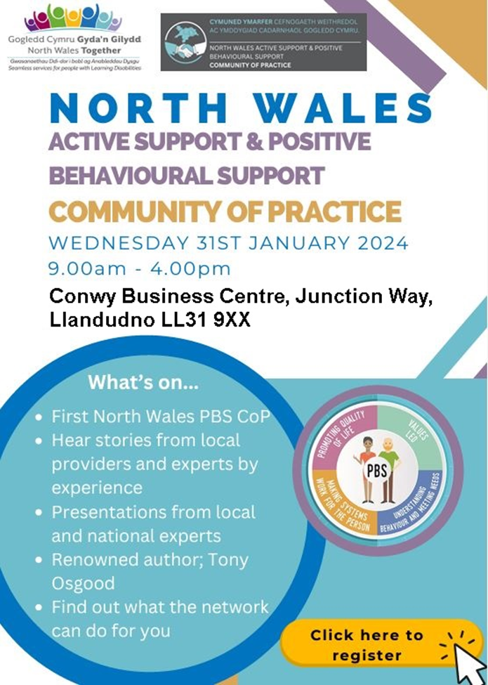
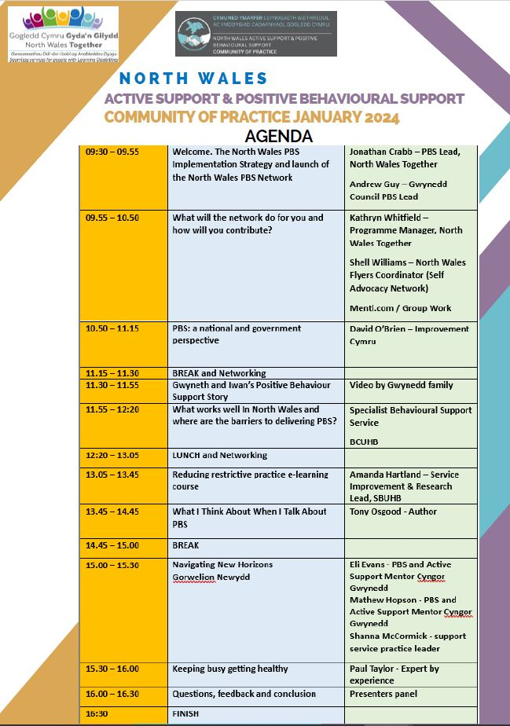

Slide 23
Increase the prevalence and quality of good PBS within North Wales
Develop a network of PBS practitioners that can share information and support each other

Slide 24
Network of PBS practitioners
Network was launched at first PBS + AS CoP January 31st 2024
Establish means whereby North Wales PBS Practitioners can help inform, develop and support each other
Information and presentations from CoP on our Website: https://northwalestogether.org/

Slide 25
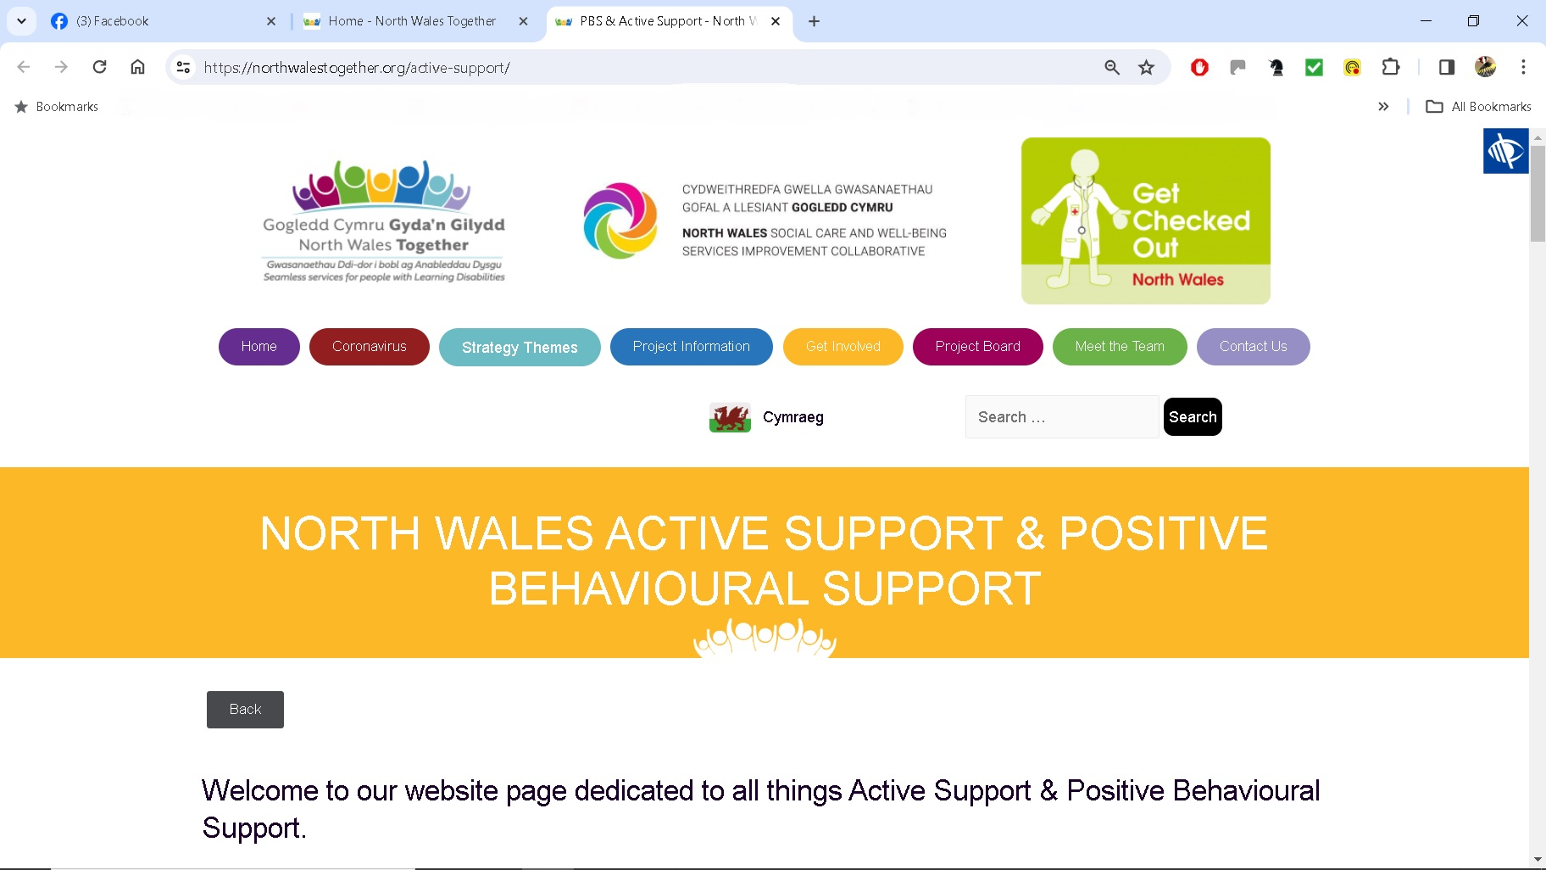

Slide 26
https://northwalestogether.org/active-support/

Slide 27
County Groups
Localised model of supporting PBS engagement and development
Ownership by the county
Chair does not have to be a PBS expert (member of steering group)
Chair needs to have well established networks with providers
Create opportunity to talk about and develop PBS
Develop TOR (the hardest bit!)
Goal: To increase the prevalence and enhance the quality of PBS in X county
Supportive environment that recognises everyone will be in a different stage of their PBS journey
A ‘round robin’ inviting each attendee to provide an update on how they are developing and implementing PBS
Sharing of information & resources by participants
NWT to provide local and national update from UK PBS Alliance
Link to the North Wales PBS Network and Community of Practice

Slide 28
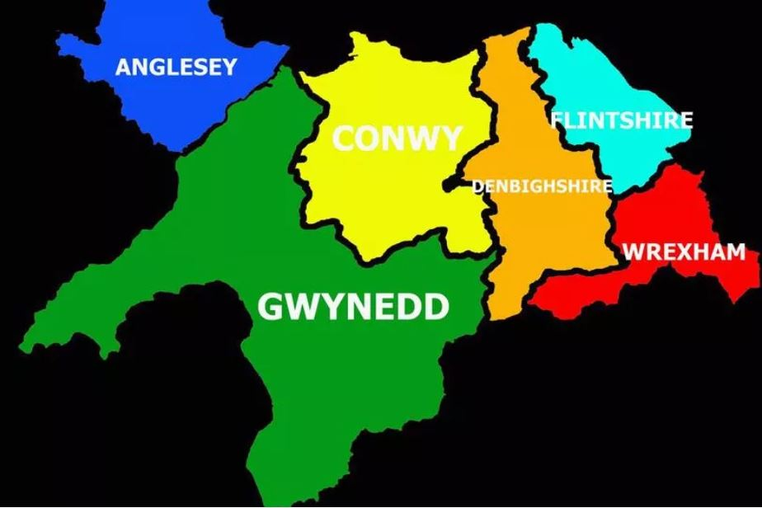
North Wales County Groups
Wrexham – up and running
Heather Henry
Heather.Henry@wrexham.gov.uk
Conwy – up and running
Emma Edwards
emma.edwards1@conwy.gov.uk
Gwynedd – just launched
Andrew Guy
andrewguy@gwynedd.llyw.cymru
Anglesey – about to launch
Sarah Horton
SarahHorton@ynysmon.llyw.cymru
Denbighshire – searching for Champion
Flintshire – Searching for Champion

Slide 29
UK PBS Alliance
North Wales PBS Network
County Groups
Communication

Slide 30
Values
Inclusion
Kindness
Empathy
Co-production
Openness and honesty
Desire and willingness to help others
Good partnership working and teamwork
The value of stories

Slide 31
Conclusion
If you provide support to people with learning disabilities in North Wales and are interested in developing PBS, you are welcome to talk to us at
Ldtransformation@flintshire.gov.uk
Thank you for listening ☺

