Slide 1
Good Morning/Bore Da
paulwt.234@gmail.com

Slide 2
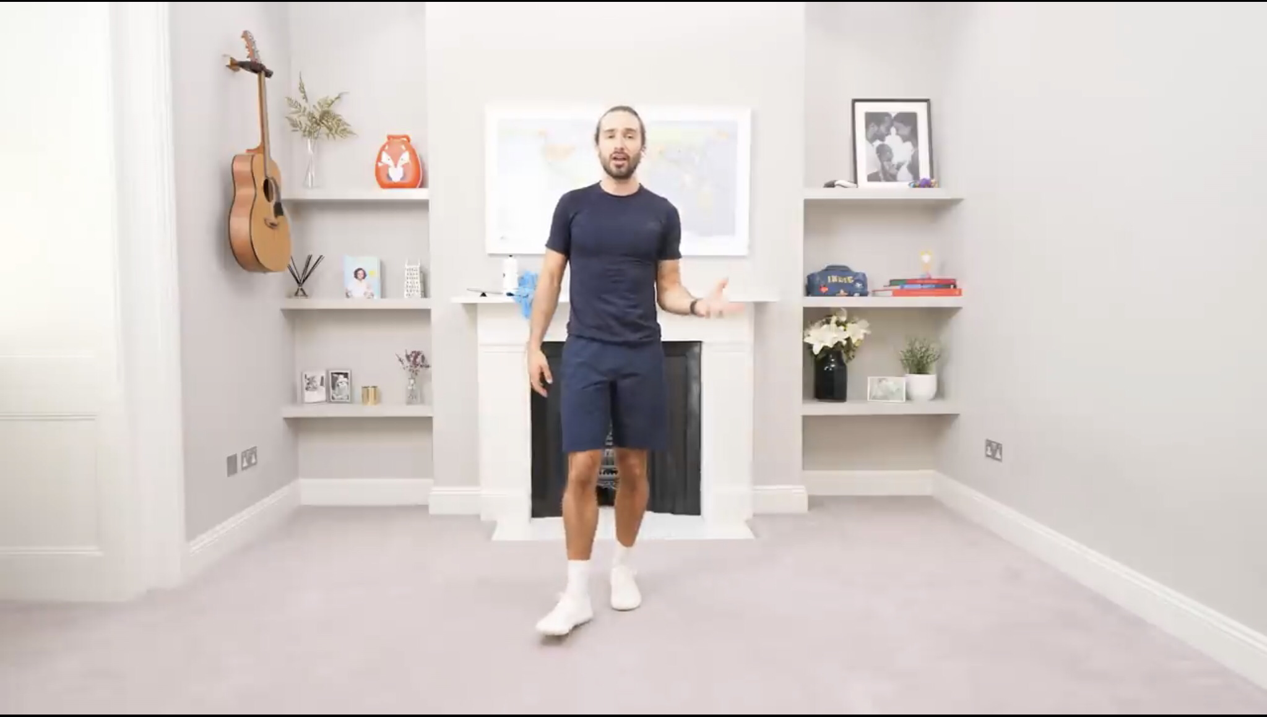
Joe Wicks

Slide 3
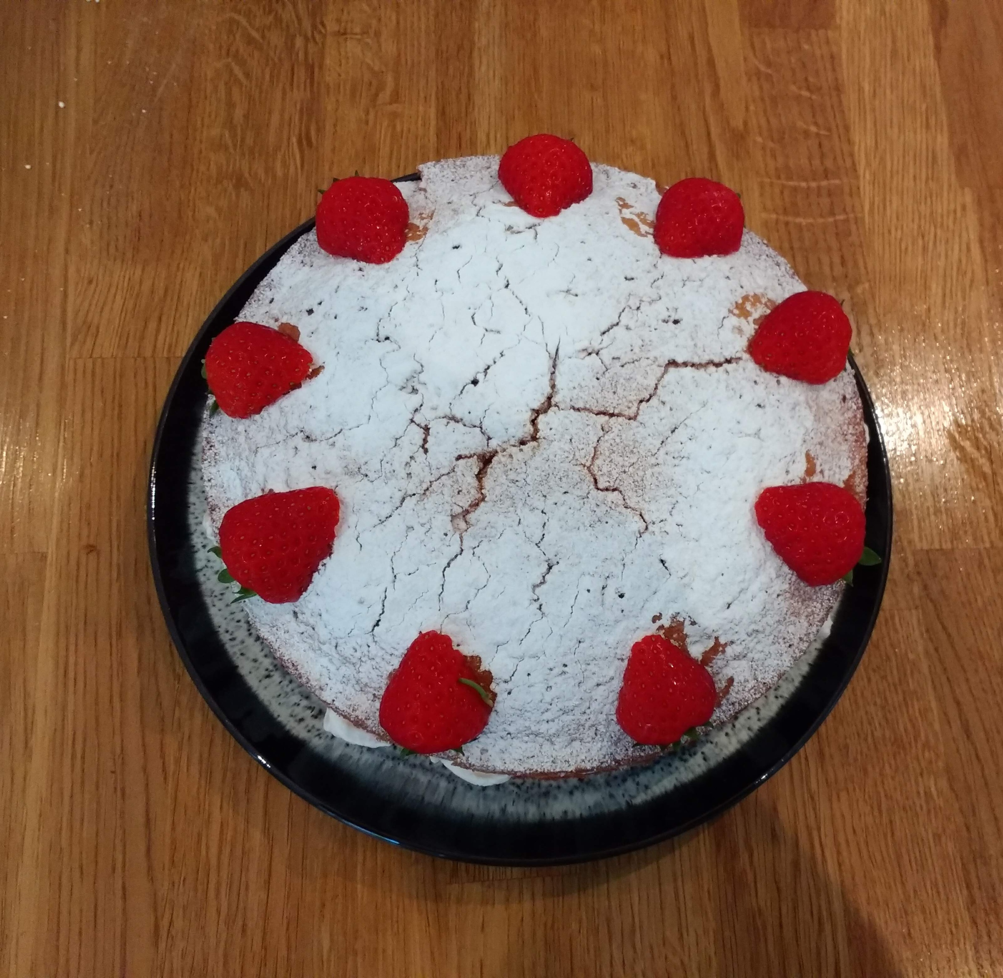
Cooking

Slide 4
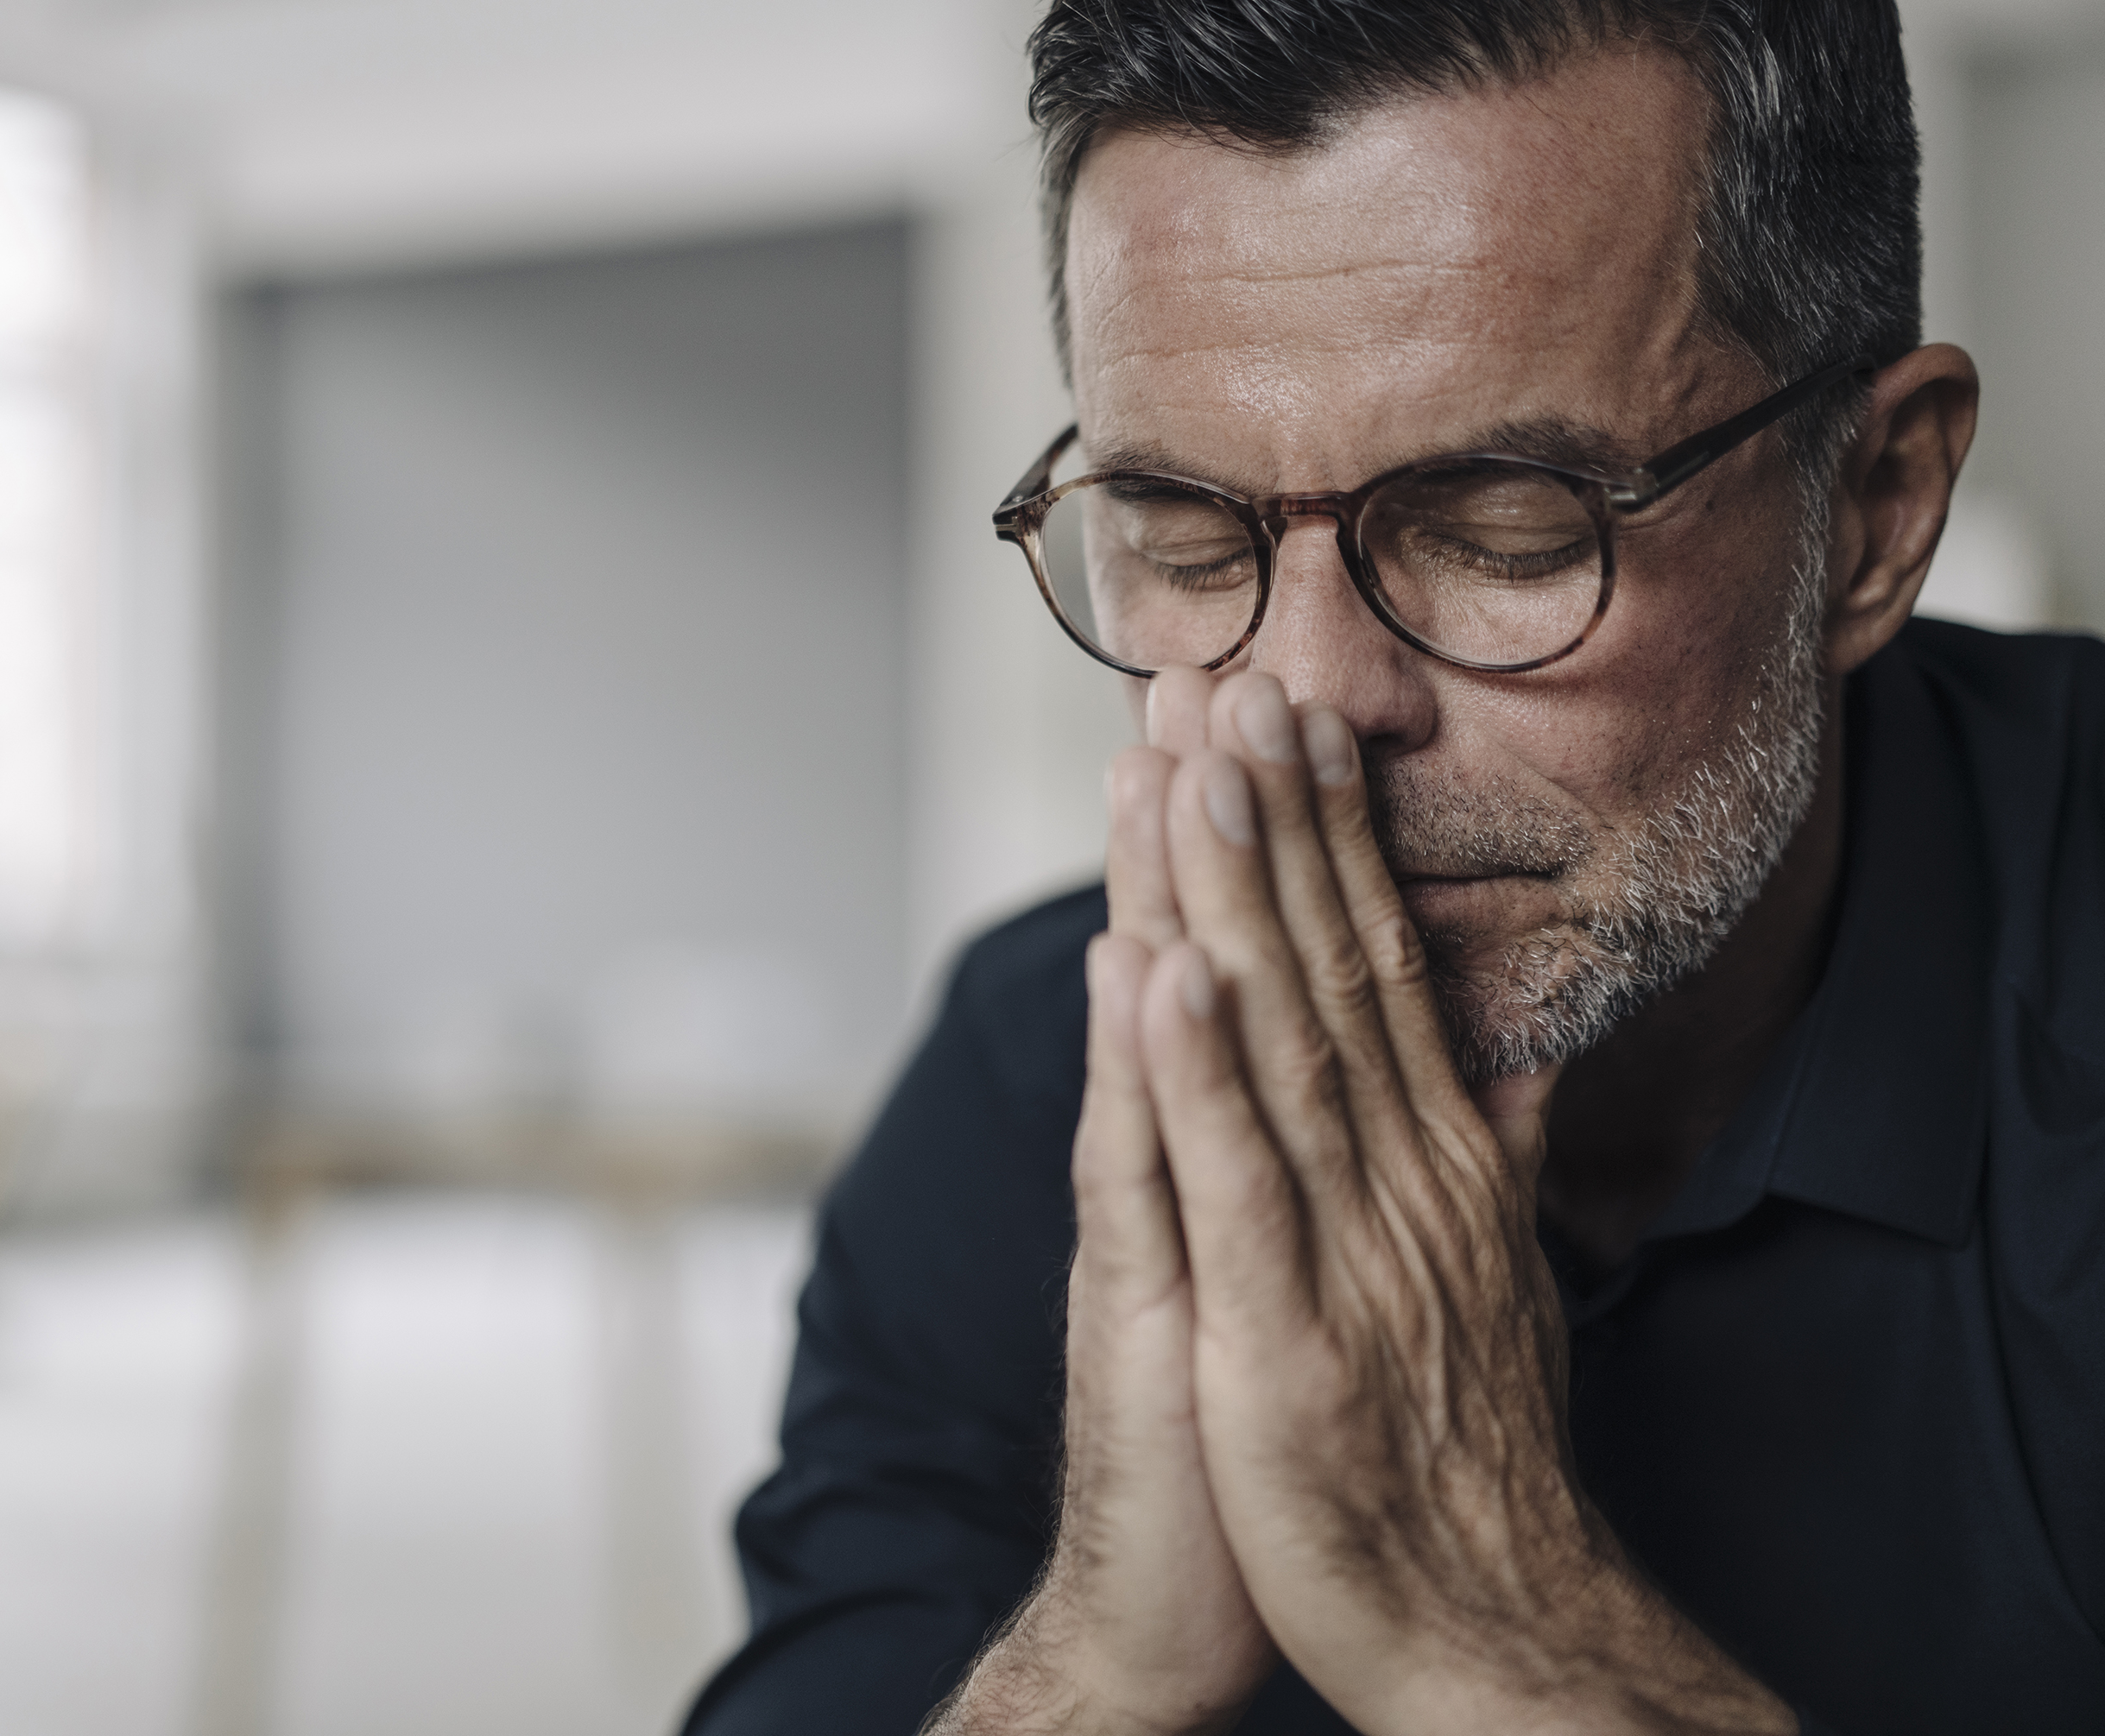

Slide 6
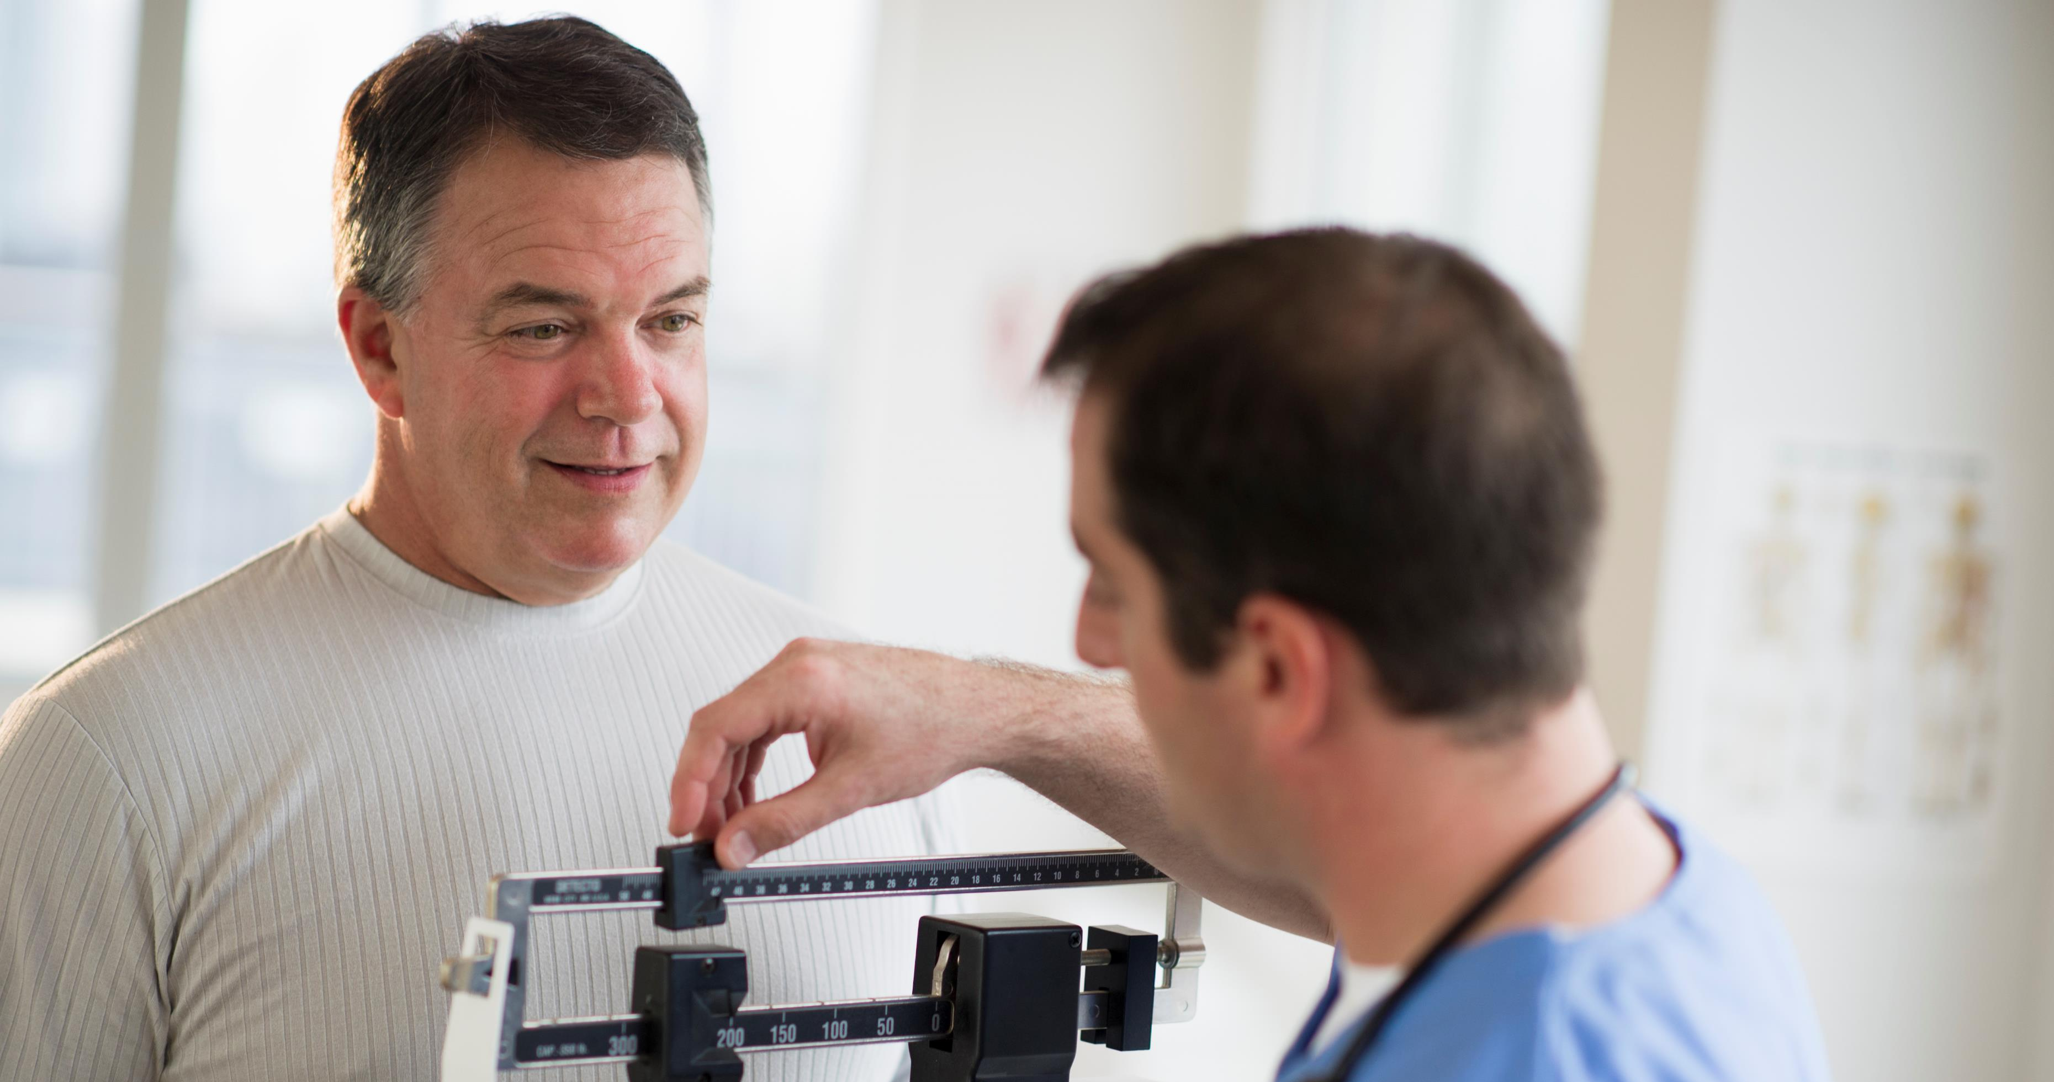

Slide 7
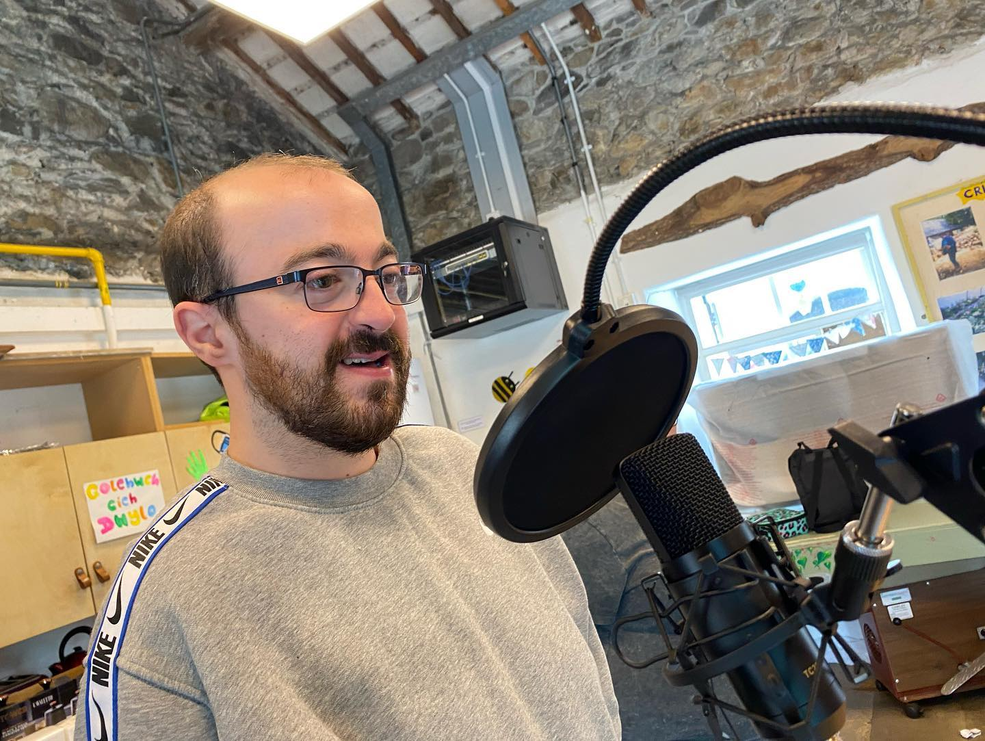
Llwybrau Llesiant
Radio Training

Slide 8
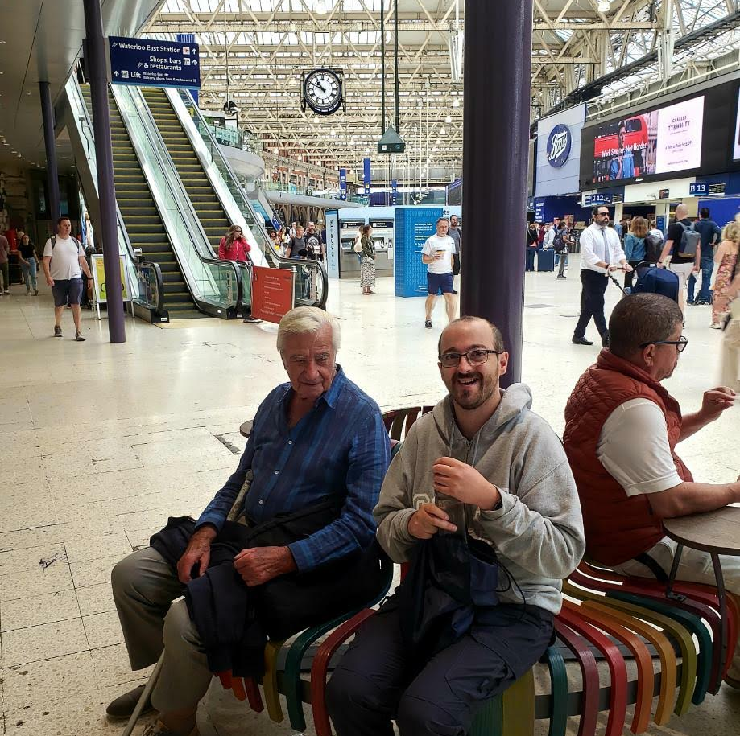
Grandad

Slide 9
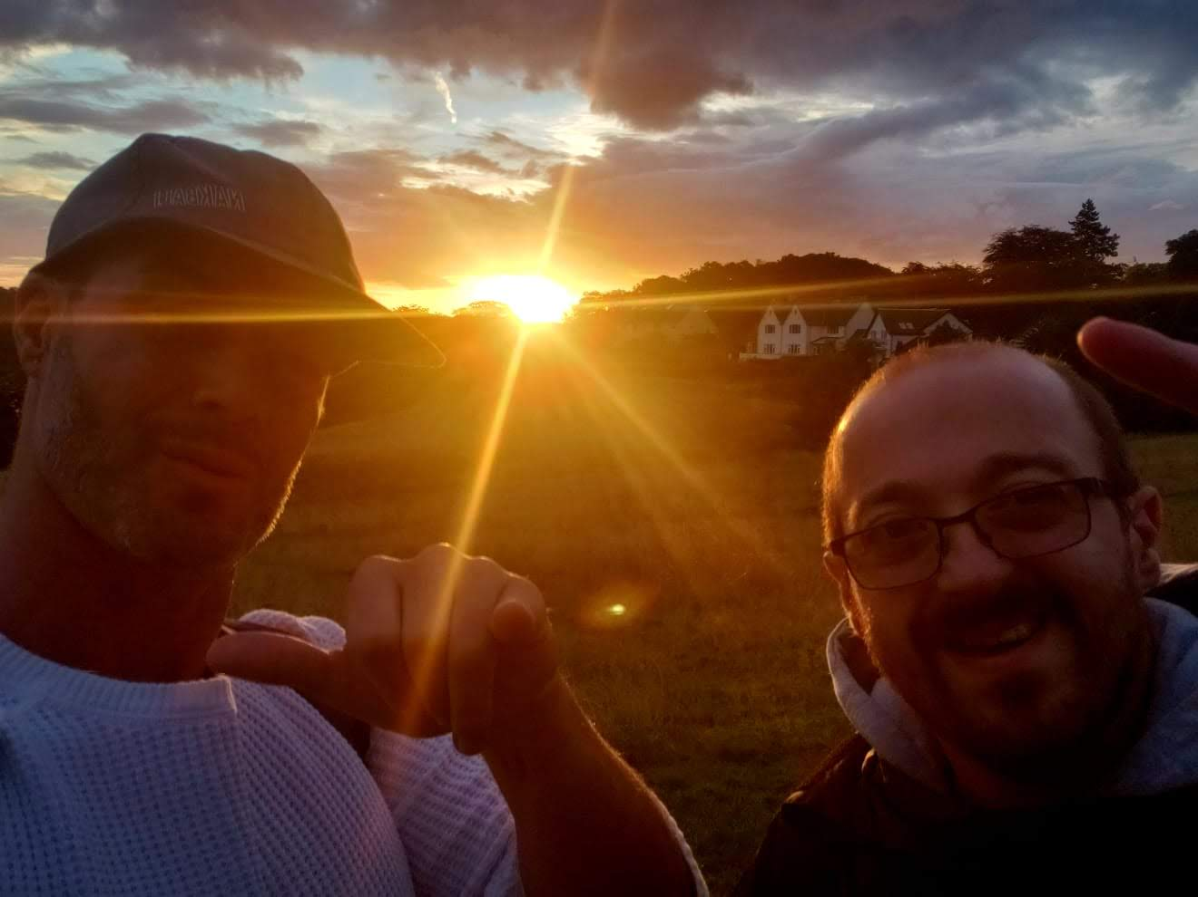
Brother

Slide 10
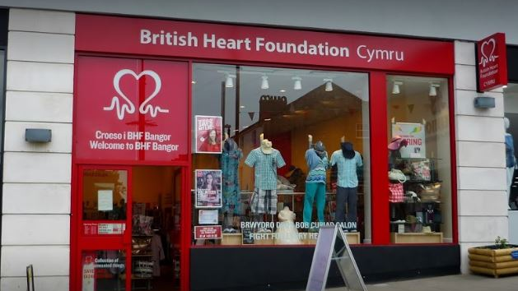
British Heart Foundation

Slide 11
Menter Fachwen

Slide 12
Annedd Ni

Slide 13
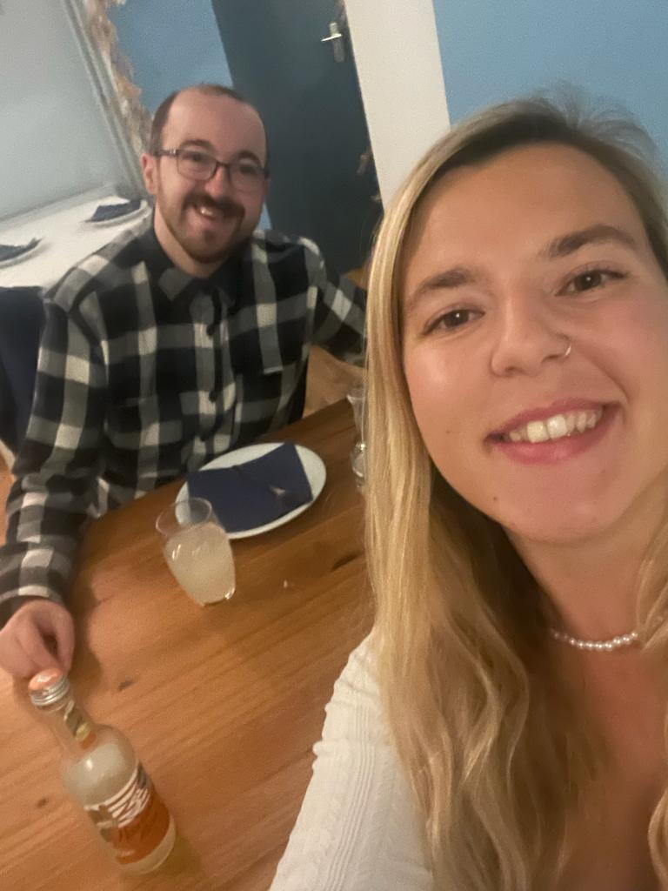
Gig Buddies Cymru
Gig Buddy and I

Slide 14
Bangor University

Slide 15
R.V.S

Slide 16
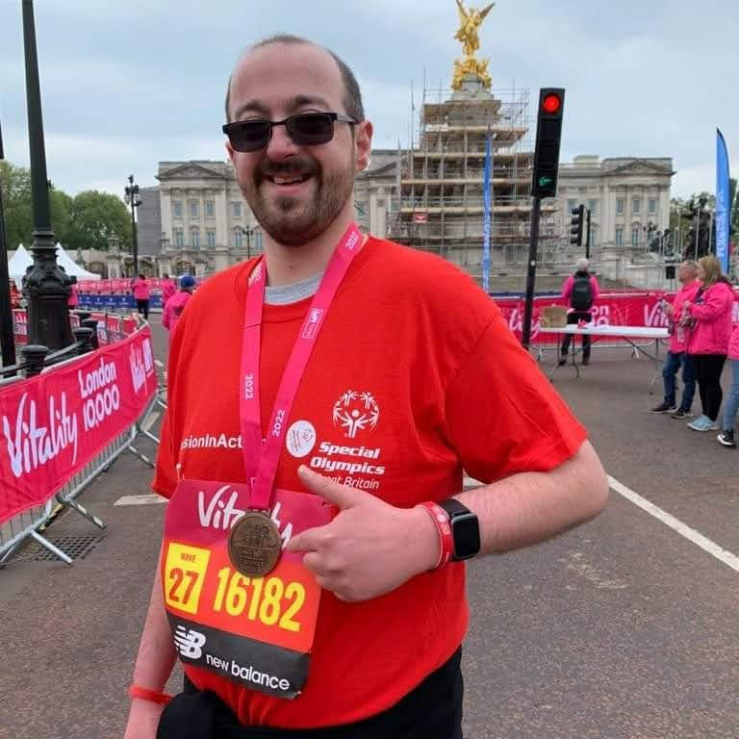

Slide 17
Twitter: paultaylorw
Instagram: paul.wtaylor

