Slide 1
Reducing Restrictive Practice / Lleihau Arferion Cyfyngol by/gan Amanda hartland

Slide 2
Aims of session / Amcanion y sesiwn
1. What are reducing restrictive practices / Beth yw lleihau arferion cyfyngol
2. Overview of Improvement Cymru Grant /
Trosolwg o Grant Gwelliant Cymru
3. Focus group /
Grŵp Ffocws

Slide 3
What are restrictive practices? / Beth yw arferion cyfyngol?
Making someone do something they don’t want to do or stopping someone from doing something that they want to do
Gwneud i rywun gwneud rhywbeth nad ydynt eisiau gwneud neu atal rhywun rhag gwneud rhywbeth maent eisiau gwneud

Slide 4
What are restrictive practices / Beth yw arferion cyfyngol?
Restrictive practice
Physical Restraint
Chemical Restraint
Environmental Restraint
Mechanical Restraint
Blanket rules
Cultural restraint
Psychological Restraint
Arferion Cyfyngol
Ataliaeth Gorfforol
Ataliaeth Gemegol
Ataliaeth Amgylcheddol
Ataliaeth Fecanyddol
Rheolau blanced
Ataliaeth Ddiwylliann-ol
Ataliaeth Seicolegol

Slide 5
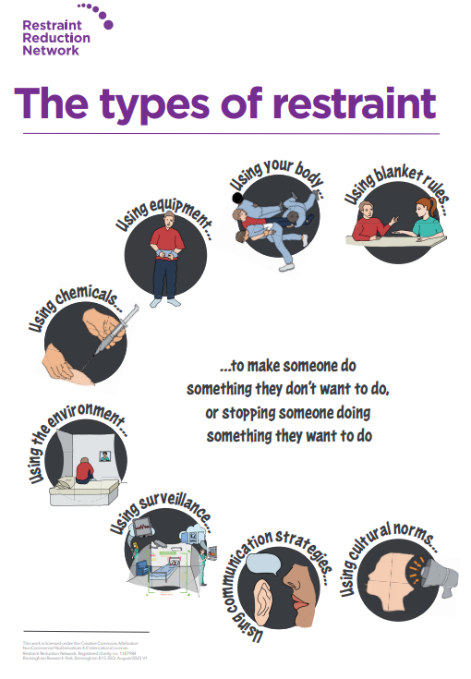

Slide 6
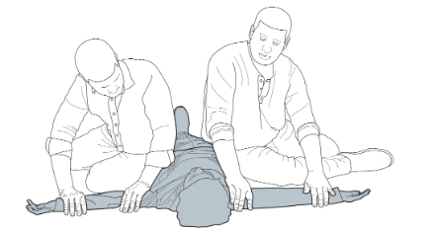
Types of restrictive practices / Mathau o arferion cyfyngol
Physical Restraint
Direct physical contact with a person to prevent, restrict or subdue movements of the body or part of the body of another person
e.g. physical holds, guided movement
Ataliaeth Gorfforol
Cyswllt corfforol uniongyrchol gyda pherson i atal, cyfyngu neu ddarostwng symudiadau'r corff neu gorff o berson arall
e.e.ddaliadau corfforol, symudiad dan arweiniad

Slide 7
Types of restrictive practices / Mathau o arferion cyfyngol
Chemical Restraint
The use of medication or a chemical substance for the primary purpose of influencing a the person’s behaviour
e.g. PRN, sedation
Ataliaeth Gemegol
Defnydd o feddyginiaethau neu sylwedd cemegol ar gyfer pwrpas sylfaenol o ddylanwadu ar ymddygiad person
e.e. PRN, tawelyddu

Slide 8
Types of restrictive practices / Mathau o arferion cyfyngol
Mechanical Restraint
Any device, material or piece of equipment attached to or near a patient that the patient cannot control or easily remove. The intent is to restrict the patient’s free body movement and/or normal access to their own body
e.g. belts/straps, restrictive clothing, bed rails, helmet, splint, seatbelt, harness, wheelchair tray
Ataliaeth Fecanyddol
Unrhyw ddefnydd, deunydd neu ddarn o offer sydd wedi'u cysylltu neu'n agos i glaf nad yw'r claf yn gallu rheoli neu dynnu'n hawdd. Y bwriad yw cyfyngu ar symudiad corff rhydd y claf a/neu fynediad arferol i'w gorff ei hun.
e.e. gwregysau/strapiau, dillad cyfyngol, rheiliau gwely, helmed, sblint, gwregys diogelwch, harnais, hambwrdd cadair olwyn

Slide 9
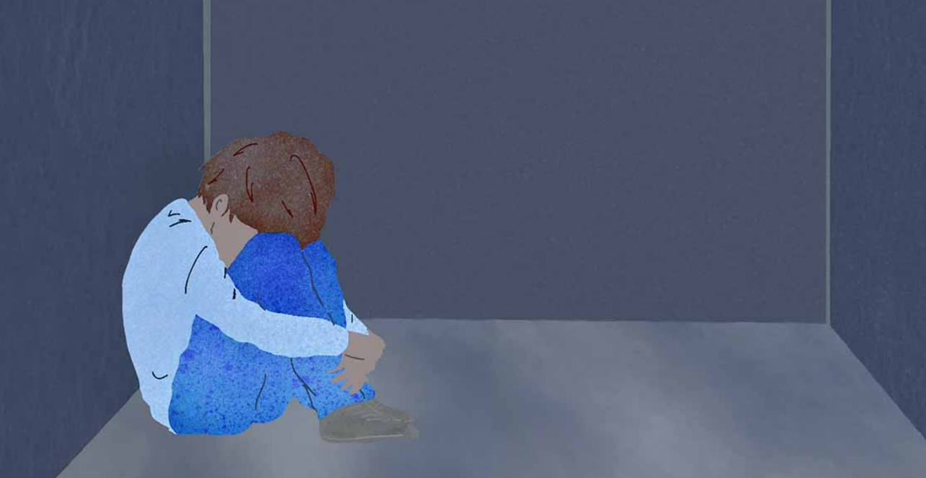
TYPES OF RESTRICTIVE PRACTICE / Mathau o arferion cyfyngol
Environmental Restraint
The use of environmental design or barriers to intentionally restrict a person’s movement in, use of or ability to leave an area
e.g. seclusion, long term segregation, locked/fobbed/coded doors, handles out of reach, window restrictor locks
Ataliaeth Amgylcheddol
Defnyddio dylunio amgylcheddol neu rwystrau i gyfyngu symudiad person yn fwriadol, defnyddio neu allu i adael ardal
e.e. neilltuo, arwahanu tymor hir, drysau cloi / allweddu/codio, handlen y tu allan i gyrraedd, cloeon cyfyngu ffenestri

Slide 10
Types of restrictive practice / Mathau o arferion cyfyngol
Blanket rules
Rules that restrict a person’s liberty and other rights, routinely applied to all people, or to classes of people, or within a service, without individual risk assessments to justify their application.
e.g. no access to kitchen to make food or tea/coffee, no TV after a certain time, bans on certain items, restrictions on family visits, no taking pictures.
Rheolau blanced
Rheolau sy'n cyfyngu ar ryddid unigolyn a hawliau eraill, sy'n cael eu cymhwyso'n rheolaidd i bawb, neu i ddosbarthiadau o bobl, neu o fewn gwasanaeth, heb asesiadau risg unigol i gyfiawnhau eu cais.
e.e. dim mynediad i gegin i wneud bwyd neu de / coffi, dim teledu ar ôl amser penodol, gwaharddiadau ar eitemau penodol, cyfyngiadau ar ymweliadau teuluol, dim tynnu lluniau.

Slide 11
Types of restrictive practices / Mathau o arferion cyfyngol
Cultural Restraint
Using cultural norms to make a person do something they don't want to do or stopping them from doing something they do want to do.
e.g. stopping someone doing something that is important to them, their values, ethnicity or culture, Making someone feel ashamed or humiliated because they are different to someone else.
Ataliaeth Ddiwylliannol
Defnyddio normau diwylliannol i wneud i berson wneud rhywbeth nad ydyn nhw eisiau ei wneud neu ei atal rhag gwneud rhywbeth maen nhw eisiau ei wneud.
e.e. atal rhywun rhag gwneud rhywbeth sy'n bwysig iddyn nhw, eu gwerthoedd, ethnigrwydd neu ddiwylliant, Gwneud i rywun deimlo cywilydd neu gywilydd oherwydd ei fod yn wahanol i rywun arall.

Slide 12
TYPES OF RESTRICTIVE PRACTICE / Mathau o arferion cyfyngol
Psychological Restraint
Any type of communication strategy that puts pressure on people to do something they don’t want to do or stop them from doing something they do want to do.
e.g. inducing fear, ignoring, tone of voice, intimidation, use of threats about actually having things taken away or done to you), visits being monitored
Ataliaeth Seicolegol
Unrhyw fath o strategaeth gyfathrebu sy'n rhoi pwysau ar bobl i wneud rhywbeth nad ydyn nhw eisiau ei wneud neu eu hatal rhag gwneud rhywbeth maen nhw eisiau ei wneud.
e.e. ysgogi ofn, anwybyddu, tôn llais, dychryn, defnyddio bygythiadau ynghylch cael pethau wedi'u tynnu i ffwrdd neu eu gwneud i chi mewn gwirionedd), ymweliadau yn cael eu monitro

Slide 13
WHY IS IMPORTANT TO REDUCE RESTRICTIVE PRACTICES / Pam yw'n bwysig lleihau arferion cyfyngol?
“We need to do our utmost to stop this re-traumatising way of controlling and supposedly caring for people” – Iris Benson
“You just feel destroyed, like your life isn’t your own anymore. And that you are not quite good enough or human enough to exist” Alexis Quinn
“The children aren’t naughty mummy, they are just scared” Callum Morrison
"Rydych chi'n teimlo wedi'ch dinistrio, fel nad eich bywyd chi yw'ch bywyd chi mwyach. Ac nad ydych chi'n ddigon da nac yn ddigon dynol i fodoli. - Alexis Quinn
"Dydy'r plant ddim yn ddrwg mami, maen nhw'n ofnus." - Callum Morrison
“Mae angen i ni wneud ein gorau glas i atal y ffordd ail-drawmatig hon o reoli a gofalu am bobl yn ôl pob sôn” – Iris Benson
Notes:
Detrimental impacts on people: psychological impacts- fear, anger, humiliation, demoralization, dehumamised, degraded, powerless, lonely and isolated, trauma, retraumatisation
Physical impacts- Deep vein thrombosis, choking, incontinence, physical pain, asphisiation, hypertension, death, pressure injuries,
Social impacts

Slide 14
WHY IS IMPORTANT TO REDUCE RESTRICTIVE PRACTICES / Pam yw'n bwysig lleihau arferion cyfyngol?
“I was praying just for someone to take me out of this world when I was in there as I didn’t want to be in this world anymore” Restraint Reduction Network lived experience video
“Most of the things that she is restricted from having from these blanket restrictions being in place prevent them from having a normal life. And how do we expect these people to recover” Restraint Reduction Network lived experience video
"Roeddwn i'n gweddïo dim ond i rywun fy nhynnu allan o'r byd hwn pan oeddwn i yno gan nad oeddwn i eisiau bod yn y byd hwn mwyach" Rhwydwaith Lleihau Atal Fideo Profiad Byw
"Mae'r rhan fwyaf o'r pethau y mae hi wedi'i chyfyngu rhag cael o'r cyfyngiadau cyffredinol hyn ar waith yn eu hatal rhag cael bywyd normal. A sut i ddisgwyl i'r bobl hyn wella" Rhwydwaith Lleihau Atal Fideo Profiad Byw
Notes:
Detrimental impacts on people: psychological impacts- fear, anger, humiliation, demoralization, dehumamised, degraded, powerless, lonely and isolated, trauma, retraumatisation
Physical impacts- Deep vein thrombosis, choking, incontinence, physical pain, asphisiation, hypertension, death, pressure injuries,
Social impacts

Slide 15
How will we reduce them / Sut byddwn ni'n eu lleihau?
All staff and carers trained to recognise what restrictive practices, their detrimental impact and the law that relates to them
Regular and mandatory audits
Restrictive practice reduction plans
Training in preventative approaches such as Positive Behaviour Support
Mae'r holl staff a gofalwyr wedi'u hyfforddi i gydnabod pa arferion cyfyngol, eu heffaith niweidiol a'r gyfraith sy'n ymwneud â nhw
Archwiliadau rheolaidd a gorfodol
Archwiliadau rheolaidd a gorfodol
Hyfforddiant mewn dulliau ataliol fel Cymorth Ymddygiad Cadarnhaol

Slide 16
REDUCING RESTRICTIVE PRACTICE AWARENESS E-LEARNING COURSE / Cwrs E-Ddysgu Lleihau ymwybyddiaeth o arferion cyfyngol
Improvement Cymru Grant to create a Reducing restrictive practice awareness E-Learning course
Free to access and available on Improvement Cymru website, ESR portals and Learning@wales
Co-produced from the beginning- focus groups and reviewers
Grant Gwelliant Cymru i greu cwrs E-Ddysgu ymwybyddiaeth o arferion cyfyngol Lleihau
Cyrchu am ddim ac ar gael ar wefan Gwelliant Cymru, porth ESR a Learning@wales
Cyd-gynhyrchwyd o'r dechrau - grwpiau ffocws ac adolygwyr

Slide 17
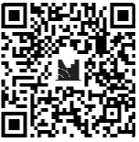
MENTIMETER
Join at menti.com and use the code
16883637
Notes:
what would be most useful to you and other people you work with
Is this a restrictive practice
Do you think all of the people you work with would know that they are restrictions

Slide 18
SIGNPOSTING / Cyfeirio
Restraint Reduction Network
Challenging Behaviour Foundation
British Institute of Learning Disabilities
Email- Amanda.hartland2@wales.nhs.uk
Twitter- @MandyPBSSBUHB

