Slide 1
Rhaglen Gwella Iechyd Genedlaethol Anabledd Dysgu
Learning Disability National Health Improvement Programme
Gwasanaethau Arbenigol / Specialist Services 2022/25
David O’Brien
Uwch Reolwr Gwella
Senior Improvement Manager

Slide 3
Learning Disability Improvement Cymru
Improvement Cymru LD Activity
Welsh Government SLA
Equality &
Inclusion
Physical Health
Specialist Services
Children & Young People
Cross Cutting Activity
Co-production in Improvement
National LD Data Observatory for Wales
Health Checks
Mainstream Services
Education Framework
Community Learning Disability Teams
Workforce Improvement Capacity
National Influencing Activity
Health Equalities Framework
Mortality Reviews & Reporting
Reducing Restrictive Practices
C&YP LD Improvement Pathway
Inpatient Services
Specific Physical Health Initiatives
Constipation
Vaccinations/ Screening
Health Profile
Flagging
Care Bundle
Acute Liaison Nurses
Improvement Programme

Slide 4
Gwelliant Cymru
Anabledd Dysgu
Gweithgaredd AD
Gwelliant Cymru
Welsh Government SLA
Cydraddoldeb a Chynhwysiant
Iechyd Corfforol
Gwasanaethau Arbenigol
Plant a phobl ifanc
Gweithgaredd Trawsbynciol
Cyd-gynhyrchu mewn Gwelliant
Arsyllfa Data AD Cenedlaethol Cymru
Gwiriadau Iechyd
Gwasanaethau prif ffrwd
Fframwaith Addysg
Timau Anabledd Dysgu Cymunedol
Gallu Gwella'r Gweithlu
Gweithgaredd Dylanwadu Cenedlaethol
Fframwaith Cydraddoldebau Iechyd
Adolygiadau ac Adrodd ar Farwolaethau
Lleihau Arferion Cyfyngol
Llwybr Gwella AD Plant a Phobl Ifanc
Gwasanaethau Cleifion Mewnol
Mentrau Iechyd Corfforol Penodol
Rhwymedd Brechiadau/ Sgrinio Proffil Iechyd Fflagio Bwndel Gofal Nyrsys Cyswllt Acíwt
Improvement Programme

Slide 5
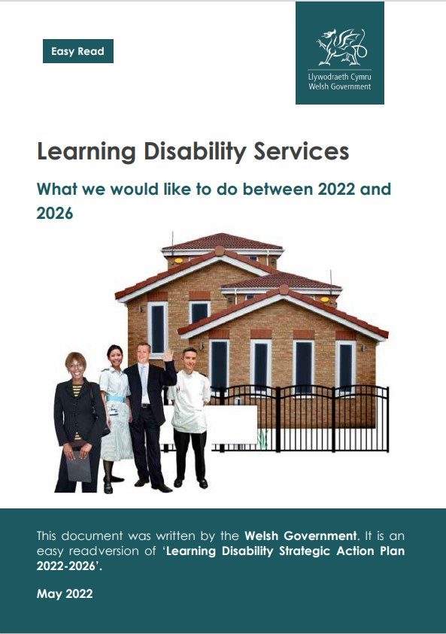
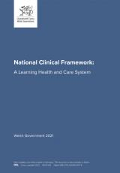
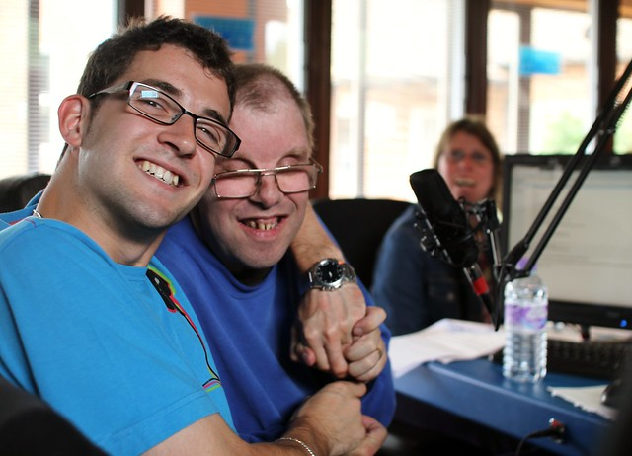
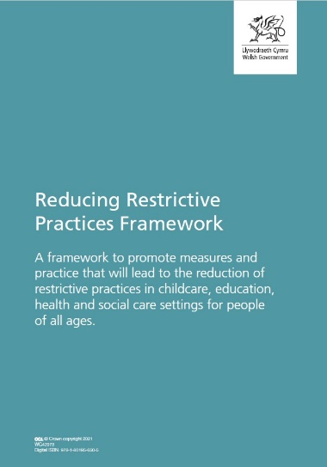
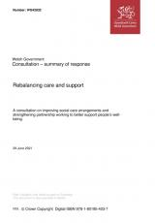
Gwasanaethau Arbenigol | Specialist services
Sbardunau ar gyfer Gwelliant / Drivers for Improvement
Notes:
NATIONAL DRIVERS
Improvement Cymru’s offer to health boards and its partners reflects legacy actions from the Welsh Government Improving Lives programme and recent ambition to build a care system that is able to meet the long-standing challenges it faces described in the National Clinical Framework: A learning health & Care System (2021) .
The Improving Care: Improving Lives (NCCU 2020) review identified seventy recommendations, sixty eight of which are for providers and commissioners of care.
As the NHS, Local Authorities and care providers emerge from the pandemic Welsh Government has described the impact on health and social care, shared lessons learnt and highlighted future priorities in the recent publication of Health and Social Care in Wales – COVID 19: Looking Forward. Organisations are asked to explore new ways of working as they formulate their recovery plans to deliver prudent health and social care services that are safe and has citizens at the centre.
White Paper - Rebalancing care and support: This consultation document seeks views on proposals to introduce new legislation to improve social care arrangements and strengthen partnership working to achieve the vision set out in the Social Services and Well-being (Wales) Act 2014 for people who need care and support and carers who need support.

Slide 6
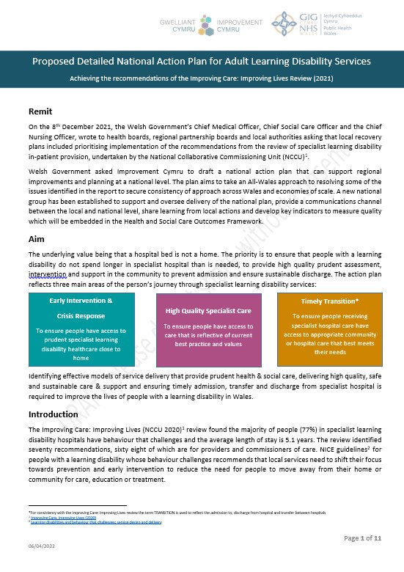
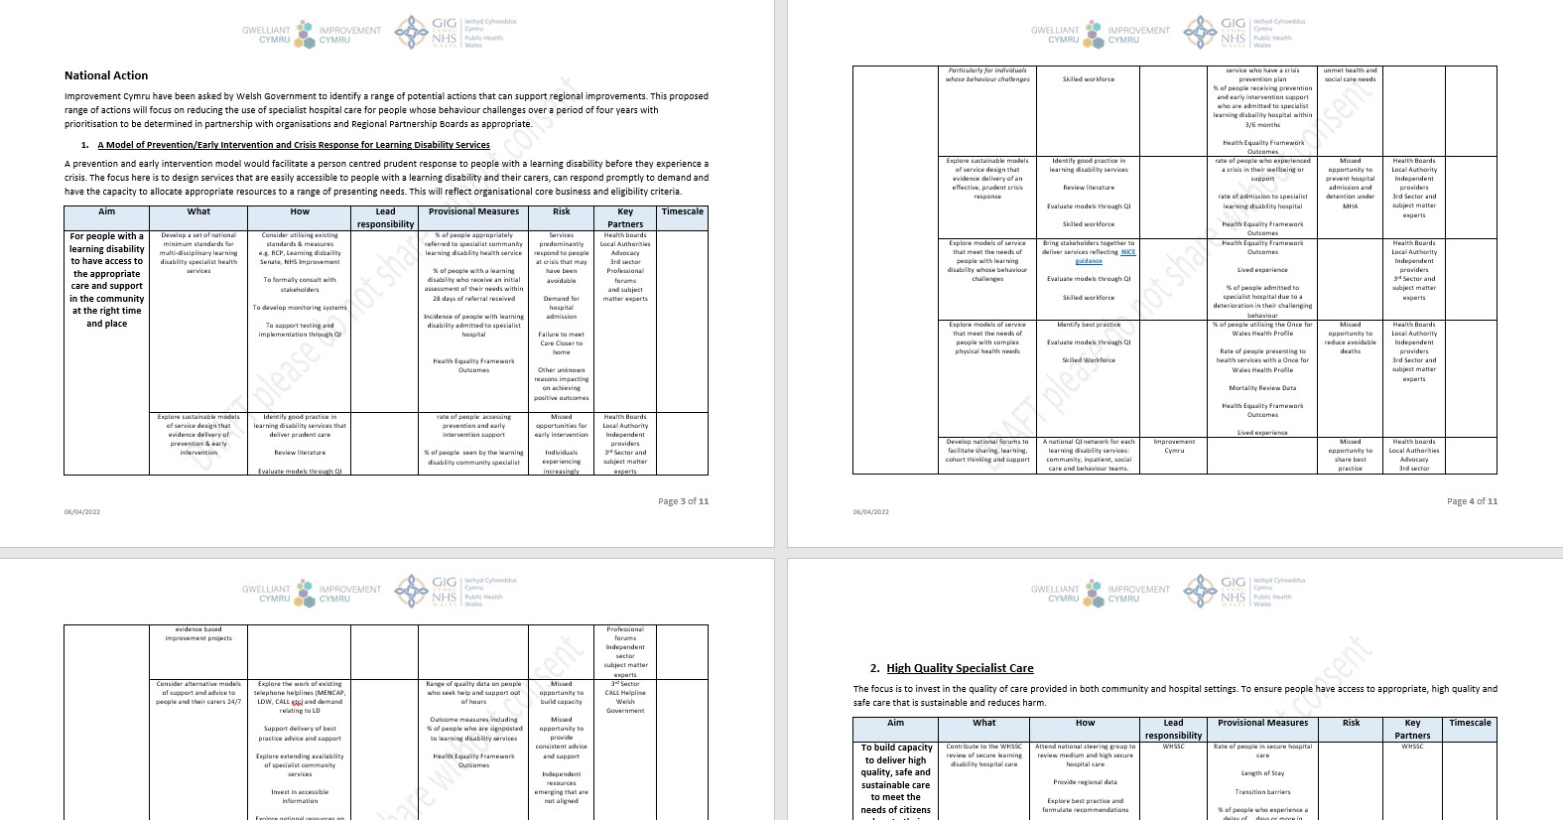
Anabledd Dysgu - Grŵp Gweithredu a Sicrwydd Cenedlaethol (LD-NIAG)
Learning Disability - National Implementation
and Assurance Group (LD-NIAG)
Notes:
Established by Welsh Government - a multi-agency/ stakeholder national group to advise and oversee delivery of the national action Plan.
Reports to the office of Chief Nursing and Social Care Officers.
Driving improvement in specialist services
Gives advice to:
The Ministerial Advisory Group for Learning Disability
Health Board Chief Executives
Local Authority Chief Executives
Health Board Executive Nurse Directors Group
The Association of Directors of Social Services
Regional Partnership Board Leads
Membership:
Regional Partnership Boards
Health boards
Local authorities
Learning disability third sector consortium
Welsh Local Government Association
Health Education and Improvement Wales
Healthcare Inspectorate Wales
Care Inspectorate Wales
Welsh Government
Improvement Cymru
The national implementation & assurance group sets out to achieve:
high quality, prudent and sustainable support to enable people with a learning disability with complex needs, to live in a community setting with the right support.
effective early intervention and support that will promote independence and reduce harm
prudent response and management within the community to people, carers and their families in a crisis.
timely access to and discharge from specialist hospital care close to home
a reduction in the use of restrictive practices through the delivery of non-pharmaceutical interventions and appropriate environments
consider the implications of the Welsh Health Specialised Services Committee (WHSSC) all Wales secure hospital review
Promote a robust quality management system across services that include quality, planning, improvement and control and enable learning environments.
Including reducing reliance on the use of pharmaceutical therapeutics to manage behaviour that challenges (anti-psychotics, anxiolytics and hypnotics medication)

Slide 7
Gwasanaethau Arbenigol | Specialist services
Strategaeth / Strategy
Cynllun Gweithredu / Action Plan
Ymyrraeth Gynnar ac Ymateb i Argyfwng
Early Intervention & Crisis Response
Canlyniadau / Outcomes
LD-NIAG
Gofal Arbenigol o Ansawdd Uchel
High Quality Specialist Care
Transnewid Amserol
Timely Transition
Notes:
Inpatient
We aim to:
Ensure that specialist hospital care in Wales for adults with a learning disability is fit for purpose and can respond to future demand.
Reduce length of stay in specialist hospital through the provision of high quality, safe and effective specialised inpatient care.
Reduce length of stay in specialist hospital through the timely transition to appropriate support in the community
Community
We aim to:
Providing people with access to prudent specialist learning disability healthcare close to home through increased community based early intervention and crisis support.
To ensure people have access to care that is reflective of current best practice and values in the community. The access to high quality, safe and effective specialised health care close to home can lead to improve outcomes for people.
To ensure people in specialist hospital can transition to their local communities in a timely manner through the provision of high quality sustainable provision of care.

Slide 8
Atal, Ymyrraeth Gynnar ac Argyfwng
Prevention, Early Intervention & Crisis
Sicrhau bod pobl ag anabledd dysgu yn cael mynediad at ofal arbenigol darbodus yn agos at eu cartrefi
To ensure people with a learning disability have access to prudent specialist care close to home
Ysbyty / Hospital
Tîm Gweithredu Iechyd/Cyswllt
Health Action Team/Liaison
TCAD / CTLD
Maint cywir / Right sizing
Canlyniadau gwell / Improved outcomes
Data wedi'i hysbysu / Data informed
Adnoddau / Resourced
Partneriaeth / Partnership
Wedi'i gydgynhyrchu / Coproduced
Notes:
Develop a set of national minimum standards for NHS
Explore sustainable models for multiagency crisis response
Explore sustainable models for multiagency early intervention/prevention

Slide 9
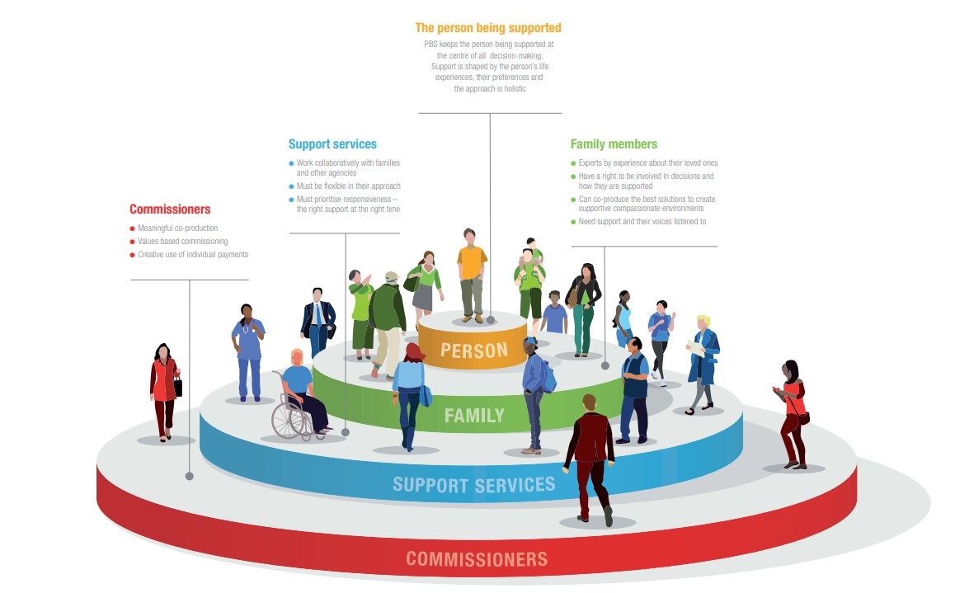
Gofal Arbenigol o Ansawdd Uchel High Quality Specialist Care
Sicrhau bod pobl yn cael mynediad at ofal sy'n adlewyrchu arfer gorau a gwerthoedd cyfredol
To ensure people have access to care that is
reflective of current best practice and values
Grwpiau arbenigol / Expert groups
Dull Cymru gyfan / All Wales approach
Wedi’I gydgynhyrchu / Coproduced
Darbodus / Prudent
Newid ymddygiad / Behaviour change
Data wedi’I hysbysu / Data informed
Canllawiau NICE / NICE Guidance
Partneriaeth / Partnership
Ansawdd a Diogelwch / Quality & Safety
Notes:
Develop a process for recording restrictive practice in NHS
Promote the use of non-pharmaceutical interventions
To reduce use of restrictive practices
To increase the % of eligible people in receipt of reasonable adjustments
To reduce variability across NHS of access to therapies
To reduce variability across NHS of core business of specialist LD services
To reduce variability across NHS of access to high quality Positive Behaviour Support
To increase use of Health Equality Framework

Slide 10
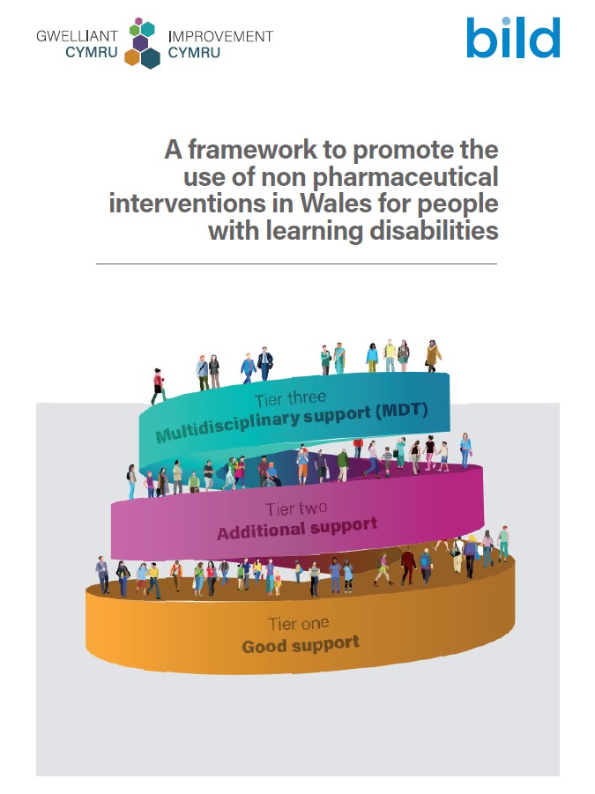
Gofal Arbenigol o Ansawdd Uchel
High Quality Specialist Care
https://phw.nhs.wales/services-and-teams/improvement-cymru
Notes:
Develop a process for recording restrictive practice in NHS
Promote the use of non-pharmaceutical interventions
To reduce use of restrictive practices
To increase the % of eligible people in receipt of reasonable adjustments
To reduce variability across NHS of access to therapies
To reduce variability across NHS of core business of specialist LD services
To reduce variability across NHS of access to high quality Positive Behaviour Support
To increase use of Health Equality Framework

Slide 11
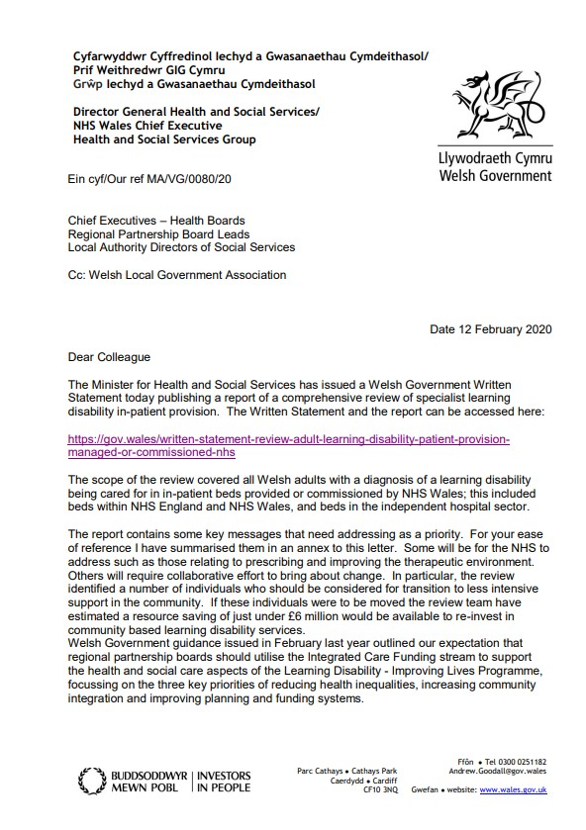
Trawsnewid Amserol / Timely Transition
Sicrhau bod pobl sy'n derbyn gofal ysbyty arbenigol yn cael mynediad at ofal cymunedol neu ysbyty priodol sy'n diwallu eu hanghenion orau
To ensure people receiving specialist hospital care have access to community or the appropriate hospital care that best meets their needs
Maint cywir / Right Size
Partneriaeth / Partnership
Lleihau PoCD / Reduce PoCD
Gweithio Galluog
Capable Workforce
D2RA
Lleihau Hyd Arhosiad / Reduce Length of Stay
Lleihau Aildderbyn / Reduce Readmission
Notes:
Understand the implications of WHSSC Secure inpatient review
Develop data to analyse LD inpatient use and population
Develop national assurance dashboard/metrics
Support regions to deliver improvements in patient flow
Explore models for sustainable community provision
Improve access to therapies

Slide 12
Unrhyw gwestiynau?
Any questions?
Notes:
11:45 am

