Slide 1
Beth gall y Rhwydwaith Cefnogi Ymddygiad Cadarnhaol ei wneud i chi?
What can the PBS Network do for you?
Shell Williams a Kathryn Whitfield.
Notes:
My name is Shell Williams and I am co chair of the North Wales Together Board.
I co chair with Neil Ayling, Chief Officer for Flintshire County Council.
…and my name is Kathryn Whitfield.
I am programme Manager for the North Wales Together programme.
Jonathan has asked us to present a session where we talk about what a Positive Behaviour support network could do for you.

Slide 2


Cefndir
Background
Gogledd Cymru Gyda’n Gilydd.
Integreiddio rhanbarthol. Wedi’i ariannu tan 2027.
Arloesi a chyflawni prosiectau a fydd yn elwa o gael eu darparu'n rhanbarthol.
Technoleg
Llety
Iechyd
Newid cymunedol a diwylliannol
Plant a phobl ifanc
Cyflogaeth
North Wales Together.
Regional integration. Funded to 2027.
Innovation and delivery of projects that will benefit from being delivered regionally.
Technology
Accommodation
Health
Community and culture change
Children and young people
Employment
Notes:
North Wales Together is a Regional project funded through Welsh Government monies until 2027.
The programme works on 6 workstreams, helping to develop approaches that would benefit from being delivered regionally.
The programme follows the North Wales LD strategy.
Our workstreams are Accommodation, Health, Technology, Communities, Children and young people and employment.
.
Examples of some of our projects are;
The health check champions, where people with Learning disabilities have a real job and are paid to talk to other people about health checks and screening.
The family transitions project run by Conwy Connect.
The supported employment project in Conwy and Denbighshire. I will soon be available to all of North Wales.
The mindfulness project and app rolled out by Dr Ceryl Davies from Bangor University.
Gig buddies.
The North Wales Flyers, the North Wales Self Advocacy group, have helped choose projects that will be funded.
£1 million has been spent on these projects over the last 4 years.

Slide 3
Model Gofal/Model of Care
Model gofal llety.
Llety
Gweithlu
Gofal canolradd.
Accommodation model
of care.
Accommodation
Workforce
Intermediate care.
Notes:
Within the Accommodation work stream, we follow a model of care that deals with
Accommodation planning, skilling up the workforce to support people with more complex needs and crisis/intermediate care.
We are;
Working to support accommodation planning in various ways across various authority areas and health.
There are around 300 people with LD on supported accommodation waiting lists across the area and only 100 placements in the pipeline and about 30 vacancies available.
Working to help skill up the workforce in relation to PBS. This is part of that work.
Supporting the development of step up step down facilities East West and central.
At the moment there is no alternative for people in crisis other than hospital admission or placements with private providers, often out of area. That risks people getting stuck in those placements for years and services want to change that.
We fund a project manager in BCUHB to take that work forward.

Slide 4
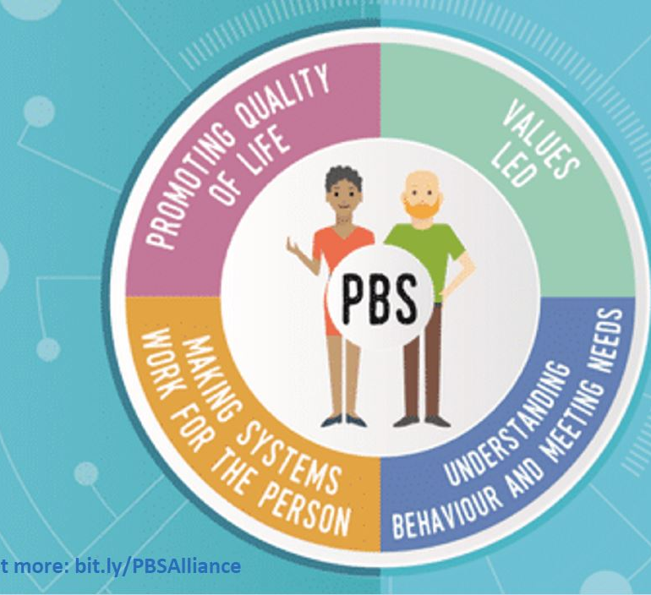
CYC PBS
Mae Jonathan Crabb yn arwain ar strategaeth CYC(PBS) ar gyfer y rhanbarth.
Cynaladwyedd yn greiddiol iddo.
Ariannu hyfforddiant PBS
Datblygu cynllun gweithredu.
Cefnogi'r COP tuag at aeddfedrwydd!
Jonathan Crabb is leading on a PBS strategy for the region.
Sustainability at its core.
Funding PBS training
Developing an implementation plan.
Supporting the COP towards maturity!
Notes:
The Positive behaviour support work is part of the accommodation model of care and it has its own delivery plan.
Jon Crabb leads on this work. He is
Developing an implementation plan for the region,
And supporting the COP to develop into a self sustaining group.
We are also funding PBS qualifications across the region. We have just put out the third round of invitations to apply for funding. Closing date is 20th Feb. .

Slide 5
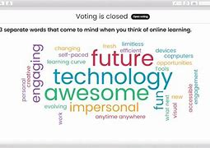
Beth yw diben posibl y rhwydwaith Cefnogi Ymddygiad Cadarnhaol?
What purpose could the PBS network serve?
Notes:
David O Brien is going to help us with this bit.
In a minute, we will give you a link to a site called menti meter.
The menti meter site will ask you to put in a code.
When you have put in your code, the site will ask you to answer some questions.
The answers you give will show up on the screen.
It will look like this picture.
We hope this will help us to think about what a North Wales PBS network might look like.

Slide 6
Beth mae Deallusrwydd Artiffisial yn ei ddweud?!What does Artificial Intelligence say?!
A health and social care network serves as a system that facilitates communication, collaboration, and information exchange among various healthcare and social care entities.
The primary purpose of such a network is to improve the quality, efficiency, and effectiveness of healthcare and social services.
In summary, a health and social care network plays a crucial role in fostering collaboration, improving information flow, and enhancing the overall quality of care and support provided to individuals in need of healthcare and social services.
Mae rhwydwaith iechyd a gofal cymdeithasol yn system sy'n hwyluso cyfathrebu, cydweithio a chyfnewid gwybodaeth ymhlith amrywiaeth o endidau gofal iechyd a gofal cymdeithasol.
Prif ddiben rhwydwaith o'r fath yw gwella ansawdd, effeithlonrwydd ac effeithiolrwydd gofal iechyd a gwasanaethau cymdeithasol.
I grynhoi, mae gan rwydwaith iechyd a gofal cymdeithasol ran hanfodol wrth feithrin dulliau cydweithio, gwella llif y wybodaeth, a gwella ansawdd cyffredinol y gofal a’r cymorth sy’n cael ei roi i unigolion y mae angen gofal iechyd a gwasanaethau cymdeithasol arnynt.
Notes:
Before we go into groups. I will share a little experiment with you all.
AI is everywhere. There is quite a bit of noise being made at the moment about what AI can do and why that is a good or bad idea.
Create an image that looks like a real person.
Write your essays for you.
Translate stuff.
The down side is it can produce total nonsense.
I tried to ask AI to write me a definition of a health and social care network.
It said this.
It also said a load of other rubbish. ..

Slide 7

Beth yw’r sefyllfa erbyn hyn?
Where are we now?
Beth sy'n gweithio'n dda o ran darparu rhwydwaith Cefnogi Ymddygiad Cadarnhaol da?
Beth sy'n anodd o ran darparu rhwydwaith Cefnogi Ymddygiad Cadarnhaol da?
What is working well in providing good PBS?
What is proving difficult in providing good PBS?
Notes:
As part of this discussion we should start with where we are now.
In your tables, please could you discuss what is working well and what is not working with PBS across the region at the moment.
I will give you 5 mins then ask you to shout out rather than have all tables feed back.
5 mins
5 mins room feedback

Slide 8

Sut beth fyddai’r rhwydwaith?
How would the network look?
Pa fath o gymorth hoffech chi ei gael gan y gynghrair?
Oes gennych chi unrhyw rwydweithiau Cefnogi Ymddygiad Cadarnhaol presennol?
Sut hoffech chi allu cyfathrebu ag aelodau?
What sort of help would you like from the alliance?
Have you got any existing PBS networks?
How would you like to be able to communicate with members?
Notes:
For this part please could you Nominate a lead to feed back.
Please could you spend 10 mins discussing what a network could do and what it would look like.
The questions are on the overhead.
10 mins feedback.

Slide 9
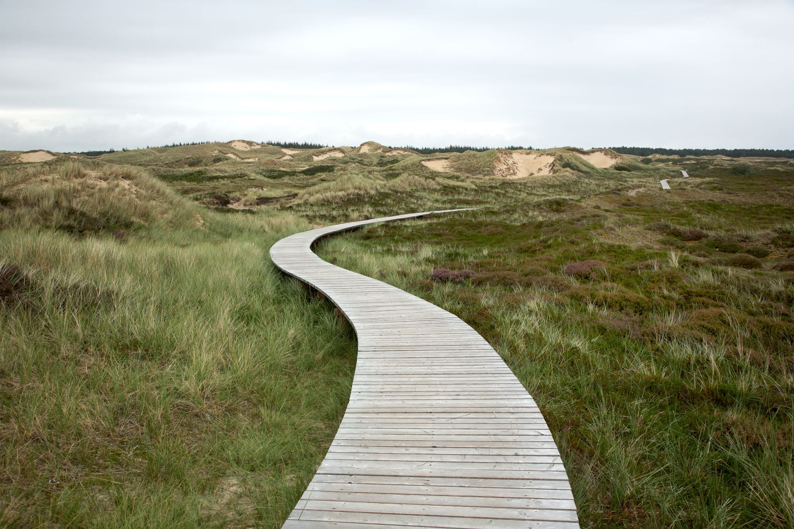
Cylch Gorchwyl
Terms of reference
Beth ddylai’r grŵp gael ei alw? (Rhwydwaith Cefnogi Ymddygiad Cadarnhaol Gogledd Cymru neu Gynghrair Cefnogi Ymddygiad Cadarnhaol Gogledd Cymru) efallai fyddai’r prif ddewisiadau
Pwy ddylai fod ynddo? A ddylai hwn fod ar gyfer anableddau dysgu yn unig?
Pa mor aml ddylai fod?
Lle dylid ei gynnal?
What should the group be called? (North Wales PBS Network or North Wales PBS Alliance) perhaps being primary options
Who should be in it? Should this be limited to LD?
How often should it be?
Where should it be held?
Notes:
Next we will need to construct Terms of reference for the group.
Please could you spend 10 mins discussing what the next steps could be
10 mins feedback.
What should the group be called? (North Wales PBS Network or North Wales PBS Alliance) perhaps being primary options
Who should be in it? Should this be limited to LD?
How often should it be?
Where should it be held? (is Llandudno Junction ok?)

Slide 10

Camau nesaf?
Next steps?
Pwy sydd angen gwneud beth?
Beth sydd angen digwydd nesaf?
Who needs to do what?
What needs to happen next?
Notes:
Room discussion. 10 mins.
Pulling the themes from the discussion together. And feeding back.
Summing up.

